Slide 2
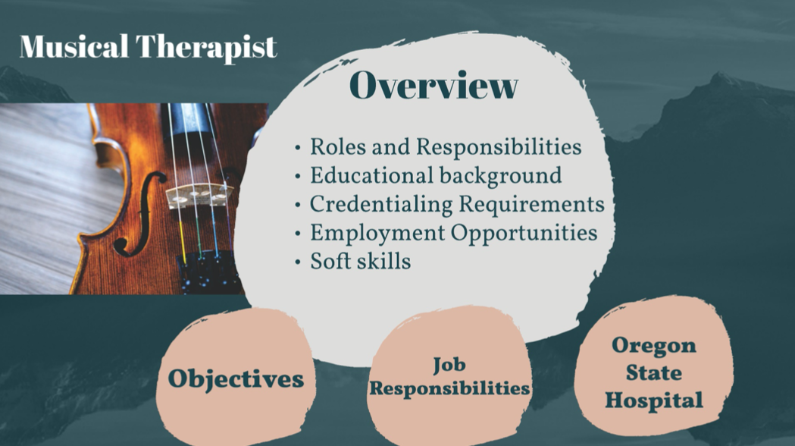

Slide 5
Notes:
https://youtu.be/zcDyZmL_q0Y

Slide 10
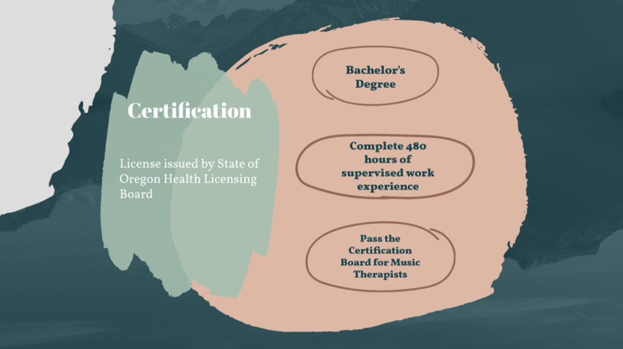

Slide 13
Notes:
https://oshmuseum.org/musical-therapist/

Slide 14
Notes:
https://docs.google.com/forms/d/e/1FAIpQLSfon72xhPX10PnyMmqHf7YVsCEKBlElM_CfXxakT_PXmMp9nA/viewform?usp=sf_link

