Slide 1
Careers in Healthcare Overview
By Carmen Boone

Slide 2
Objectives
Compare
Differentiate
01
03
Explain
Describe
02
04
requirements for associate’s, bachelor’s, master’s, and doctorate degrees
certification, registration, and licensure
the differences between education institutions
three different healthcare career options

Slide 3
Education Requirements
Requirements vary by program and state
Preparation begins in high school
Career and Technical Ed.
Sciences, social studies, English, and mathematics
Knowledge of computer applications, keyboarding, and accounting skills
Program offered in high school
Students develop employability skills
Notes:
Requirements vary by program and state
Preparation begins in high school
Sciences, social studies, English, and mathematics
Knowledge of computer applications, keyboarding, and accounting skills
Health Science Technology Ed. (HSTE)/Career and Technical Ed. (CTE)
Program offered in high school
Students develop employability skills

Slide 4
Post-secondary education (after high school)
Associate’s (2 years):
Career/technical school
Community College
Bachelor’s (>4 years):
Community College
University
Master’s (>1 year):
University
Doctor’s degree (>2 years):
University
Notes:
Bachelor’s offered by colleges: 23 states community colleges offer bachelor’s. Since Dec 2019 all 17 community colleges in Oregon can, but need to comply some requirements, due to Covid19, there’s a waiting period. https://www.bendbulletin.com/localstate/education/oregon-community-colleges-can-now-offer-4-year-degrees-but-cocc-will-wait/article_afef03ea-33d0-11ea-9c4c-f768e38990e5.html#:~:text=This%20year%20marks%20the%20first,students%20will%20have%20to%20wait.&text=Community%20colleges%20must%20prove%20that,one%20that%20is%20hands%2Don.
Doctorate, doctoral, or doctor’s degree, some may require 4 to 6 years

Slide 5
Certification, Registration, and Licensure
Purpose: To ensure skill and competence and protect the patient
Certification:
Shows that you have achieved a set of specific skills or knowledge. Certifications are usually offered by a professional association or government agency that regulates a given career.
Registration:
requires by some healthcare careers. Involves the filing of name, address and qualifications before practicing the field of expertise. Done by a regulatory body, which maintains a current list of qualified professionals.

Slide 6
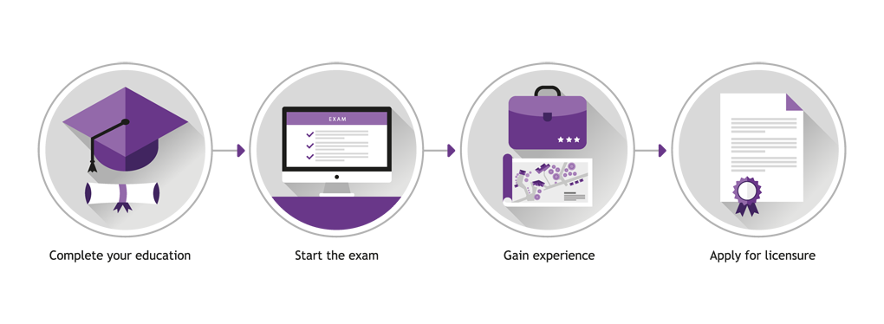
Licensure
Authorization to work in a specific occupation, validated by a government agency.
To keep a license requires fulfilling an educational program, a state board test, and maintenance of standards.
Notes:
https://www.clarb.org/learn-about-licensure

Slide 7
Accreditation
Purpose:
To ensure that one graduates from a program with established quality standards.
It’s important to choose a technical school, college, or university that offers an accredited program before enrolling.
You can contact these agencies to find out if a program is accredited.
Commission on Accreditation of Allied Health Education Programs (CAAHEP)
Accrediting Bureau of Health Education Schools (ABHES)

Slide 8
Continuing Education (CE, CME)
Hours of education required to maintain/renew certification, license, or registration
Varies by state and health career
Hours are accrued during a given period of time

Slide 9
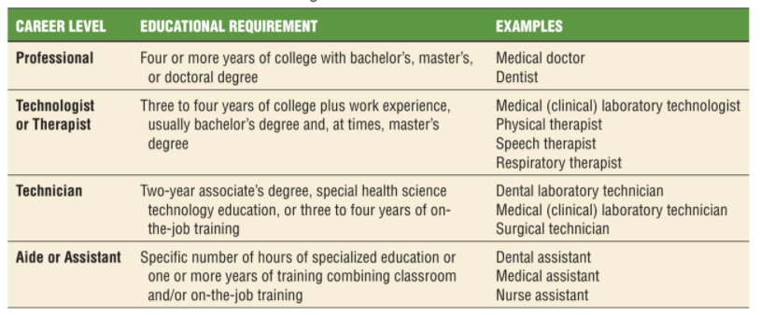
Education and Levels of Training

Slide 10
Healthcare Pathways
Biotech
R&D
Support Services
Diagnostic Services
Health Informatics
Notes:
Diagnostic Services
Therapeutic Services
Health Informatics
Support Services
Biotechnology Research & Development

Slide 11
Therapeutic Services
Dental Careers
Emergency Medical Services Careers
Medical Careers
Mental and Social Services Careers
Mortuary Careers
Nursing Careers
Nutrition and Dietary Services Careers
Veterinary Careers
Vision Services Careers
Other Therapeutic Services Careers
Notes:
The therapeutic services pathway is the most popular pathway in health science.
It’s focused on working with patients to provide care, treatment, or counseling to improve the patient’s status over time.

Slide 12
Diagnostic Services
Cardiovascular Technologist
Clinical Laboratory Technologist
Dental Laboratory Technician
Diagnostic Medical Sonographer
Diagnostic Molecular Scientist
EKG Technician
Histotechnologist
Medical Laboratory Technician
MRI Technologist
Nuclear Medicine Technologist
Pathologist
Pathologist Assistant
Phlebotomist
Radiology Technician
Notes:
The diagnostic services pathway is made up of careers that use tests to detect, diagnose, and treat diseases, injuries, or other physical conditions.

Slide 13
Health Informatics
Allied Health Manager
Cancer Registrar
Health Care Administrator
Health Educator
Health Information Specialist
Health Information Technician
Health Services Manager
Hospital Administrator
Medical Administrative Assistant
Medical Billing and Coding
Medical Illustrator
Medical Office Manager
Medical Secretary
Medical Transcriptionist
Nurse Manager
Public Health Educator
Social Worker
Notes:
Careers that document and facilitate patient care

Slide 14
Support Services
Biomedical Equipment Technician
Hospital Maintenance Engineer
Industrial Hygienist
Medical Librarian
Notes:
The support services pathway is often unnoticed by patients, but it’s what keeps healthcare facilities running. Support services employees work behind the scenes to ensure other health care professionals can accomplish their duties.
Jobs that impact hospital safety and functionality

Slide 15
Biotechnology Research and Development
Biomedical Engineer
Bioinformatics Specialist
Biomedical Chemist
Biometrician
Biostatician
Blood Bank Technology Specialist
Cytotechnologist
Epidemiologist
Forensic Science Technician
Geneticist
Toxicologist

Slide 16
References
● Health Care Careers, Your Online guide for Health Care Career Planning and Education information https://www.healthcarepathway.com/health-care-careers/ (accessed 7/15/2020)
● What Are the 5 Health Science Career Pathways? https://www.aeseducation.com/blog/health-science-career-pathways (accessed 7/21/2020)
● Simmers, L., Simmers-Nartker, K., & Simmers-Kobelak, S. (2009). Diversified health occupations. Clifton Park, NY: Delmar Cengage Learning.
Teacher post lesson evaluation:
https://docs.google.com/forms/d/e/1FAIpQLScm7bY40s5NeCkKOae37psyrt4kuhGB7ssErRHKDb3mJemD8g/viewform?usp=sf_link
Student post lesson evaluation: https://docs.google.com/forms/d/e/1FAIpQLSfon72xhPX10PnyMmqHf7YVsCEKBlElM_CfXxakT_PXmMp9nA/viewform
This presentation was supported by the Health Resources and Services Administration (HRSA) of the U.S. Department of Health and Human Services (HHS) as part of a subaward totaling $101,995 (33%) financed with Federal funding and $210,226 (67%) financed with non-Federal sources. The contents are those of the author(s) and do not necessary represent the official views of, nor an endorsement, by HRSA, HHS or the U.S. Government.

Slide 17
Thanks!
Do you have any questions?
carmenb@samhealth.org
www.opahec.org
CREDITS: This presentation template was created by Slidesgo, including icons by Flaticon, and infographics & images by Freepik.
Please keep this slide for attribution

