Slide 1
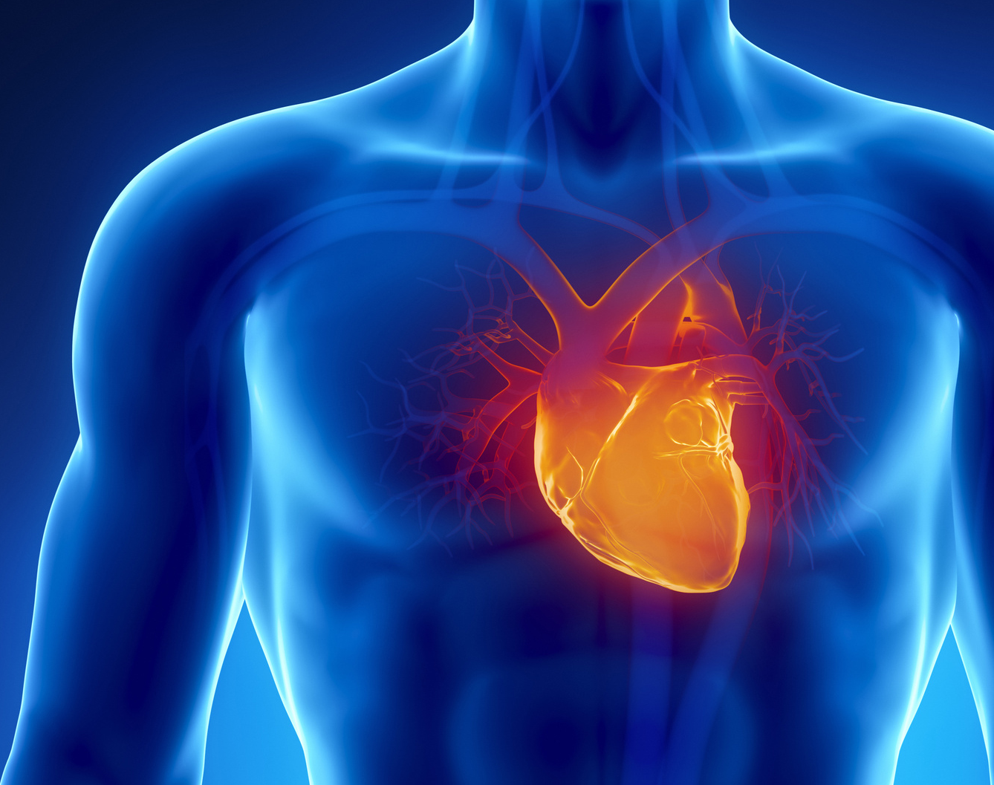
CAREERS IN CARDIOVASCULAR HEALTH
By Julia Labahn
This Photo by Unknown Author is licensed under CC BY-SA-NC
Notes:
Today we will explore careers in cardiovascular health. Cardiovascular health refers to the health of the heart and blood vessels.

Slide 2
OVERVIEW
What is Cardiology?
Who works on a Cardiovascular team?
Careers in Cardiology
Job Responsibilities
Skills & Competencies
Education Requirements & Licensure
Notes:
This is an overview of this presentation which includes what the cardiovascular system is, who works on a cardiovascular team, the job responsibilities and skills and competencies as well as the educational and licensure requirements to work in these professions.

Slide 3
OBJECTIVES After viewing this presentation, students will be able to:
List
List 3 careers in Cardiology
Name
Describe
Describe 3 job responsibilities of a Cardiologist
List
List 3 skills & competencies of a Cardiovascular Technician
Discuss
Discuss the educational pathway to work in Cardiology
Name 2 areas of the body that Cardiovascular Specialists treat
Notes:
After viewing this presentation, students will be able to:
List 3 careers in Cardiology, Name 2 areas of the body that Cardiovascular Specialists treat, Describe 3 job responsibilities of a Cardiologist, List 3 skills and competencies of a Cardiovascular Technician and Discuss the educational pathway to work in Cardiology.

Slide 4
WHAT IS THE CARDIOVASCULAR SYSTEM?
Notes:
We are now going to watch a video that explains how the cardiovascular system works in the human body.

Slide 5
THE CARDIOVASCULAR TEAM
Cardiologist
Cardiovascular Surgeon
Clinical Cardiac Perfusionist
Cardiovascular Technician
EKG Technician
Notes:
Healthcare professionals specializing in the cardiovascular systems diagnose and treat patients experiencing difficulties with the heart and lungs.
Each health care professional requires varied experience, but each position is necessary to help patients prevent and recover from potentially life threatening cardiovascular events.
The cardiovascular team consists of a Cardiologist, a Cardiovascular Surgeon, a Clinical Cardiac Perfusionist, a Cardiovascular Technician, and an EKG Technician.

Slide 6
CARDIOLOGIST Job Responsibilities
Diagnose & treat aliments
Help patients through the rehabilitation process
Explain risks
Perform tests
Refer patients to surgeon
This Photo by Unknown Author is licensed under CC BY
Median annual salary $371,792
Notes:
Cardiologists are doctors that prevent, diagnose and treat heart and blood vessel issues, such as heart and vascular disease, congenital heart defects, heart attacks, coronary artery disease, heart rhythm disturbances and heart failure.
After assessing a patient, it is common for a cardiologist to refer patients to a cardiovascular surgeon, when surgery is needed.
Cardiologists explain risks of prohibited activities for their patients and give health advice.
They also perform exercise and diagnostic imaging tests.
Cardiologists may find positions within hospitals, private practices and universities.
The median annual salary is $371,792.

Slide 7
CARDIOLOGIST Skills & Competencies
Critical thinking
Analytical judgement
Complex problem solving skills
Strong interpersonal skills
Self-confident
Compassionate
This Photo by Unknown Author is licensed under CC BY-NC-ND
Notes:
Cardiologists must be excellent critical thinkers and be able to make complex decisions in different situations. They must have strong interpersonal communication skills, as they have to take difficult scientific concepts and be able to relay information to patients so they can understand their options as well as how the system works. It’s important for these professionals to be self-confident, motivated and have compassion for patients and their families.

Slide 8
LET’S HEAR FROM A CARDIOLOGIST
Notes:
We are now going to watch a video and listen to some interesting findings this Cardiologist is working on.

Slide 9
CARDIOLOGIST Education & Licensure Requirements
Earn a 4 year bachelors degree
Complete Medical School
Complete 3 years of Internal Medicine Training
Complete a 3 year Residency in Cardiology
This Photo by Unknown Author is licensed under CC BY-ND
Notes:
A student pursing a career as a Cardiologist must first earn a 4 year bachelors degree, complete medical school, complete 3 years of Internal Medicine training and then go on to complete 3 years in a Residency in Cardiology.
The most logical pre-med bachelor degrees include courses in chemistry, mathematics, engineering or psychology. Then one must gain a passing score on the MCAT (Medical College Admission Test).
The four years in medical school covers standard medical terminology, medical judgment and clinical standard procedures. Potential cardiologists who complete the eight to ten years of educational preparation must then pass a certification exam administered by the American Board of Internal Medicine.

Slide 10
CARDIOVASCULAR SURGEON Job Responsibilities
Performs surgical procedures
Exams patients
Makes diagnoses
Determines treatment
Advises on lifestyle changes
This Photo by Unknown Author is licensed under CC BY-NC-ND
The median annual salary is $437,371.
Notes:
Cardiovascular Surgeons perform lifesaving operations on patients to correct, improve and remove heart problems.
After a patient has been assessed by a Cardiologist, patients needing heart surgery are referred to a Cardiovascular Surgeon.
Common surgical interventions include heart defect repair, aneurysm repair, heart value replacement, heart transplantation, and coronary artery bypass surgery.
These professionals make diagnoses, determine treatments and surgical procedures and advise patients on lifestyle changes post surgery.
The median annual salary is $437,371.

Slide 11
CARDIOVASCULAR SURGEON Skills & Competencies
Dexterity
Physical stamina
Strong communication
Problem-solving skills
Patience
Compassion
Notes:
Cardiovascular Surgeons must have excellent dexterity and physical stamina to endure standing for long periods of time in the operating room.
They must have strong communications and problem-solving skills to work well with their healthcare team, patients and their families.
It’s also important for them to have patience and compassion.

Slide 12
CARDIOVASCULAR SURGEON Education & Licensure Requirements
Obtain a 4 year Bachelors degree with a Pre-med Emphasis
Complete 4 years of Medical School
Pass the US Medical Licensing Exam
Complete 4-5 years of Residency in General Surgery
Complete at least 2 years in a Specialty Fellowship in Cardiovascular Surgery
Pass the American Board of Specialties Certification Exam
Notes:
The educational path to become a Cardiovascular Surgeon is a long one but well worth it.
First you would need to earn a 4 year bachelors degree with a emphasis in pre-med and then complete 4 years of medical school.
You would then need to pass the US Medical Licensing Exam to become a licensed doctor in the United States by the National Board of Medical Examiners.
After successful licensing, a future cardiovascular surgeon would then complete a 4-5 year Residency program in general surgery under the supervision of board certified surgeons.
Surgeons usually follow up completing a 2 year Specialty Fellowship on more specialized Cardiovascular Surgery.
Finally, the American Board of Specialties Certification Exam must be passed to become a certified surgeon,

Slide 13
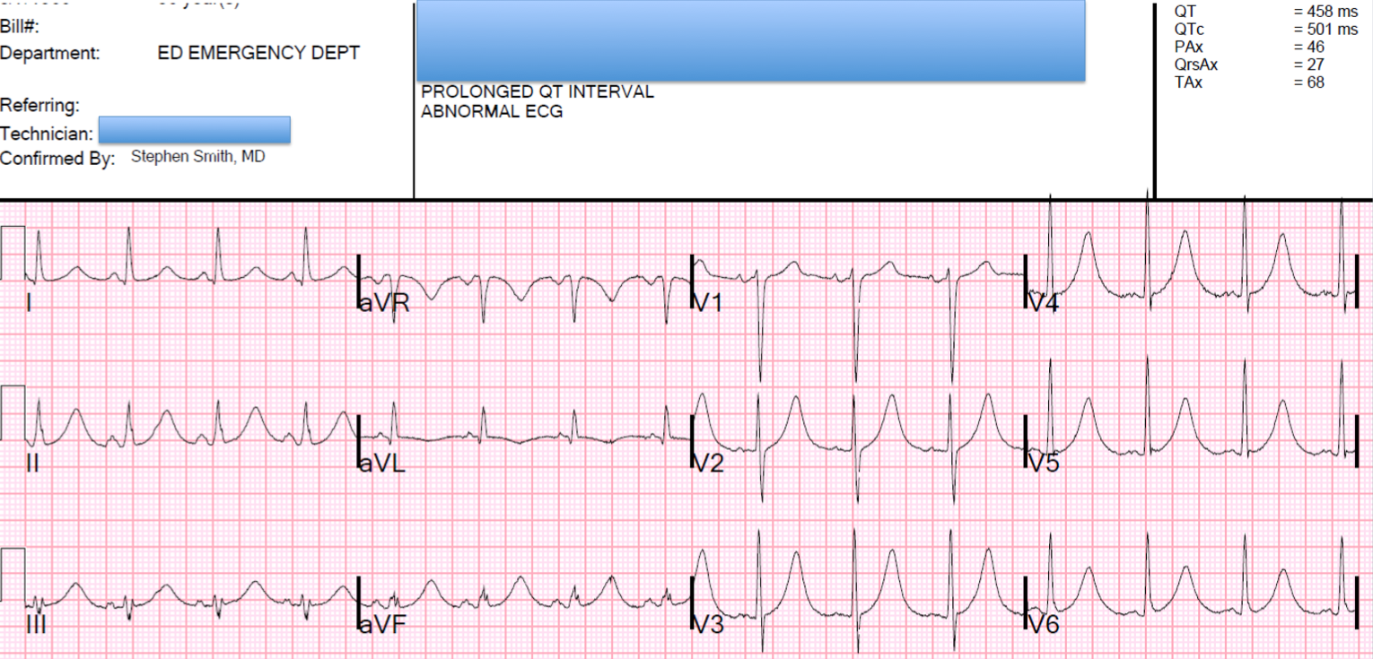
CLINICAL CARDIAC PERFUSIONIST Job Responsibilities
Work mostly in the Operating Room
Responsible for heart-lung machine
Assist with patient monitoring
Communicates with OR team
Studies patient history
This Photo by Unknown Author is licensed under CC BY-NC
Median annual salary $127,600
Notes:
Clinical Cardiac Perfusionist's spend 90% of their time in the operating room. They play an important role during cardiac surgery. During heart bypass or arterial grafting surgery, a clinical cardiac perfusionist uses the same technique to stop the heart so that surgeons can make repairs as they would use on victims of hypothermia or drowning.
They operate a heart-lung machine, which is an arterial blood pump, which propels oxygenated blood to patients tissues while the surgeon operates on the heart.
They control body temperature and monitor vital signs.
They communicate with operating room members and these health care professional also work in intensive care and the catherization laboratory monitoring patients and assisting, if needed.

Slide 14
CLINICAL CARDIAC PERFUSIONIST Skills & Competencies
Detail-oriented
A problem-solver
Critical thinker
Organized
Ability to remain calm
Understanding of perfusion/surgical equipment
Physical stamina
Notes:
Clinical Cardiac Perfusionist's must be extremely detail-oriented and have excellent problem-solving skills.
The role of a perfusionist involves understanding a patients medical history and choosing proper medical equipment so they be have strong organizational skills.
These professionals must have the ability to remain calm in emergency situations and thinking throughout long surgeries and have physical stamina.

Slide 15
REAL LIFE WORK AS A CARDIAC PERFUSIONIST

Slide 16
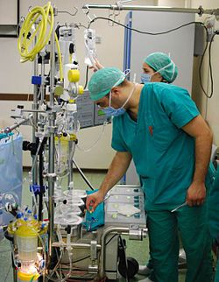
CLINICAL CARDIAC PERUSIONIST Education & Licensure Requirements
Earn a 4 year bachelors degree
Graduate from an Accredited Perfusion Technology Program
Become certified through the American Board of Cardiovascular Perfusionists
This Photo by Unknown Author is licensed under CC BY-SA
Notes:
The educational path to becoming a clinical cardiac perfusionist is to first earn a 4 year bachelors degree with an emphasis in health care and/or pre-med.
You will need to graduate from an accredited Perfusion Technology Program and then become certified through the American Board of Cardiovascular Perfusionists.

Slide 17
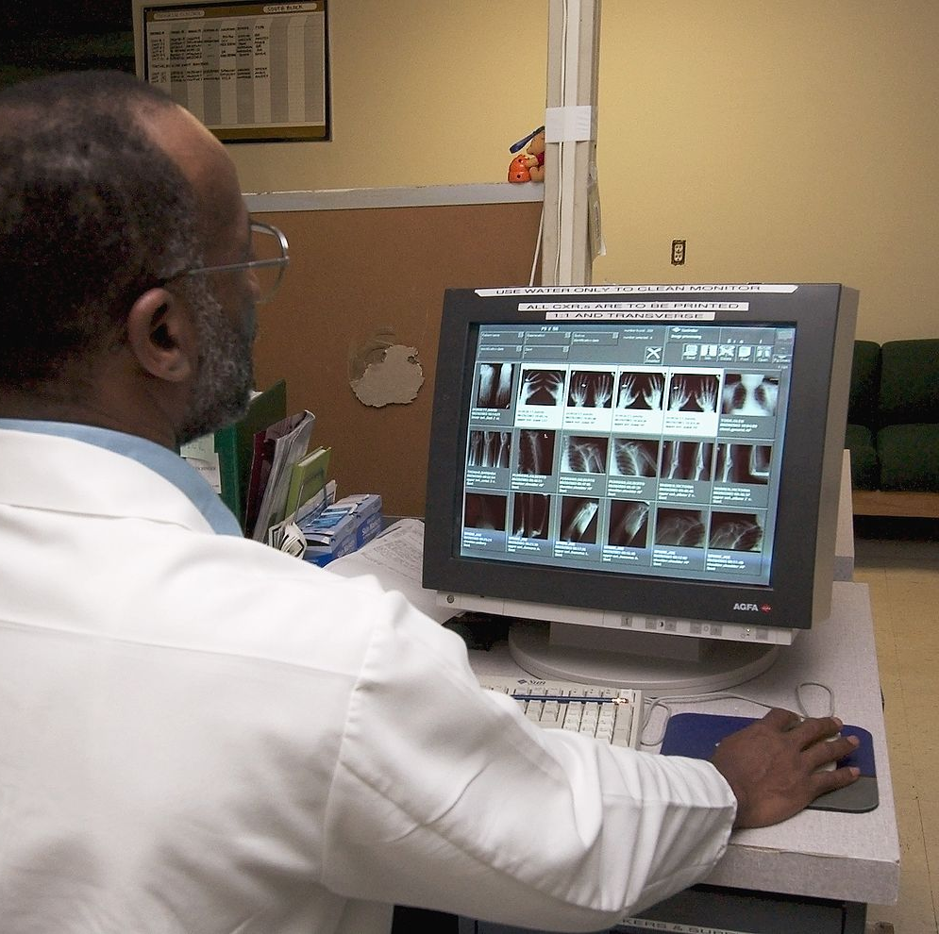
CARDIOVASCULAR TECHNICIAN – (CVT) Job Responsibilities
Aids in physical diagnosis & treatment of lung, heart, & blood vessel disorders
Perform diagnostic tests
Monitor vital signs
Maintain equipment
Record test results
Patient comfort & care
This Photo by Unknown Author is licensed under CC BY-SA
Median annual salary $87,045
Notes:
Cardiovascular Technicians, also called Cardio Tech’s aid in the physical diagnosis and treatment of lung, heart and blood vessel disorders.
Cardiologists rely on Cardio Tech’s to determine specific issues related that diminish performance of the heart through testing devices.
They operate electrocardiograph’s (EKG’s) and other patient monitoring devices for a wide variety of critically ill patients.
They monitor patient’s blood pressure and heart rate using equipment during diagnostic and therapeutic procedures.
These professionals must know principles and daily operations of the cardiac cath lab and provide patient comfort and care.
The median annual salary is $87,045.

Slide 18
CARDIOVASCULAR TECHNICIAN Skills & Competencies
Critical thinking skills
Active listening
Reading comprehension
Good time management
Compassionate
Proficient knowledge in cardiovascular health
Notes:
Cardiovascular Technician's need to have good critical thinking skills and knowledge of medical devices.
They should be active listeners and have good reading comprehension.
Cardiac Tech’s need to have good time management skills to be efficient in testing patients that may be experiencing critical ailments and be compassionate to their patients.
It’s imperative for Cardiac Tech’s to be proficient in their knowledge of cardiovascular health.

Slide 19
CARDIOVASCULAR TECHNICIAN Education & Licensure Requirements
Obtain
Obtain a high school diploma or GED
Earn
Earn a 2 year Associate or 4 year Bachelors degree in Cardiovascular Technology
Become
Become licensed through the American Association of Radiologic Technology
Notes:
A Cardiovascular Technician must go to college and earn an Associates degree. One year is focused on core courses, followed by a year of specialized training in a specialty. These are:
Invasive cardiology, for students who plan on working in a cardiac catherization lab or with the cardiac catherization suite.
Non-invasive cardiology, for students who plan on working in Holter monitor, stress, and pacemaker testing.
Non-invasive echo technology, for students who plan to work with cardiovascular ultrasound.
And
Non-invasive vascular cardiology, for students who plan to work in peripheral vascular technology.
Upon completion of a program, technicians become credentialed in that specialty.
A trained Technician would then become licensed through the American Association of Radiologic Technology.

Slide 20
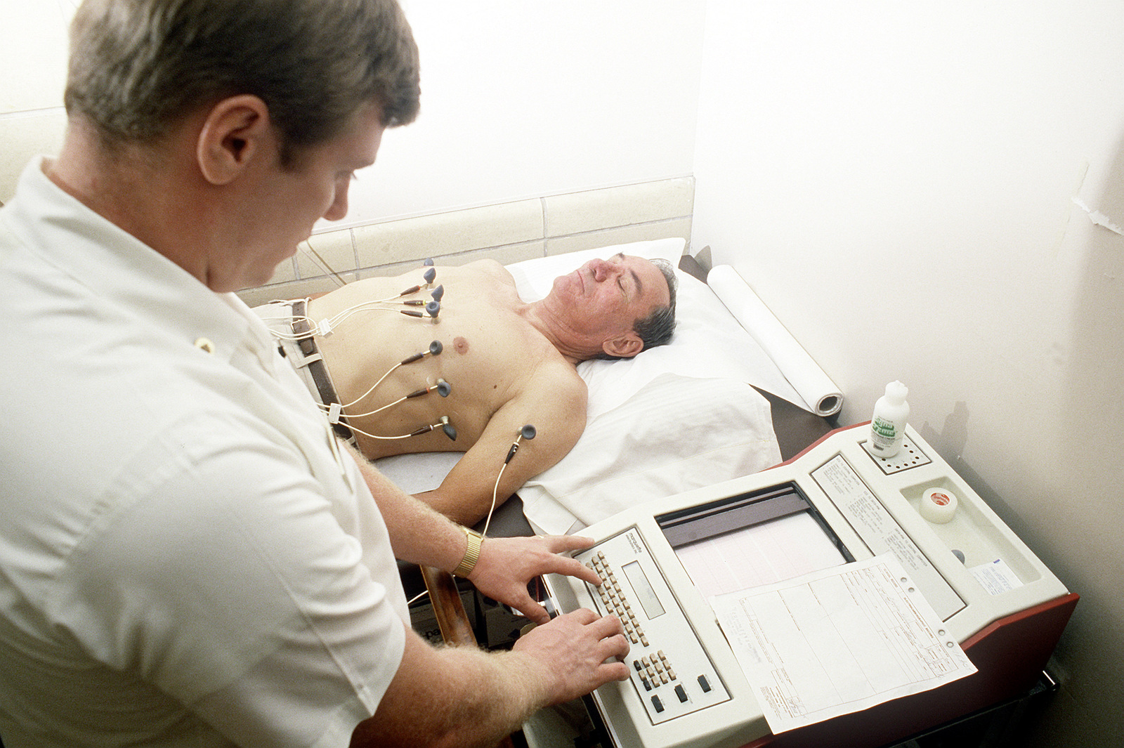
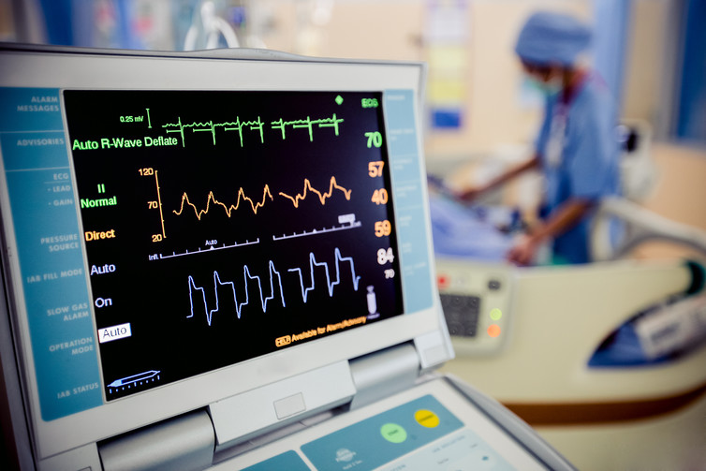
EKG TECHNICIAN Job Responsibilities
Perform monitoring tests
Provide stress tests
Take medical history & ask questions
Work with doctors and technologists
Keep EKG machine in good working order
Record data
Median annual salary $49.410
This Photo by Unknown Author is licensed under CC BY-ND
Notes:
Certified EKG Technicians perform meaningful work in helping diagnose cardiovascular conditions. EKG Technicians work in healthcare facilities with doctors and technologists and specialize in electrocardiogram testing for patients. EKG machines are complex devices that monitor the heart’s performance. This is done by attaching wires and electrodes to a patients chest, arms, and legs.
They also provide stress tests and Holter monitoring tests.
They monitor the readings, make sure the machine is attached properly and in working order, and record the results of the EKG tests.
EKG Tech’s might take a patient’s medical history and ask questions. They keep equipment in good working order, check the quality of recorded data, and help physicians and technologists during procedures.
The median annual salary is $49,410.

Slide 21
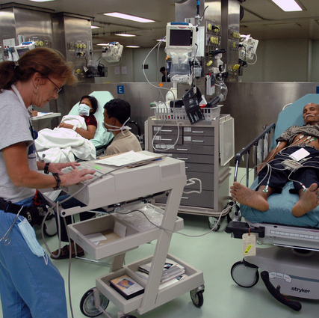
EKG TECHNICIAN Skills & Competencies
Technical skills
Attention to detail
Interpersonal skills
Good communication skills
Stamina
Notes:
EKG Technician’s must be able to understand and use complex machinery, therefore they must have excellent technical skills. They need to have razor focus and the ability to follow precise instructions. Because EKG Tech’s work directly with patient’s, and must come into physical contact with them at a time when they might be scared or in pain, interpersonal skills are required. They should have a friendly demeanor and good communication skills. EKG Tech’s are on their feet for many hours and may be required to lift heavy objects, so having good stamina is important.

Slide 22
EKG TECHNICIAN Education Requirements
Obtain
Obtain a 2 year Associate’s degree or complete a 1 year certificate program
Training
On-the-job training
Pass
Pass the CET exam
Continue
Continue required continuous education annually
Notes:
The educational pathways to become an EKG Technician is to obtain a high school diploma or earn a GED.
Complete a EKG Technician certification program and/or earn a 2 year Associate’s degree.
Pass the Certified EKG Technician exam.
On-the-job training is a great way to get good clinical experience in the field.
Finally, you must continue your educational credits annually and pay a small fee.

Slide 23
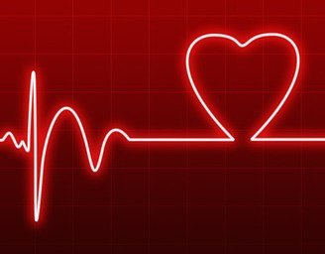
CERTIFIED EKG TECHNICIAN TRAINING
Anatomy & physiology of the heart
Medical disease processes
Medical terminology
Electrocardiography
Echocardiography
Medical ethics
Legal aspects
This Photo by Unknown Author is licensed under CC BY-NC-ND
Notes:
EKG Technician certification programs teach students what they need to know to work in the profession successfully. Students will be taught the anatomy and physiology of the heart, medical disease processes of the cardiovascular system, medical terminology and medical ethics and legal aspects of patient contact.
They will also study and become proficient in the use of a electrocardiography and echocardiography machines so they can best utilize them to work with patients.

Slide 24
PLEASE TAKE THIS POST-PRESENTATION SURVEY
https://docs.google.com/forms/d/e/1FAIpQLSfon72xhPX10PnyMmqHf7YVsCEKBlElM_CfXxakT_PXmMp9nA/viewform?usp=sf_link
This Photo by Unknown Author is licensed under CC BY-SA
This Photo by Unknown Author is licensed under CC BY-SA-NC

Slide 25
Thank you for viewing this presentation about Careers in Cardiovascular Health
Please feel free to contact OPAHEC with any questions or comments.
Shellene Dougherty, Executive Director
shdougherty@samhealth.org
Julia Labahn, Education Coordinator
Jlabahn@samhealth.org
Petra Gutierrez, Education Coordinator
pgutierrez@samhealth.org
Carmen Boone, Education Coordinator
carmenb@samhealth.org
www.ophaec.org
This presentation was supported by the Health Resources and Services Administration (HRSA) of the U.S. Department of Health and Human Services (HHS) as part of a subaward totaling $101,995 (33%) financed with Federal funding and $210,226 (67%) financed with non-Federal sources. The contents are those of the author(s) and do not necessary represent the official views of, nor an endorsement, by HRSA, HHS or the U.S. Government.
Notes:
Thank you for viewing this presentation about careers in Cardiovascular Health. Please feel free to contact Oregon Pacific Area Health Education Center for any questions or comments. You can also visit our website to find more information about health care careers @ www.opahec.org.

Slide 26
REFERENCES
Meier, D. (2018, June 29). List of Jobs & Careers Involving the Cardiovascular System. Retrieved August 12, 2020, from https://work.chron.com/list-jobs-careers-involving-cardiovascular-system-16564.html
How to Become a Cardiovascular Surgeon. (n.d.). Retrieved August 12, 2020, from http://doctorly.org/how-to-become-a-cardiovascular-surgeon/
Mayo Clinic College of Medicine & Science. (n.d.). Cardiovascular Perfusionist. Retrieved August 12, 2020, from https://college.mayo.edu/academics/explore-health-care-careers/careers-a-z/cardiovascular-perfusionist/
Cardiovascular Technologist / Technician. (2017, July 14). Retrieved August 13, 2020, from https://explorehealthcareers.org/career/allied-health-professions/cardiovascular-technologist-technician/

