Slide 1





10TH GRADE HIGH SCHOOL TIMELINE
This Photo by Unknown Author is licensed under CC BY-SA-NC
Notes:
To ensure a successful high school career and pathway into college you’ll need to follow a timeline to keep you on track. Here is the Sophomore high school timeline.

Slide 2

Step by step
This Photo by Unknown Author is licensed under CC BY
MEET WITH YOUR COUNSELOR
Notes:
It’s important for you to meet with your counselor who can help you to plan out the best path for you each term to take all of the courses you will need to complete by the time you graduate. Ask about challenging courses such as Advanced Placement (AP), International Baccalaureate (IB) or dual enrollment courses. Ask your counselor if they have brochures and information about local colleges you may be interested in checking out.

Slide 3


GRADES ARE IMPORTANT
This Photo by Unknown Author is licensed under CC BY-SA
Notes:
Continue pursing the best possible grades you can. If you keep your grades up your GPA and effort will look outstanding on college applications. Your GPA follows you into college so if you find the best type of learning practices for you the easier it will be for you to learn and get good grades.

Slide 4
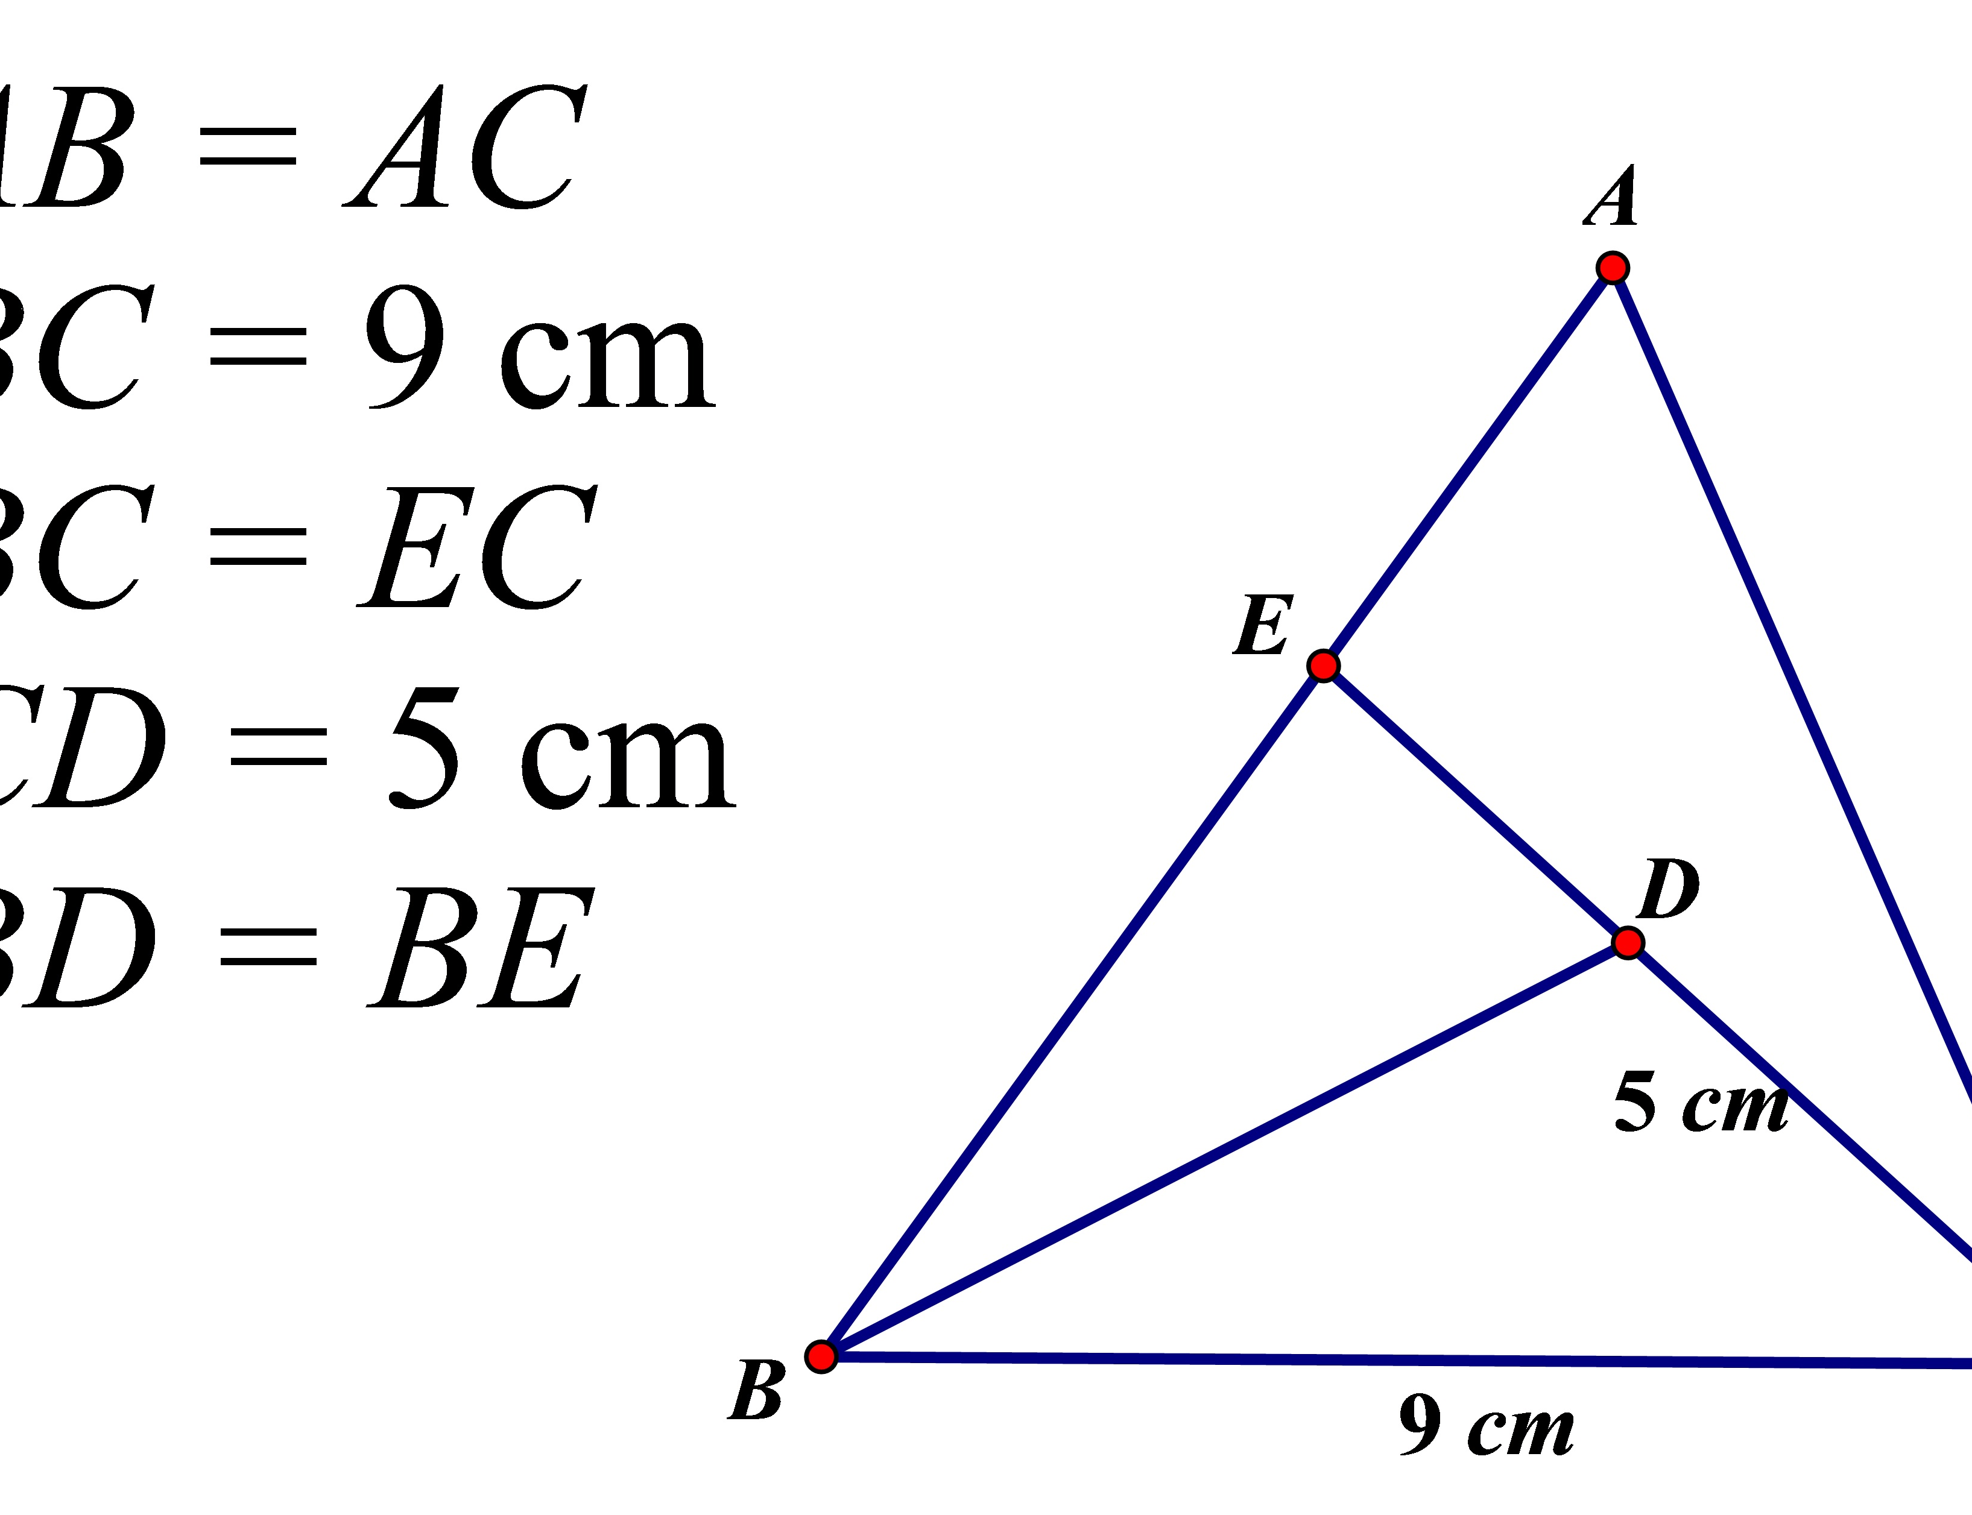


IMPORTANT COURSES
This Photo by Unknown Author is licensed under CC BY-SA
This Photo by Unknown Author is licensed under CC BY-SA-NC
This Photo by Unknown Author is licensed under CC BY-SA
Notes:
In your Sophomore year it’s important to take courses that are progressive in knowledge. Geometry, biology and continue with your second year of a foreign language. Universities require students to take at least 2 years of a foreign language to graduate. The best path is to learn these subjects early in high school to prepare you best for college.

Slide 5

EXPLORE YOUR INTERESTS & POSSIBLE CAREERS
This Photo by Unknown Author is licensed under CC BY-SA-NC
Notes:
Continue exploring your interests and possible careers. Take advantage of career day opportunities and speak to the professionals that interest you the most. The internet is a great tool for investigating careers and best fit that relate to your personality, strengths, and aptitudes that can help you determine key factors to help you find your ideal future career.

Slide 6

GET INVOLVED IN EXTRACURRICULAR ACTIVITIES
CLUBS
VOLUNTEERING
ACADEMIC ENRICHMENT PROGRAMS
WORKSHOPS
SCHOOL LEADERSHIP
Notes:
Stay involved in school and community extracurricular activities that develop a deeper focus on the things that interest you. Being involved in school clubs, volunteering your time in the community, attending academic enrichment programs and workshops and being active in school leadership are all great ways to get involved.

Slide 7
START PREPARING TO TAKE COLLEGE ADMISSIONS EXAMS IN YOUR JUNIOR & SENIOR YEARS
PSAT
SAT
SAT II SUBJECT TESTS
ACT
Notes:
If you have not already started to learn about the college admission exams now is the time. These are exams designed to measure students’ skills & knowledge that help colleges evaluate how ready students are for college-level work.
The PSAT is a preliminary “practice” test of the SAT. Colleges use admission test scores in a variety of different ways. Freshman, Sophomores and Juniors can all take the PSAT, but Freshman and Sophomores taking the PSAT are not eligible for the National Merit Award until in their Junior year. The test is usually give in October and students can sign up through their high school. There is a small fee to take the test. Students should ask their counselor for the details as well as the date and location of the test. Results are usually returned by your high school by December.
When taking the SAT and ACT students will have 7 opportunities each year to test and have access to free practice tools.
Most 4 year colleges use test score in their admission decisions but remember that scores are just one part of your college application, along with grades, course rigor, and recommendations.
2. Test scores are not the most important factor. Colleges give the most weight to your grades and rigor of your classes.
3. Most colleges publish student test score information. Some colleges publish the average scores of their students, and others show ranges. If you’re interested in a particular college, you can see how your scores compare. Keep in mind that most colleges admit students with a wide range of scores, there are always some students who will score above and below the published scores. Think of these scores as a guide, not a cut off.
Admission tests allow colleges to find you. You have the opportunity to share your name with interested colleges based on your test scores, grades, academic interests and other characteristics.
Colleges may use scores to award scholarships.
Scores may determine placement in colleges classes to put students in the right level.
Most 4 year colleges require tests. The SAT is accepted by almost all US colleges.
It’s important to know that the SAT and ACT have fee waivers available to apply for to reduce the cost of preparing for college.

Slide 8



SAT ii SUBJECT TESTS
ENGLISH
HISTORY
SOCIAL SCIENCES
MATHEMATICS
PHYSICAL SCIENCES
FOREIGN LANGUAGE
Notes:
If you are able to, consider taking the SAT II subject tests. These are 20 multiple choice standardized tests given by the College Board on individual subjects. These are typically taken to improve a student’s credential for admission to colleges.

Slide 9
AMERICAN COLLEGE TESTING PROGRAM (PLAN)
Pre-act assessment program
Notes:
Ask your guidance counselor about the American College Testing Program (PLAN) pre-ACT assessment program, which helps determine your study habits and academic progress and interests. This test will prepare you for the ACT assessment in your Junior year.
The ACT is a standardized test used for college admissions which covers academic skill areas of English, math, reading and science reasoning as well as offers an optional writing test.

Slide 10

COLLEGE ENTRANCE REQUIREMENTS
This Photo by Unknown Author is licensed under CC BY
Notes:
The baseline GPA requirement for a first round college applicant is 2.5 to 3.0. Applicants must have completed a high school diploma or GED and certain coursework must be completed at the end of the high school level. Minimum aptitude test scores are also necessary.
Exact courses and test score minimums vary between schools so it’s important to find out the requirements necessary for the colleges you are interested in sooner than later.

Slide 11

HAVE THE DISCUSSION WITH YOUR FAMILY
COLLEGE
  SIZE
  PROMINANCE
  LOCATION
  COST
  FIELD OF STUDY
Notes:
Talk with your family about what factors are important in your college choice. For example, the size, prominence, location, cost and field of study that you are interested in.
It’s important to know that state schools are less expensive to attend if you live in the state where your school is and private schools are more expensive than state schools. If you are interested in attending a proprietary school please ensure it is an accredited college and that your credits and degree will be recognized at all levels.

Slide 12
Paying for college
HAVE A PLAN
SAVINGS
FINANCIAL AID
GRANTS
SCHOLARSHIPS
THE OREGON PROMISE
Notes:
There are many different ways to pay for an college education including financial aid assistance, grants and scholarships. Working towards the goal of earning grants and scholarships in high school will improve your opportunities. Colleges offer application fee waivers, all you need to do is speak to the counselor an you can locate the waiver on their websites as well. Most colleges try and make it as easy as possible for students and parents to navigate through the application process.
On the next slide we will discuss The Oregon Promise Grant.

Slide 13

The Oregon promise grant
Notes:
The Oregon Promise Grant is an excellent opportunity to pay for the first two years of your college education within an Oregon community college.

Slide 14

INTERESTED IN THE MILITARY?
This Photo by Unknown Author is licensed under CC BY-SA
Notes:
If you are interested in attending a military academy such as West Point now is the time to start planning and getting information. Your school counselor can be a great resource in helping you navigate your options.

Slide 15

DIVISION I OR II COLLEGE SPORTS
This Photo by Unknown Author is licensed under CC BY-SA
Notes:
If you plan on participating in Division I or II college sports, register with the NCAA Eligibility Center @ www.eligibilitycenter.org. . Check with your counselor to get a list of NCAA core courses to make sure you are taking the right classes to be eligible.

Slide 16

VISIT COLLEGE CAMPUSES
ATTEND COLLEGE FAIRS
Notes:
The easiest way to check out prospective colleges that you may be interested in is to visit their websites. Most colleges offer virtual tours, videos about their school and programs.
If you are able to, set up a campus tour and attend college fairs. Visit the library, dorms, dining areas and explore anything you are able to. This will give you a feel for what the campus life is like.

Slide 17


Enjoy your summer & USE
YOUR TIME WISELY!
ATTEND SUMMER CAMPS
ATTEND CAREER CAMPS
VOLUNTEER
This Photo by Unknown Author is licensed under CC BY-SA-NC
This Photo by Unknown Author is licensed under CC BY-NC
Notes:
During your summer use your time wisely and have fun doing so! There are many different ways to get involved and learn from. You can attend summer camps, career camps, and even volunteer your time helping others in the community.

Slide 18
Oregon pacific area health education center
Please take this post
presentation survey
https://docs.google.com/forms/d/e/1FAIpQLSfon72xhPX10PnyMmqHf7YVsCEKBlElM_CfXxakT_PXmMp9nA/viewform?usp=sf_link
This presentation was supported by the Health Resources and Services Administration (HRSA) of the U.S. Department of Health and Human Services (HHS) as part of a subaward totaling $101,995 (33%) financed with Federal funding and $210,226 (67%) financed with non-Federal sources. The contents are those of the author(s) and do not necessary represent the official views of, nor an endorsement, by HRSA, HHS or the U.S. Government.

Slide 19

If you have any questions or comments, please feel free to email:
Shellene Dougherty, Executive Director
shdougherty@samhealth.org
Julia Labahn, Education Coordinator
Jlabahn@samhealth.org
Petra Gutierrez, Education Coordinator
pgutierrez@samhealth.org
Carmen Boone, Education Coordinator
carmenb@samhealth.org
www.opahec.org

Slide 20
REFERENCES
(n.d.). Retrieved August 13, 2020, from https://bigfuture.collegeboard.org/get-in/testing/8-things-to-know-about-how-colleges-use-admission-tests

