Slide 7
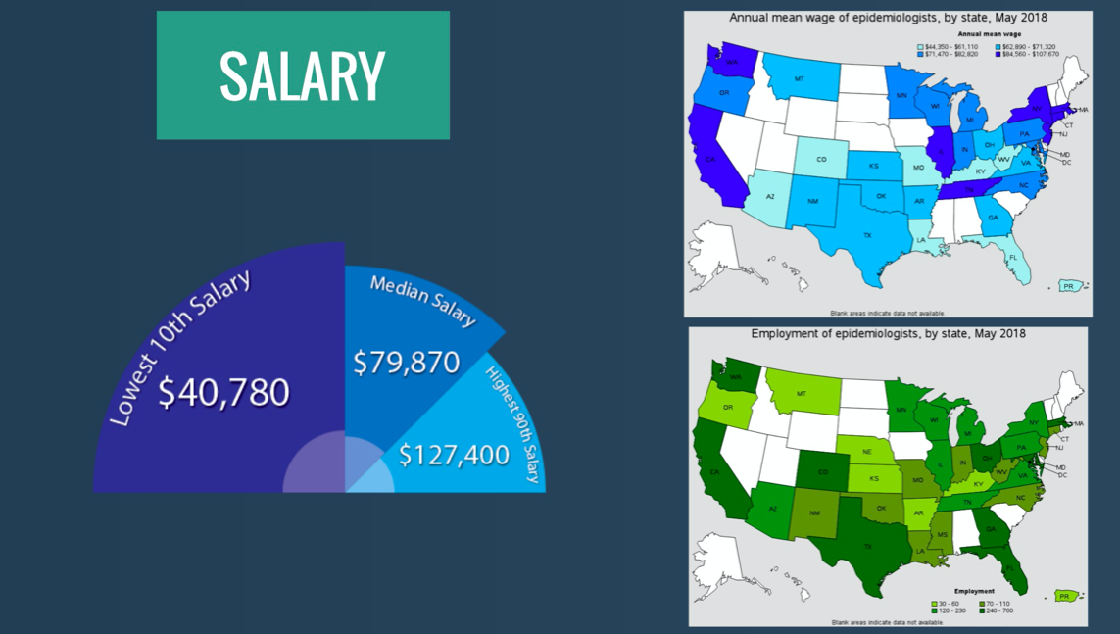

Slide 28
Notes:
https://docs.google.com/forms/d/e/1FAIpQLSfon72xhPX10PnyMmqHf7YVsCEKBlElM_CfXxakT_PXmMp9nA/viewform?usp=sf_link

Slide 29
Notes:
https://www.publichealthonline.org/careers/
https://explorehealthcareers.org/field/public-health/

