Slide 1
ALLIED HEALTH CAREERS
By Julia Labahn
Notes:
This presentation is exploring Healthcare Professional Careers .

Slide 2
OVERVIEW:
WHAT ARE HEALTHCARE PROFESSIONAL CAREERS?
TECHNICIAN VS. TECHNOLOGIST
CERTIFIED TECHNICAL PROFESSIONS
MEDICAL DIAGNOSTIC CAREERS
SKILLS & COMPETENCIES
EDUCATIONAL PATHWAYS
PROGRAMS IN OREGON
SALARIES
Notes:
We will be reviewing what Healthcare Professional careers are including Certified Technical professions and Medical Diagnostic Careers. We will learn the difference between a technician and a technologist and explore necessary skills and comptencies to be successful, educational pathways, programs in Oregon and the various median annual salaries that these professionals earn each year.

Slide 3
OBJECTIVES:
After this presentation, students will be about to:
List 5 different types of Healthcare Professional careers
Explain the educational requirements
Name at least 4 skills & competencies needed to work in these professions.
Notes:
After this presentation, students will be about to:
List 5 different types of healthcare professional careers
Explain the educational requirements
And
Name at least 4 skills and competencies needed to work in these professions.

Slide 4
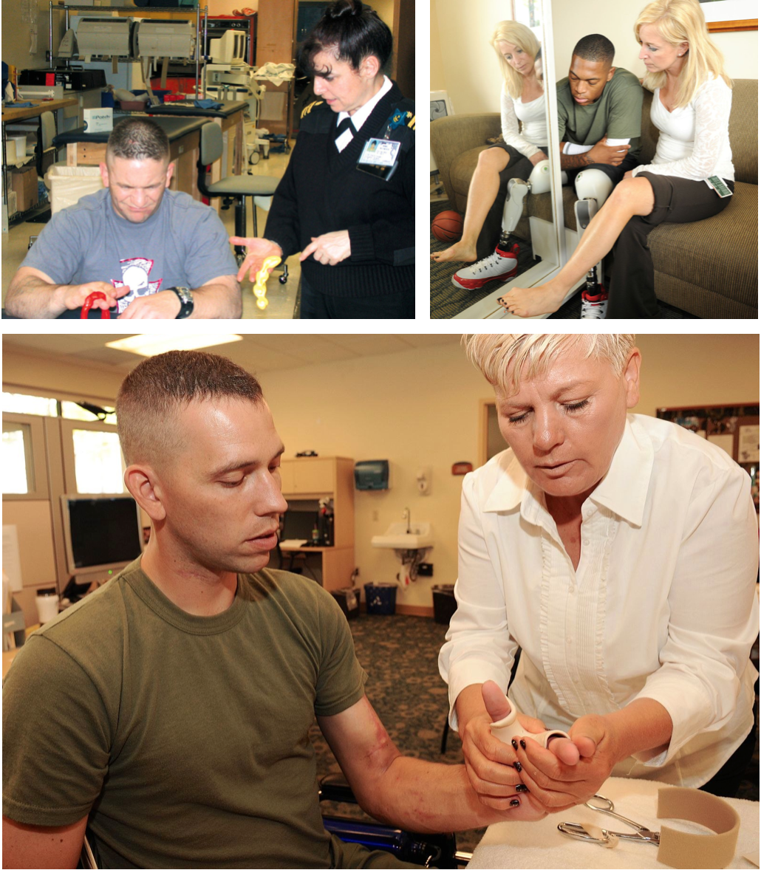
WHAT IS ALLIED HEALTH?
This Photo by Unknown Author is licensed under CC BY-SA
Notes:
So let’s explore what allied health professionals are in health care professions. They are a distinct form of dentistry, nursing, medicine and pharmacy. Some examples are Nursing Assistants, Medical Assistants, Dental Assistants, Pharmacy Technicians and Nuclear Medicine Technologists.
Allied Health encompasses a broad group of health professionals estimated about 60% of the U.S. healthcare workforce.
They use scientific principles and evidence-based practice for the diagnosis, evaluation, and treatment of acute and chronic disease, promote prevention and wellness for optimum health.
They apply administration and management skills to support health care systems in a variety of settings.
They provide a range of diagnostic, technical, therapeutic and support service in connection with health care.
In this presentation we are exploring just a few of these important careers. You can search “Allied Health Careers” on the internet to find the many different careers that fall under this category.

Slide 5
TECHNICIAN VS.
TECHNOLOGIST
This Photo by Unknown Author is licensed under CC BY-SA
Notes:
It’s important to recognize the difference between a technician and a technologist. The main differences are the level of education and responsibilities. Medical Technicians use practical understanding of technology in the field they work in. They usually work under the supervision of a Technologist. They serve as an entry-level role and might perform tasks that include running routine tests, inputting patient data, setting up equipment and prepping patients for procedures. A certification and/or Associates degree is required.
A Medical Technologist is a person who is completely aware of various technologies and responsible for conducting more complex tests, analyzing samples, discussing results with a physician, and supervising or training technicians. A Bachelors degree and some sort of licensing or certification is required.

Slide 6
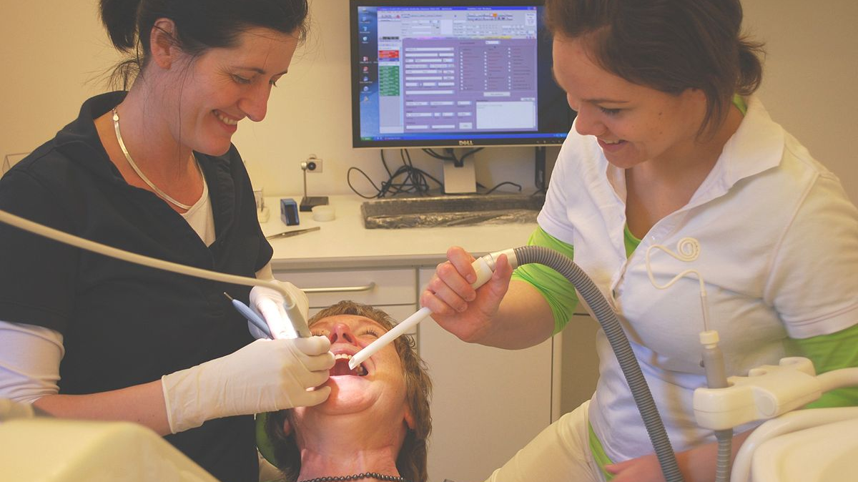
CERTIFIED TECHNICAL
PROFESSIONS
This Photo by Unknown Author is licensed under CC BY-SA
Notes:
First we will take a look at Certified Technical professions. These include careers in biomedical equipment, a dental assistant, a physical therapy assistant and more.
Technical certifications are issues to students who have completed a specialized course of study that is related to a specific vocational skill. Generally, obtaining a technical certificate involved commitment to a minimum of hours in a classroom, and the pursuit of specified courses that are considered necessary before the training period is considered complete. Some certification courses of study may involve outside the classroom as well, such as obtaining clinical experience.

Slide 7
EXCELLENT COMMUNICATION
THE ABILITY TO THINK CRITICALLY
DETAIL-ORIENTED
HAVE ANALYTICAL SKILLS
HEALTH LITERACY
SKILLS &
COMPENTENCIES
Notes:
Certified Tech’s must have excellent communication skills because they are generally working closely with patients. They need to be able to think critically and make good decisions, be detail oriented and analytical. It’s also important that they have an education in health literacy, which means they have a clear understanding and knowledge of medical terminology, the anatomy and physiology and relevant medical knowledge in the field they are working in.

Slide 8
ALL CERTIFIED TECHNICIAN CAREERS REQUIRE DIFFERENT EDUCATION
DENTAL TECHNICIAN – 2 YEAR DENTAL TECHNOLOGY PROGRAM CERTIFICATION OF ASSOCIATES DEGREE - $41,990
BIO-MEDICAL TECHNICIAN – 2 YEAR ASSOCIATE DEGREE - $48,000
PHARMACY TECHNICIAN – 2 YEAR ASSOCIATES DEGREE AND/OR ON-THE-JOB TRAINING - $30,900
EDUCATION & MEDIAN ANNUAL SALARIES
Notes:
The educational pathway for technical certifications varies depending on the program of choice.
A few examples are:
A Dental Technology program takes 2 years to complete and many times the outcome is an Associate degree. They can earn approximately $41,990.
A bio-medical technician will earn a 2 year Associate degree and can earn $48,000.
Some states require a Pharmacy Technician to obtain a 2 year Associates degree or have on the job training and earn a median annual salary of $30,900.
It’s important to speak to a program or college advisor about what is necessary to apply for and be admitted into the program of your choice.

Slide 9
CERTIFIED TECHNICIAN PROGRAMS IN OREGON
LANE CC – EUGENE
MT. HOOD – GRESHAM
OHSU – PORTLAND
PORTLAND CC – PORTLAND
ROGUE CC – GRANTS PASS
Notes:
Here are just a few certified technician programs in Oregon. There is a wide variety of programs in community colleges, vocational or technical schools and within private organizations.

Slide 10
MEDICAL DIAGNOSTIC CAREERS
RADIOLOGY TECHNICIAN
NUCLEAR MEDICINE TECHNOLOGIST
SONOGRAPHER/ULTRASOUND TECHNOLOGIST
This Photo by Unknown Author is licensed under CC BY
Notes:
Diagnostic medical careers are a vital part of the medical field. Imaging and diagnostics involves day to day patient interaction. They involve the use of diagnostic imaging technology techniques such as ultrasound, x-ray and MRI. Each play a significant role in determining patient diagnosis.

Slide 11
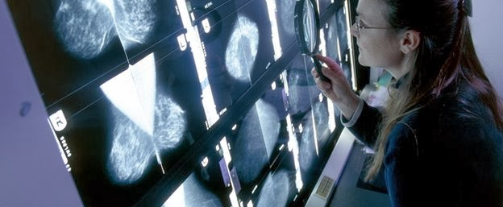
RADIOLOGY TECHNICIAN
This Photo by Unknown Author is licensed under CC BY-NC-ND
Notes:
Radiology Technicians produce x-rays of the patient for diagnostic purposes. They prepare the patients and explain procedures. They operate and control equipment so that the x-rays are of the correct contrast, detail and density.

Slide 12
RADIOLOGY TECHNICIAN
EDUCATION
COMPLETED AN ACCREDITED CERTIFICATION PROGRAM
6-12 MONTHES
OBTAIN CERTIFICATION & LICENSURE
MAINTAIN CERTIFICATION EVERY 2 YEARS WITH 24 HOURS OF CME
MEDIAN ANNUAL SALARY $59,520
Notes:
Prospective Radiology Technician’s can obtain a certificate from an accredited college or program in 6 to 12 months. If you are planning on working towards a high education it’s a good idea to get an Associate’s degree while completing your certification program. Most community colleges have opportunities to achieve that goal. After successful completion of a program you would then need to obtain certification through the American Registry of Radiologic Technologists (ARRT) and licensed through The Joint Review Committee on Education in Radiologic Technology (JRCERT).
The median annual salary is $59.520.

Slide 13
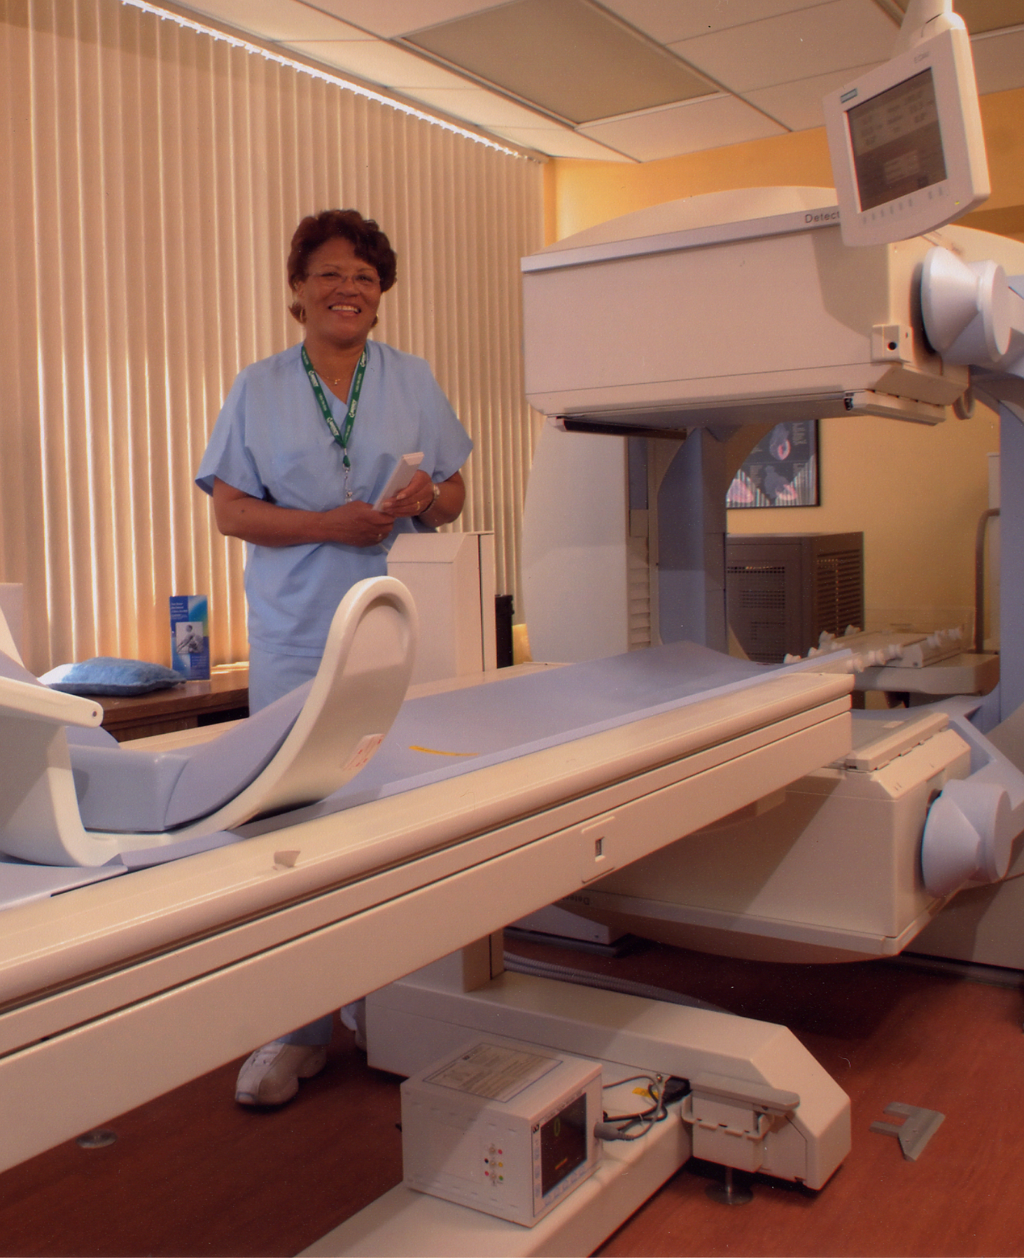
NUCLEAR MEDICINE TECHNOLOGIST
This Photo by Unknown Author is licensed under CC BY-SA
This Photo by Unknown Author is licensed under CC BY-NC-ND
Notes:
Nuclear Medicine Technologist’s prepare and administer radioactive drugs to patients prior to performing imaging tests for issues that affect the brain, heart, lungs, kidneys, bones and other areas in the body. These tests are then used by doctors to diagnose disease and determine treatment plans.

Slide 14
NUCLEAR MEDICINE
TECHNOLOGIST
EDUCATION
COMPLETED AN ACCREDITED ASSOCIATE’S DEGREE IN NUCLEAR MEDICAL TECHNOLOGY
MANY EMPLOYERS REQUIRE A BACHELORS DEGREE
OBTAIN CERTIFICATION & LICENSURE
MAINTAIN CERTIFICATION WITH CME
MEDIAN ANNUAL SALARY $
Notes:
To become a Nuclear Medicine Technologist one must first earn at least an Associates degree in Nuclear Medicine Technology. Many employers require a Bachelor’s degree. The program of choice must be accredited by the Joint Review Committee on Educational Programs in Nuclear Medicine Technology (JRCNMT). A qualified program will also require clinical experience under the supervision of a certified technologist or other physician who specializes in nuclear medicine.
Licensure is through the Society of Nuclear Medicine and Molecular Imaging (SNMMI) and certification is through the American Registry of Radiologic Technologists (ARRT) or the Nuclear Medicine Technology Certification Board (NMTCB). The median annual salary is $83,378 depending on the level of education and years of experience.

Slide 15
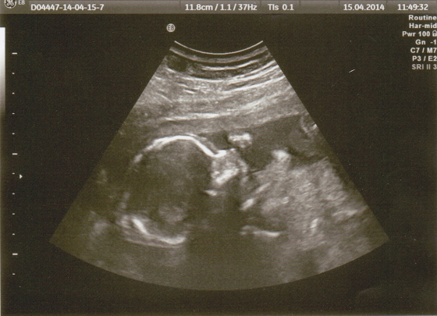
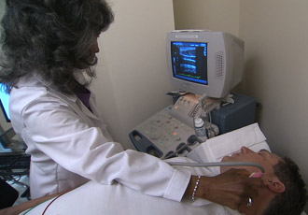
This Photo by Unknown Author is licensed under CC BY-NC-ND
This Photo by Unknown Author is licensed under CC BY-SA
DIAGNOSTIC MEDICAL SONOGRAPHER/ULTRASOUND TECHNOLOGIST
This Photo by Unknown Author is licensed under CC BY-NC-ND
Notes:
Diagnostic Medical Sonographers also known as Ultrasound Technologist’s use imaging equipment and soundwaves to form images of many parts of the body, known as ultrasounds. They are trained to acquire and analyze these sonographic images. These images are used to help doctors diagnose and treat many medical conditions.
Ultrasound is a non-invasive way to visualize internal organs and is often the first imaging test performed when disease is detected. Ultrasounds are also utilized to view babies in utero.
This profession has an important role in conducting and interpreting imaging that may help narrow down a patients diagnosis and quickly get them the care they need.

Slide 16
EARN
EARN AN ASSOCIATES OR BACHELORS DEGREE
COMPLETE
COMPLETE A CERTIFICATION PROGRAM IN DIAGNOSTIC MEDICAL SONOGRAPHY
OBTAIN
OBTAIN A NATIONAL CERTIFICATION/CREDENTIAL
BECOME
BECOME LICENSED THROUGH OBMI IN OREGON
DIAGNOSTIC MEDICAL SONOGRAPHER/ULTRASOUND TECHNOLOGIST
EDUCATION
MEDIAN ANNUAL SALARY $71,000
MEDIAN ANNUAL SALARY
$71,000
Notes:
To become a Diagnostic Medical Sonographer one must first earn an Associates or Bachelors degree and complete a certification program in Diagnostic Medical Sonography. They would then need to become certified through the American Registry for Diagnostic Medical Sonographers or the American Registry of Radiologic Technologists. The state of Oregon requires these professionals to become licensed through the Oregon Board of Medical Imaging. The median annual salary is $71,000.

Slide 17
EXCELLENT COMMUNICATION
KIND & COMPASSIONATE
MEDICAL & ANATOMICAL KNOWLEDGE
MECHINICAL APTITUDE
SKILLS &
COMPETENCIES
Notes:
All professionals in these positions must have excellent communication skills because they are working closely with patients.
They should be kind and compassionate, have excellent medical and anatomical knowledge and mechanical aptitude which means the ability to use the machines properly and maintain the equipment to keep them in good working order.

Slide 18
PROGRAMS IN OREGON
LINN-BENTON CC – LEBANON, OR
PORTLAND CC – PORTLAND, OR
OHSU – PORTLAND, OR
OIT, KLAMATH FALLS, OR
Notes:
There are many certification programs in Oregon that you can attend. Here are a few of interest.
Linn-Benton Community College, Portland Community College, Oregon Health & Science, and OIT.

Slide 19
WHAT IS THIS OBJECT?
LET’S LOOK AT SOME X-RAY’S AND SEE WHAT OBJECTS WE CAN FIND AND WHAT PART OF THE BODY THEY ARE LOCATED IN!

Slide 20
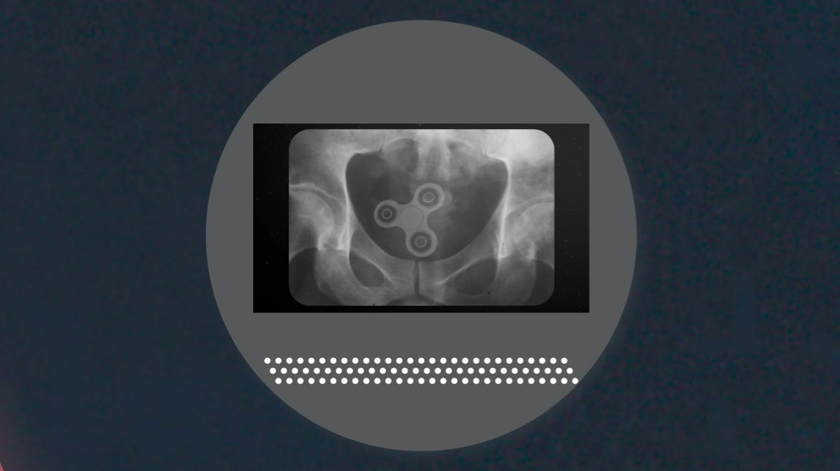
Notes:
Fidget Spinner in Pelvis

Slide 21
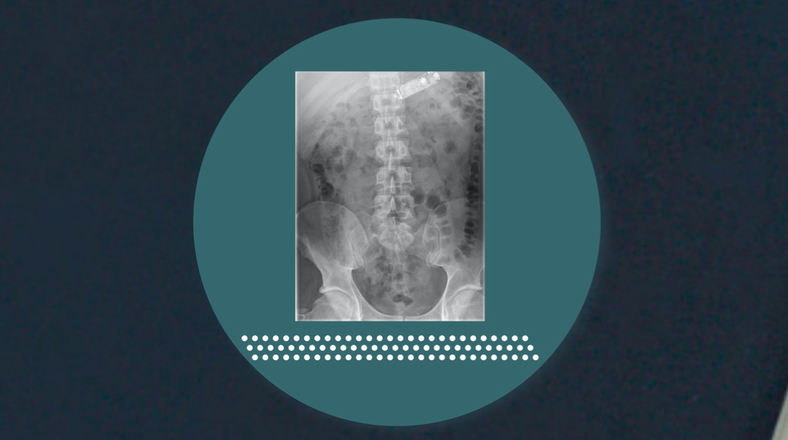
Notes:
Swallowed phone in upper chest

Slide 22
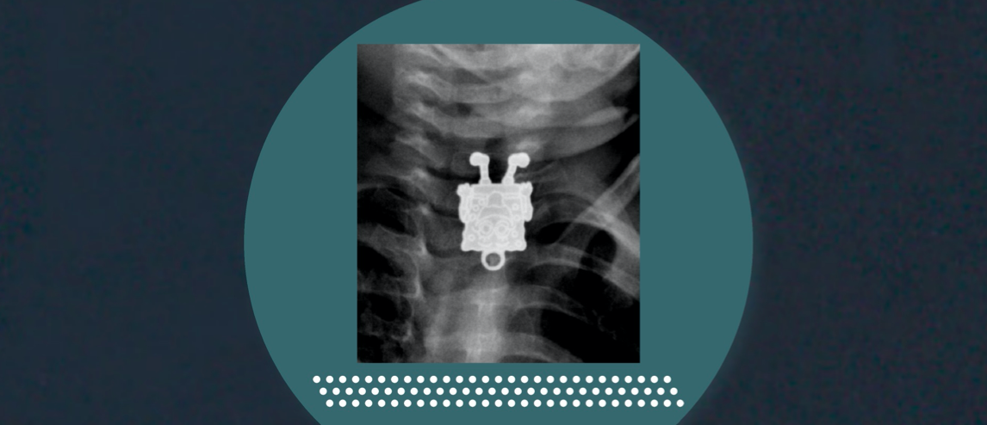
Notes:
4 year old swallowed a SpongeBob toy

Slide 23
PLEASE TAKE THIS POST-PRESENTATION SURVEY
https://docs.google.com/forms/d/e/1FAIpQLSfon72xhPX10PnyMmqHf7YVsCEKBlElM_CfXxakT_PXmMp9nA/viewform?usp=sf_link
This Photo by Unknown Author is licensed under CC BY-SA
This Photo by Unknown Author is licensed under CC BY-SA-NC
Notes:
On behalf of Oregon Pacific Area Health Education Center we would like to ask you to take this post-presentation survey.

Slide 24
Thank you for viewing this presentation about Healthcare Professional Careers!
Please feel free to contact OPAHEC with any questions or comments.
Shellene Dougherty, Executive Director
shdougherty@samhealth.org
Julia Labahn, Education Coordinator
Jlabahn@samhealth.org
Petra Gutierrez, Education Coordinator
pgutierrez@samhealth.org
Carmen Boone, Education Coordinator
carmenb@samhealth.org
www.opahec.org
Notes:
Thank you for viewing this presentation about Healthcare Professional Careers. Please feel free to contact us with any questions or comments. You can also visit us at www.opahec.org.

Slide 25
REFERENCES:
Julita. (2018, July 23). Difference Between Technician and Technologist. Retrieved August 27, 2020, from http://www.differencebetween.net/miscellaneous/difference-between-technician-and-technologist/
What is Allied Health? (n.d.). Retrieved August 27, 2020, from https://www.asahp.org/what-is
This presentation was supported by the Health Resources and Services Administration (HRSA) of the U.S. Department of Health and Human Services (HHS) as part of a subaward totaling $101,995 (33%) financed with Federal funding and $210,226 (67%) financed with non-Federal sources. The contents are those of the author(s) and do not necessary represent the official views of, nor an endorsement, by HRSA, HHS or the U.S. Government.

