Slide 1
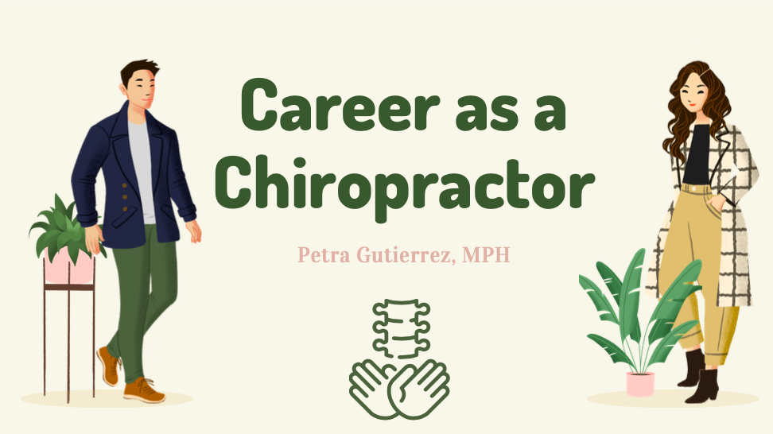
Notes:
Today we will be exploring careers as a Chiropractor. The chiropractic theory is that proper alignment of the body’s musculoskeletal structure, particularly the spine, will enable the body to heal itself without surgery or medication.
Treatment is primarily used as a pain relief alternative for muscles, joints, bones, and connective tissues such as cartilage, ligaments, and tendons.

Slide 2
Notes:
By the end of this presentation students will be able to:
List the educational requirements to become a Chiropractor
Describe essential soft skills for this profession
And Identify areas of expertise

Slide 3
Notes:
Among people seeking back pain relief alternatives, most choose chiropractic treatment.
About 22 million Americans visit chiropractors each year.
Of these, 7.7 million, or 35%, are seeking relief from back pain from various causes, including accidents, sports injuries, and muscle strains.
Other complaints include pain in the neck, arms, and legs, and headaches.
Chiropractors must first assess a patient’s medical condition and analyze the patient’s posture, spine, and reflexes after performing a physical examination.
Many times a chiropractor will take x-ray’s in addition to the physical exam to get an accurate diagnosis.
There are a variety of therapies a chiropractor may use as techniques to adjust a patient’s spinal column and other joints.
The use of heat or cold as treatment on injured areas is common.
As health and wellness professionals, chiropractors advise patients in best exercise techniques, eating a well-rounded diet, and improved sleep habits.
If necessary, chiropractors also refer patients to other healthcare professionals.

Slide 4
Notes:
There are many different types of procedures a chiropractor may use in treatment plans.
Chiropractic massage offers a combination of massage therapy and chiropractic care to help support the whole spine and body health in a patient.
Massage is used to help promote healing and wellness to the smaller systems of the body such as the limbic and nervous system.
Rehabilitative exercise aims to bring back full function following an injury through restoring muscle strength, endurance, power and improving flexibility. This part of a treatment plan uses carefully selected and planned exercises and drills for each patient.
A chiropractic adjustment is a procedure in which these trained specialists use their hands or a small instrument to apply a controlled, sudden force to a spinal joint.
The goal of the procedure, also known as spinal manipulation, is to improve spinal motion and improve your body’s physical function.
Manipulation is used to restore mobility of joints restricted by tissue injury.
Chiropractors also use supports such as braces or shoe inserts to treat patients and relieve pain. When leg length deficiencies, flat feet and/or subtalar instability are present, the chiropractor may place a small heel lift in the patients shoe on the short side and/or prescribe corrective arch supports to help stabilize the pelvis.

Slide 5
Notes:
https://youtu.be/jxNYW_0HskM

Slide 6
Notes:
The education needed to become a licensed chiropractor are:
Earn a 4 year bachelor’s degree from an accredited university taking courses such as biology, anatomy and physiology and physics.
Complete a Doctor of Chiropractic degree which is a postgraduate professional degree that typically takes 4 years to complete
And then
Pass all four parts of the National Board of Chiropractic Examiners exam. The four parts of the exam incude:
basic science areas including general anatomy, spinal anatomy, physiology, pathology, and microbiology, case history, physical examinations, clinical labs and techniques, as well as diagnostic imaging and case management skills.

Slide 7
Notes:
University of western States is a nonprofit, regionally accredited, private university that offers a highly focused and renowned program for a Doctor of Chiropractic degree which is located in Portland, Oregon.
This degree is 3-4 year program consisting of 12 quarters. January and October are the two entry terms and the tuition is $10.311 per quarter. Although obtaining this degree can be expensive, the median annual salary for a Chiropractor is $151,437 which more than covers the cost of the education.

Slide 8
Notes:
https://youtu.be/07bilo0zBZk

Slide 9
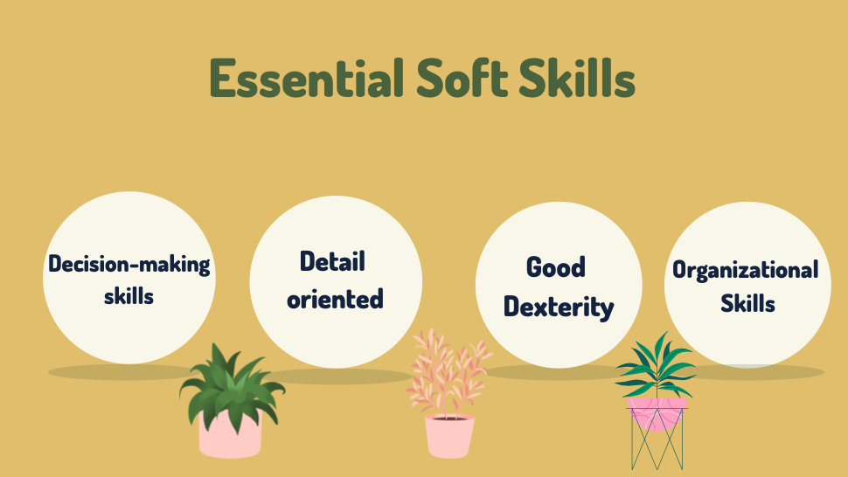
Notes:
Chiropractor’s must have good decision-making skills and be detail oriented.
Critical thinking skills are also highly important. Because chiropractic medicine often falls within and outside traditional medicine, you would need to think carefully about your patient’s symptoms and recommend the best course of action. Often, patients will be trying to explain symptoms that they do not fully understand, and you must be able to interpret what they are saying and diagnose the cause.
Important in chiropractic training lies in the ability to feel when something is inflamed or misaligned, therefore having good dexterity is imperative. As a chiropractor, you will spend many hours adjusting spines and joints back into their corrected position.
From patient records and appointments, it’s important for chiropractors to be organized so as to be a reliable healthcare provider for patients.

Slide 10
Notes:
As healthcare professionals, having a clean and comfortable office and working environment is important for patient safety and comfort. Chiropractors spend many hours on their feet so having good fitting, supportive shoes are a must.
Chiropractors usually work full time and may work in the evenings and on weekends to accommodate their patients schedules.

Slide 11
Notes:
Here are some interesting facts!
Fact #1-
Over 40% of all chiropractors are self-employed and own their own clinic. Being self-employed has it’s pros and cons like in any profession. Having your own practice means that you can make your own schedule which allows for flexibility in your work schedule, although you may have to work odd hours. Having your own practice means that you are not sharing profits with other chiropractors, although you have all of the costs of running your business on your shoulders.
Fact # 2- 4 out of 5 people have experiences lower back pain. Not everyone that has back pain gets chiropractic care, although it has proven to be helpful for many people.
Fact #3 – More than 1/3 of US adults are obese, which puts added pressure on the spine and joints. As previously mentioned, chiropractors also give advice to patients about their eating habits and nutrition. This can be an important tool to relieving pain and pressure in a patients body. Not to mention, their overall health.

Slide 12
Notes:
Here is a quick review about how to become a Chiropractor.
Step 1- Complete a 4 year bachelors degree
Step 2 – Obtain a Doctor of Chiropractic degree and a clinical internship though an accredited 4 year chiropractic college program
Step 3 – Pass the National Board of Chiropractic Examiners Exam
Step 4 – Ensure that you have met all of the requirements for licensure ddepending on the state you wish to practice in.

Slide 13
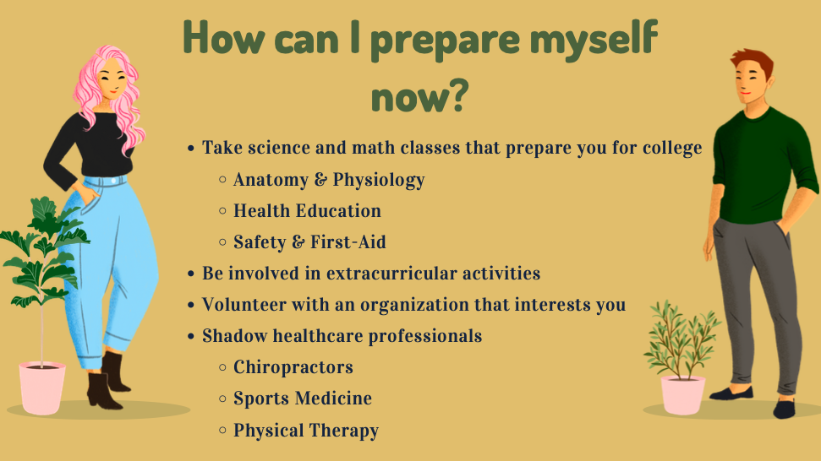
Notes:
To prepare yourself for college while in high school it’s important to take science and math courses. If you are interested in healthcare as a profession, it’s a good idea to take as many biology, health education, anatomy and physiology and health related courses.
If you are thinking about pursing a higher education and/or any health care career program it’s important to fully understand what school require in potential candidates.
Grades are important and are a reflect your progression on knowledge, time management skills and ability to think critically.
Other than grades it’s important to be well-rounded in your life. Having a balance of getting good grades, volunteering your time for others, being an active part of relevant clubs and having a good family and social life is important.
Volunteering while in high school, taking a gap year or in college has many benefits. It only takes a few hours out of your week to help others and also has other personal benefits.
Volunteer experience improves your resume and increases college acceptance. According to researchers, students who do community service are more likely to do well in school which in turn improves grades and academic potential.
Volunteering can also create a network which is beneficial to create opportunities and it also allows you to become a better person overall.
Actively participating in clubs in high school and college are really important to learn from and stay active in the community.
It shows that you’re proactive and enthusiastic
It improves your resume and can increase your acceptance in college or a health care program of your choice.
Another idea to explore various careers is to job shadow healthcare professionals. These experiences can give you an idea about what their day to day work life is like.

