Slide 1
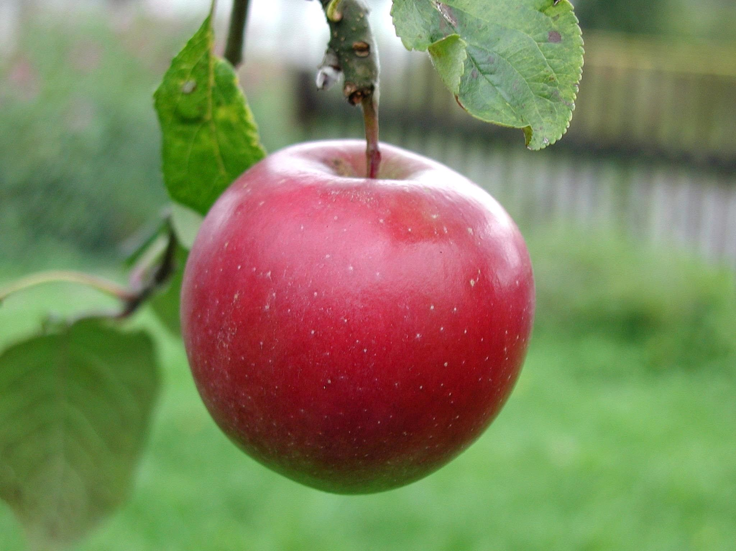
Careers in Nutrition
This Photo by Unknown Author is licensed under CC BY-SA
By Julia Labahn, BS Health Education Coordinator

Slide 2
OVERVIEW:
Gain knowledge about the field of nutrition
Learn about careers in nutrition
Discover educational pathways & colleges in Oregon
Learn how advanced degree professionals are innovators
Understand basic skills & competencies

Slide 3
OBJECTIVES After viewing this presentation students will be able to:
Discuss information about the general field of nutrition with teacher
List 2 careers in nutrition & what they do
Discover 2 educational pathways & colleges in Oregon
DISCUSS advanced degree professions AND THE IMPORTANCE OF RESEARCH
Describe 3 basic skills & competencies

Slide 4
INTERESTED IN A CAREER IN NUTRITION?
What's the Difference Between a Dietitian and a Nutritionist?
Dietitians are nutritionists with specialized certification.
This Photo by Unknown Author is licensed under CC BY-SA
Notes:
The term "registered dietitian" is legally protected and can only be used by those who have earned the Registered Dietitian Nutritionist (RDN) designation administered by the Commission on Dietetic Registration.
(The registered dietitian career path involves getting an approved four-year degree, completing a supervised internship, and passing a national exam.)

Slide 5
What do Registered Dietitian Nutritionists do?
PLAN
SUPERVISE
PROMOTE
COUNCEL
RESEARCH
EVALUATE
This Photo by Unknown Author is licensed under CC BY-SA
Notes:
Dieticians & Nutritionists plan food & nutrition programs.
They supervise the preparation & serving of meals.
They help prevent & treat illnesses by promoting healthy eating habits & suggesting diet modifications.
Dietitians & nutritionists sometimes work with individual clients to develop customized diets & meal plans as part of their overall health care.
Some dietitians run food service systems for institutions such as hospitals and schools, promote sound eating habits through education, & conduct research.
Dietitians & nutritionists work with groups & individuals to help provide education about eating habits & how they can impact overall health.
Primary areas of practice include clinical, community, management, and consulting.

Slide 6
EDUCATION & TRAINING
Working as a Dietitian and Nutritionist requires at least a bachelor’s degree, and most states have licensure/certification requirements as well.
Education: Dietitians need at least a bachelor's degree in dietetics, foods, nutrition, food service systems management, or a related area.
This Photo by Unknown Author is licensed under CC BY
Notes:
Certification: The Commission on Dietetic Registration offers the Registered Dietitian (RD) credential to graduates of dietetic education programs accredited by the Accreditation Council for Education in Nutrition and Dietetics (ACEND).
Those who want to apply for this credential must complete an internship and pass an exam. Different states have different requirements on what is necessary to work as a dietitian.
The Commission on Dietetic Registration of the American Dietetic Association (ADA) maintains a list of state licensure agencies to see what the regulations are in different states.
This will include courses in:
Foods, nutrition, institution management, chemistry, biochemistry, biology microbiology, and physiology. Classes in business, mathematics, statistics, computer science, psychology, sociology, and economics also are beneficial.

Slide 7
CAREERS IN NUTRITION
Registered dietitian nutritionist (RDN)
Median Annual salary: $60,370
This Photo by Unknown Author is licensed under CC BY
Notes:
Registered dietitian nutritionist (RDN)
Dietitian’s counsel people about diet, food, and nutrition & developing eating plans that are tailored to manage disease and promote long-term health and well-being.
RDN’s monitor patients' progress & adjust meal plans accordingly. They might also conduct nutritional research. Many specializations are available in this field.
Median Annual salary: $60,370

Slide 8
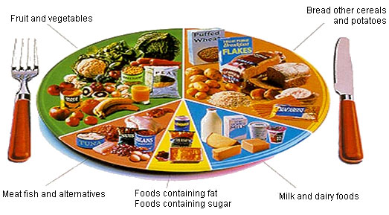
CAREERS IN NUTRITION
Nutritionist
Median Annual salary: $60,370
Nutrition educator
Median Annual salary: $41,335
This Photo by Unknown Author is licensed under CC BY
Notes:
Nutritionist
Typical tasks of nutritionists include assessing a client's dietary needs, consulting with a variety of health professionals, and creating a customized nutrition plan. In some cases, they also offer nutritional counseling. The process for learning how to be a nutritionist varies widely from state to state, so be sure to research the requirements in your area.
Median Annual salary: $60,370
Nutrition educator
Nutrition educators develop programs to promote healthy food choices and habits. They often work for government agencies that serve new mothers or low-income groups. They might offer information about basic nutrition along with tips on budgeting and food safety. They might also be responsible for screening candidates for food assistance services and helping applicants with paperwork.
Median Annual salary: $41,335

Slide 9
CAREERS IN NUTRITION
Sports nutritionists
median annual salary of $57,910
This Photo by Unknown Author is licensed under CC BY-SA
Notes:
Sports Nutritionists work with clients to develop nutrition plans that fit athletic lifestyles. They might counsel their clients in healthy eating practices for athletes, promote a healthy lifestyle for individuals in sports and keep abreast of current nutritional research.
Those who are self-employed may have more scheduling flexibility and might meet with clients on weekends and evenings.
Sports nutritionists should have proper training as well as strong verbal and written communication skills and people skills. According to the U.S. Bureau of Labor Statistics in 2015, nutritionists and dieticians in general.

Slide 10
ADVANCED EDUCATION – Dietetics
Future Registered Dietitian Nutritionists are be trained at the graduate level for the purpose of advancing the profession and protecting the public.
Doctorate in Clinical Nutrition
Research Scientist
This Photo by Unknown Author is licensed under CC BY-NC-ND
Notes:
A Nutrition and Health Science Major will provide a solid foundation in science and the role of nutrition and exercise in achieving and maintaining health.
Advanced degree holders can earn a salary on average of 35% higher than bachelor degree holders. Trends and the market outlook growth in this field is being driven by efforts to decrease spending on healthcare and increase health outcomes by educating the general population on healthy behaviors and prevention.
There are a variety of advanced level careers involving nutrition. A top level career is that of a Clinical Nutritionist with a PhD. Another is that of a Research Scientist.

Slide 11
ADVANCED EDUCATION Doctorate in Clinical Nutrition
Education:
4 years undergrad Bachelors degree
Masters degree
Advanced practice Residency
Minimum of 3 years work experience in the field of nutrition and dietetics
Obtain licensure
Critically analyze
Implement programs, policies, & procedures
Leadership roles in critical, community or higher education settings
PhD in Nutrition
Annual Median Salary
$92,811
This Photo by Unknown Author is licensed under CC BY-NC-ND
Notes:
A professional with a Doctorate in Clinical Nutrition critically analyzes the evidence in order to design and implement programs, policies and procedures that promote health and wellbeing in communities. A Doctoral degree emphasis is an advanced evidence based practice and chronic disease prevention, as well as treatment for the underserved and other populations in both clinical and community settings. This leadership role works in clinical, community or higher education settings.
The educational pathway to become a Clinical Nutritionist with a Doctorate degree would be to obtain a 4 year undergraduate Bachelors degree in Dietetics or related field, a Masters degree in the field of Dietetics, complete a doctoral degree program in Clinical Nutrition (DCN), complete an Advanced Practice Residency and finally obtain licensure.
Areas of study include biochemistry of nutrients, kinesiology, eating disorders, human metabolism, statistics, metabolic imbalance and cellular nutrition.
The median annual salary is $92.811.

Slide 12
ADVANCED EDUCATION NUTRITION RESEARCHER
Education:
4 years undergrad Bachelors degree
Masters degree in Nutrition
Doctoral degree
Research training and postdoctoral experience
Research
Increase understanding
Experiment
Analyze
Calculate
Assess
This Photo by Unknown Author is licensed under CC BY-NC
Annual Median Salary $154,306
This Photo by Unknown Author is licensed under CC BY-NC-ND
Notes:
Nutrition research includes strategies that can be applied toward the prevention and treatment of both infections and noncommunicable diseases, including cardiovascular disease, diabetes, and cancer.
Nutrition holds the key to our understanding of the underlying causes of a variety of diseases that hold promise to influence global economies.
Knowledge and adequate nutrition also has an important role in reducing or ending global and domestic food insecurity through direct and purposeful agricultural practices.
There are numerous nutrition research topics in which a Nutrition Researcher provides.
First, a top priority for future nutrition research is the need to better understand variability in metabolic responses to food and diet.
Second is the research of omics which is nutrigenetics and nutrigenomes. This research helps determine how specific nutrients interact with genes. Omics provide into an individualized nutrient requirements including how nutrients are digested, absorbed, and metabolized and their functions in the body.
Omics will help to determine and reflect an individuals nutritional status and will aid in the creation of new nutritional and disease biomarkers.
Third is the study and research of diverse microbiomes, such as bacteria and viruses live in and on the body and contribute to the microbiome.
Research is needed to determine the microbiomes role in varying biological responses to diet and food components and it’s importance in disease prevention and progression.
Research is also needed to determine how the microbiome is influenced by diet and other environmental factors.
Next is the research needed of biological networks such as an individuals’ genome which are DNA & RNA protein profiles and how these networks affect metabolic responses to diet and food. It also includes research on nutrition and reproductive health before and after conception.
Disease progression is another important concept that Nutrition Researcher work on. This is how nutritional factors influence both disease initiation and progression, as well as how nutrition affects a patients response to therapy.
Nutrition Researchers also focus on the understanding of food supply and environment. Understanding how the food environment affects dietary and lifestyle choices is necessary before effective policies can be instituted that will change a population’s diet in a meaningful way.
Researching food consumption and novel foods and food ingredients is imperative. Having an affordable, available, sustainable, safe and nutritious food supply is significant to a population’s diet and lifestyle.
Researchers are able to enhance our knowledge of the nutrient and phytonutrient content and bioavailability of foods produced, processed, and consumed.
Finally, Researcher use a tool to calculate and compare the relative costs and benefits of nutrition research interventions. This is called cost-effectiveness analysis. It helps to determine the most cost-effective options that will have the greatest benefit to public health.
The educational pathway to becoming a Nutrition Research is completing a 4 year undergraduate Bachelors degree, completing a Masters and/or a PhD in Food Science, complete training and postdoctoral experience. A Ph.D. in nutrition prepares you for a career in academia, governmental agencies, research institutes, and private industries. The median annual salary is $154,306.

Slide 13
Skills & Competencies
Dietitians and nutritionists need certain soft skills in order to effectively work with patients & put their knowledge of diet & nutrition to use. Some of these skills include:
Active listening
Verbal communication
Interpersonal Skills
Time management
Organizational skills
Work independently
This Photo by Unknown Author is licensed under CC BY-SA-NC
Notes:
Active listening: Clients need complete attention when they are talking about their health issues, dietary concerns, & other challenges.
Verbal communication: A significant part of a dietitian & nutritionist’s job involves conveying information to clients and their caregivers. Doing so effectively requires excellent communication skills & speaking skills.
Interpersonal Skills: These people skills allow dietitians & nutritionists to instruct and persuade clients and also to interact with colleagues.
Time management and organizational skills: Caseloads sometimes can be heavy, & be highly organized can help prevent dietitians & nutritionists from becoming overwhelmed.
Work independently: While dietitians and nutritionists spend a lot of time working with clients and their caregivers, they need to be able to meet with those clients, evaluate cases, and make recommendations independently.

Slide 14
COLLEGES IN OREGON
Portland State University, Portland, OR. – Food Service Systems/Administration Management/Foods & Nutrition
Oregon Health & Science University, Portland, OR. – Clinical Nutrition/Nutritionist/Dietitian
Central Oregon Community College, Bend, OR. – Dietetics, Dietitian
Oregon State University, Corvallis, OR. – Foods, Nutrition & Wellness Studies
National University of Natural Medicine, Portland, OR. – Clinical Nutrition/Nutritionist

Slide 15
WHAT IS HEALTHY NUTRITION?
Healthy nutrition means your body gets all of the nutrients, vitamins, and minerals is needs to work its best.
This Photo by Unknown Author is licensed under CC BY-NC-ND
Notes:
Good nutrition is essential in keeping current and future generations healthy across the lifespan.
The availability of healthy foods contributes to a person’s diet and risk of related chronic disease.
Good nutrition means your body gets all the nutrients, vitamins, and minerals it needs to work its best. Plan your meals and snacks to include nutrient-dense foods that are also low in calories.

Slide 16
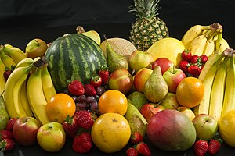
WHY IS A HEALTHY DIET IMPORTANT?
Poor Nutrition Is Making Our Nation Sick
What can we do?
This Photo by Unknown Author is licensed under CC BY-SA
Notes:
Only 4 in 10 children and fewer than 1 in 7 adults eat enough fruit. Eat your fruit.
Fewer than 1 in 10 children and adults eat recommended daily amount of vegetables. Eat your veggies.
A healthy, well rounded diet can reduce the risk of some diseases, including heart disease, some cancer, diabetes, stroke, and osteoporosis.
Improve your ability to fight off disease.

Slide 17
Tips for Eating Well
Eat plenty of fruit
Eat plenty of vegetables
Eat plenty of whole grains
Choose lean meats
Try other healthy foods such as fish, beans, and nuts.
This Photo by Unknown Author is licensed under CC BY-SA
Notes:
Eat plenty of fruit – To get the benefit of the natural fiber in fruit, you should eat fruit whole instead of juice.
Eat plenty of vegetables – eat a variety of colors of vegetables everyday.
Eat plenty of whole grains – choose hearty whole grains packed with fiber.
Choose lean meats – lean cuts of meat and poultry have less fat and fewer calories but are good choices of protein.
Try other healthy foods such as fish, beans, and nuts.

Slide 18
Thank you for taking the time to learn about a Career in the field of Nutrition!
Please feel free to contact Oregon Pacific Area Health Education Center for more information or any questions you may have.
www.OPAHEC.org

Slide 19
Student Activity The Label Game
1. Obtain 10 food products with nutritional labels.
2. Look at the serving size and fill in those two columns on the answer sheet on the next slide.
3. Check out value to guess for that specific product.
Examples: Calories, total fat in grams, Sodium in mg, Protein in grams, Dietary Fiber in % of daily value.
4. Examine your answers vs. what the labels state about the products. How close were you to the correct answers?

Slide 20
Student Activity The Label Game
 | Product | Serving Size | Nutrient | My Guess | Actual Value | Difference
 | Skim milk | 8 oz | Protein in g | 10 | 8 | 2
1
2
3
4
5
6
7
8
9
10

Slide 21
References:
Doctorate in Clinical Nutrition. (n.d.). Retrieved from https://www.unf.edu/brooks/nutrition/DCN.aspx
Association for Nutrition. (n.d.). Association for Nutrition. Retrieved from http://www.associationfornutrition.org/Default.aspx?tabid=145#Academia
What Is The Difference Between A Nutritionist And A Dietitian? (n.d.). Retrieved from https://nutritionsciencedegree.org/what-is-the-difference-between-a-nutritionist-and-a-dietician/
What is a Registered Dietician? (n.d.). Retrieved from https://www.healthcare-administration-degree.net/faq/what-is-a-registered-dietician/

