Slide 1


VACCINE RELATED CAREERS
By julia labahn
Notes:
This presentation is about careers related to Vaccinations and Immunizations.

Slide 2
OVERVIEW
EXPLORE CAREERS IN:
VACCINE DEVELOPMENT RESEARCH
BASIC SCIENCE RESEARCH & PRECLINICAL RESEARCH FOR VACCINES
CLINICAL TRIALS
INFECTIOUS DISEASE MANAGEMENT
INFECTIONS & COMMUNICABLE DISEASES
TOPICAL MEDICINE
INFECTIOUS DISEASE & VACCINOLOGY
PUBLIC HEALTH
Notes:
We will explore careers in vaccine development research, basic science research and preclinical research for vaccines, clinical trials, infectious disease management, injections and communicable diseases, topical medicine, infectious disease and vaccinology and public health careers.

Slide 3
OBJECTIVES
LIST
LIST TWO CAREERS IN VACCINE DEVELOPMENT RESEARCH
DESCRIBE
DESCRIBE THE JOB OF THE FDA RELATED TO VACCINES
DISCUSS
DISCUSS TWO PROPERTIES A BASIC SCIENCE RESEARCHER WORKS WITH
LIST
LIST THE THREE PHASES OF CLINICAL TRIALS FOR A INVESTIGATIONAL VACCINE
DESCRIBE
DESCRIBE THE JOB DESCRIPTION OF A BIOSTATISTICIAN
Notes:
By the end of this presentation, students will be able to:
List two careers in Vaccine Development Research
Describe the job of the FDA related to vaccines
Discuss two properties a Basic Science Researcher works with
List the three phases f clinical trials for an investigational vaccine
And
Describe the job description of a Biostatistician.

Slide 4
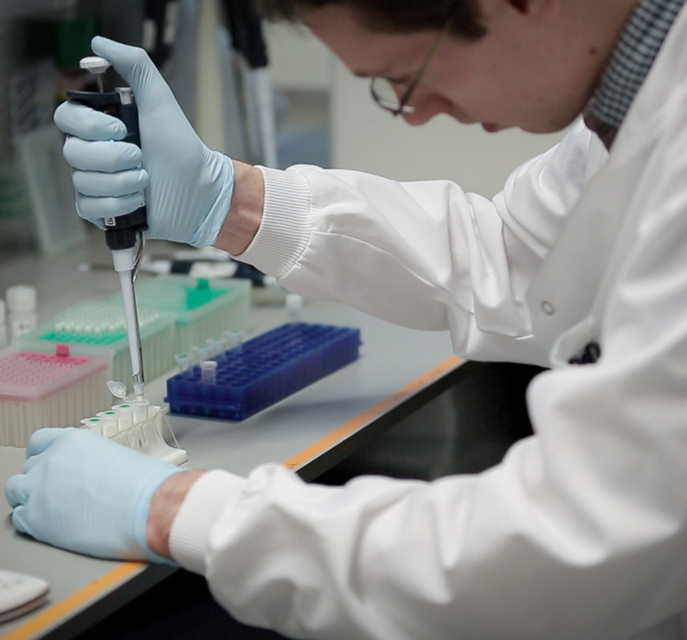
VACCINE DEVELOPMENT research
UNIVERSITIES
INDUSTRY
GOVERNMENT LABS & AGENCIES
NOT-FOR-PROFIT ORGANIZATION LABS
This Photo by Unknown Author is licensed under CC BY-SA-NC
Notes:
Vaccine development research takes place in universities, industry, in government labs and agencies and not-for-profit organization labs.
University research projects usually rely on federal grants from agencies such as the National Institute of Health.
Industry, which includes pharmaceuticals and biotechnology companies, contract labs, and diagnostic testing facilities, have access to investor money, revenue from commercial projects that put money int basic vaccine research.
The U.S. federal government funds research at many small startup companies that are often focused on specific projects such as those supporting the development of vaccines against potential biological warfare agents such as anthrax, or large public health issues like Hepatitis C and HIV. Government vaccine development research jobs are also funded by the federal budget.
Not-for-profit vaccine development is conducted by organization such as Global Vaccines, with a mission to develop vaccines for diseases prevalent to developing countries.

Slide 5

THE U.S. FOOD & DRUG ADMINISTRATION (FDA)
This Photo by Unknown Author is licensed under CC BY
Notes:
The U.S. Food and Drug Administration oversees all clinical trials assessing the safety and efficacy of vaccines. They staff scientists and doctors that evaluates potential vaccines and approves and monitors the clinical studies. These positions usually require advanced degrees.

Slide 6
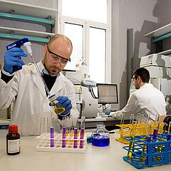
BASIC SCIENCE RESEARCH
FOCUSES ON THE BIOCHEMISTRY AND PHYSICAL PROPERTIES THAT DISEASE CAUSING MICROBES USE TO CAUSE DAMAGE TO THE HOST.
This Photo by Unknown Author is licensed under CC BY-NC
Notes:
Basic Science Research focuses on the biochemistry and physical properties that disease-causing microbes use to cause damage to the host. This research also considers the biophysical characteristics of the microbes that might be used in vaccines or drugs to prevent or interrupt the disease process. This part of the vaccine development cycle is called basic or preclinical research.

Slide 7
CAREERS IN BASIC OR PRECLINICAL RESEARCH
FOR VACCINES
SCIENTISTS
RESEARCH ASSOCIATES & ASSITANTS
TECHNICIAN ASSISTANTS
SENIOR TECHNICIANS
Notes:
Typically, a scientist with a doctorate degree in cellular and molecular biology, biochemistry, or microbiology leads the basic or preclinical research studies for vaccines.
Research Associate jobs involved in vaccine research might involve growing cell line in a culture, cloning DNA, and performing an array of lab tests looking for, quantifying, or measuring some activities of proteins, viruses and DNA.
Technician Assistant positions would require some knowledge of basic scientific processes and procedures. This is a great way to get your foot in the door in the field of scientific research while in college. These Assistants prepare chemical stock solutions, wash and sterilize glassware and care for research animals.
Senior Technicians may have a Bachelors degree and/or are working towards their Masters or Doctorate. They have a higher level of knowledge and responsibilities that an Assistant may have. Job responsibilities may include maintaining cell line stocks, track and breed research animals, order lab supplies and may conduct experiments.

Slide 8
CAREERS IN VACCINE
DEVELOPMENT PHASE OR SCALE-UP DEVELOPMENT PHASE
SCIENTISTS ON THE PhD LEVEL HEAD EXPERIMENTS
SCIENTISTS WITH ADVANCED DEGREES IN MANUFACTURING ENGINEERING
ASSISTANTS
Notes:
Once a vaccine looks like it is a serious candidate for therapeutic use, the project team moves it into the development phase, or the scale-up development phase.
In development, Scientists, who likely have advanced degrees in manufacturing engineering, and their team of Assistants work out the best methods for producing the vaccine on a larger scale.
A PhD level Scientist typically heads these experiments, although there are numerous jobs for individuals with BS degrees.

Slide 9
CLINICAL TRIALS
(INVESTGATIONAL VACCINE)
PHASE I
INVOLVED A SMALL TRIAL TO ACCESS SAFETY IN HUMANS
PHASE II
SLIGHTLY LARGER & MONITORS SAFETY, IMMUNE RESPONSE, AND THE DESIRED PROTECTION.
PHASE III
INVOLVES TESTING THE VACCINE IN A LARGER GROUP OF PEOPLE TO PROVE THAT THE VACCINE IS STILL SAFE & EFFECTIVE.
Notes:
A candidate vaccine that successfully makes it through the preclinical research and scale-up development is eligible to become an “investigational vaccine”.
The FDA decides whether or not the data on the vaccine warrants a clinical trial.
An investigational vaccine undergoes 3 phases of clinical trials before it can be licensed for public use.
Phase I is a small trial to access safety in humans. Phase II is slightly larger and monitors safety, immune responses, and the desired protection and Phase III involves testing the vaccine in a larger group of people to prove the vaccine is still safe and effective.

Slide 10
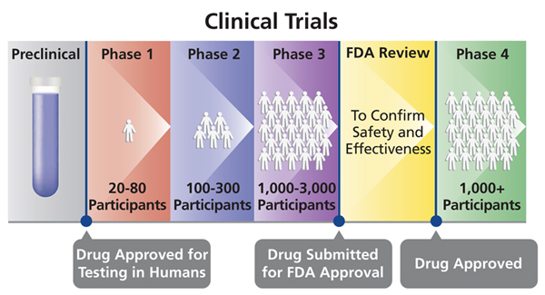
WHO WORKS IN CLINICAL TRIALS?
MEDICAL DOCTORS
TEAM LEADERS WITH THEIR PhD's
CLINICAL ASSOCIATES
REGULATION
STATISTICIANS
MEDICAL WRITERS
This Photo by Unknown Author is licensed under CC BY-SA
Notes:
The clinical trial area encompasses a wide variety of different careers and jobs.
The trials are usually ran by medical doctors and team leaders with PhD’s. Trials also involve many people with a Bachelors or Masters degree.
For example, Clinical Associates might work with the clinical sites to ensure that the correct protocols are followed.
Workers in regulatory positions make sure the trial is on compliance with governmental regulations.
Statisticians work on the trial data and Medical Writers produce the documents that detail the trial for the doctors and patients, as well as many documents for the FDA.
Being involved in vaccine research offers professionals the opportunities to work on a project that could directly impact public health, whether it is working directly on the lab bench, on a production line, or to support a clinical trial.
It is a great achievement helping to define and develop a vaccine or drug that is proven to be clinically relevant and helps people lead healthier lives.

Slide 11
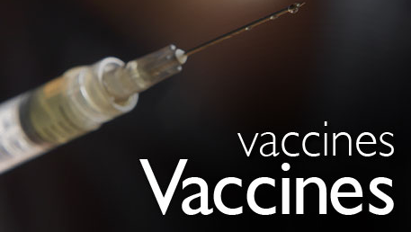
Infectious disease MANAGEMENT CAREERS
COMMUNICABLE DISEASE ANALYST
IMMUNIZATION EDUCATOR
EPIDEMIOLOGIST
This Photo by Unknown Author is licensed under CC BY
Notes:
Infectious Disease Management careers focus on local, regional, national, and global implications of infectious diseases and the ways thee conditions are treated and managed.
Three important careers that fall under Infectious Disease Management are Communicable Disease Analysts, Immunization Educators and Epidemiologists.
Communicable Disease Analysts study the spread of disease. This work provides a basis for response to a communicable disease, which can include the role that vaccines play in treating it and slowing down at outbreak.
Immunization Coordinators work to educate the public about the benefits of vaccinations. They may develop strategies for a raising the percent of the population that receive vaccinations or research factors preventing immunization in an area.
Epidemiologists track the causes and patterns of infectious diseases to find ways to reduce the risk on infection in a community. This work involved identifying the role that vaccinations can play in preventing an infectious disease, as well as slowing down the spread of a disease.

Slide 12

CAREERS IN INFECTIONS OR
COMMUNICABLE DISEASES
INFECTION CONTROL PRACTIONER
INFECTIOUS DISEASE SPECIALIST
OCCUPATIONAL HEALTH & SAFETY SPECIALIST
This Photo by Unknown Author is licensed under CC BY-ND
Notes:
Careers in infections or communicable diseases focus on the role of infections and or communicable diseases in healthcare systems around the world and how immunizations have played a role in the response to these illnesses.
Three important related careers are Infection Control Practioners, Infectious Disease Specialists, and Occupational Health & Safety Specialists.
Infection Control Practioners help to identify, control and prevent infectious disease outbreaks in specific settings, such as hospitals, prisons, and nursing homes. They also are responsible for identifying and implementing programs that can help prevent and control outbreaks.
Infectious Disease Specialists are responsible for the spread, treatment, and containment of infectious diseases, and using the data to implement treatment plans. They may recommend vaccination regimens in response to an infectious disease.
Occupational Health & Safety Specialists help to ensure that workplaces are safe by analyzing safety procedures in a work environment. Part of this work includes protecting employees from infectious diseases by monitoring a workplace for risk, educating staff about safety procedures, and recommending vaccinations.

Slide 13
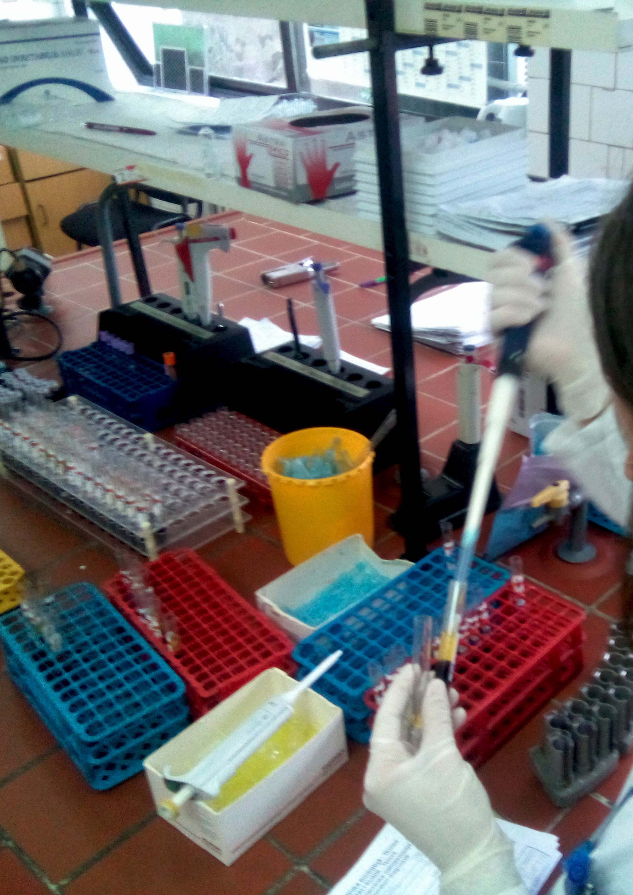
TROPICAL MEDICINE CAREERS
VACCINE RESEARCHER
BIOCHEMIST
NON-CLINICAL VACCINE ADVISOR
This Photo by Unknown Author is licensed under CC BY-SA
Notes:
Careers in the field of Tropical Medicine focus on infectious diseases that are found in tropical settings around the world. These professionals take a holistic look at the public health implications of these conditions, including their medical, biological, social, and epidemiological components. They also receive information on how these diseases are diagnosed and treated, which includes the role of vaccinations in medical care. Three careers include: Vaccine Researchers, Biochemists, and Non-Clinical Vaccine Advisors.
Vaccine Researchers use clinical and investigatory methods to help develop new immunizations, perform trials, and monitor long-term effects to understand effectiveness.
Biochemists study the chemical makeup of living organisms. They can use their research to develop vaccinations.
Non-Clinical Vaccine Advisors work as vaccines are being developed to provide guidance on how non-clinical studies on drugs should be conducted. In order to do this, they design experiments, review data, and communication research results to company stakeholders.

Slide 14
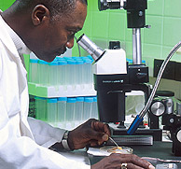
INFECTIOUS DISEASES & VACCINOLOGY
IMMUNIZATION MICROBIOLOGIST
BIOSTATISTICIAN
This Photo by Unknown Author is licensed under CC BY-SA
Notes:
Careers in Infectious Diseases and Vaccinology places a emphasis on the cellular and molecular biology of infectious diseases. Two important careers in this field are Immunization Microbiologists and Biostatisticians.
Immunization Microbiologists study bacteria, viruses, and other types of microorganisms in order to understand how infectious diseases behave within the human body and respond to vaccinations.
Biostatisticians design and collect data and analyze results of research studies related to medicine, biology, and public health issues. This work can include looking at how the body responds to vaccinations as it fights a disease.

Slide 15
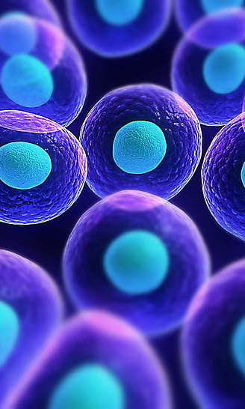
IMMUNOLOGY
CONCENTRATES ON THE CELL BIOLOGY OF PARASITES
DEVELOPING TREATMENT
CONTROL & PREVENTION OF INFECTIOUS DISEASES
VACCINATION AIDS IN THESE EFFORTS
Notes:
Careers in Immunology concentrates on the cell biology of parasites and other infections and the role immunology plays in developing treatment. It also focuses on the control and prevention of infectious diseases and how vaccinations aid in these efforts.
Immunologists are scientific researchers or practicing specialists who study, analyze, and/or treat disease processes that involve the immune system. They work in laboratories that enable them to study and test interactions of chemicals, cells, and genes in the body to better understand what is necessary for an immune system to function properly.

Slide 16

PARASITOLOGY & VECTOR BIOLOGY
Notes:
Careers in Parasitology and Vector Biology focuses on parasites and the effects they have in the human body, as well as how the relationship between parasites affecting the immune system, the role of vectors in spreading infectious diseases, and ways parasitic infections can be controlled through immunization.

Slide 17

HEALTH PROMOTION
PUBLIC HEALTH OUTREACH & EDUCATION
DEVELOP CAMPAIGNS
CREATE WELLNESS PROGRAMS
PROMOTE DISEASE MANAGEMENT ACTIVITIES
Notes:
Careers in Health Promotion include Community Health Workers and Public Health Educators. The focus is on public health outreach and education, which often includes knowledge of vaccinations and herd immunity. Theses professionals develop media campaigns, wellness programs, and disease management activities.

Slide 18

PUBLIC HEALTH & CLINICAL SYSTEMS
This Photo by Unknown Author is licensed under CC BY
Notes:
Professionals that work in public Health and Clinical Systems assess, design, and evaluate the public health responses to disease, which may include the use of immunizations within a clinical healthcare system. They also conduct community health assessments and develop healthcare policies.

Slide 19
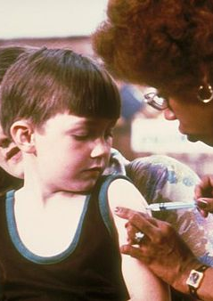
HEALTHCARE PROFESSIONALS
PHYSICIAN
NURSE
PHARMACIST
This Photo by Unknown Author is licensed under CC BY-SA
Notes:
On the front lines of healthcare, Physicians, Nurses and even Pharmacists are important professionals that educate and advise individuals, communities and other healthcare professionals about the importance of vaccinations as well as administer vaccines. If you have questions about your personal immunization status, asking your doctor to provide you with your up to date information is a great way to obtain your information.

Slide 20

PLEASE TAKE THIS POST-PRESENTATION SURVEY
https://docs.google.com/forms/d/e/1FAIpQLSfon72xhPX10PnyMmqHf7YVsCEKBlElM_CfXxakT_PXmMp9nA/viewform?usp=sf_link
This Photo by Unknown Author is licensed under CC BY-SA
This Photo by Unknown Author is licensed under CC BY-SA-NC
Notes:
On behalf of Oregon Pacific Area Health Education Center we would like to ask you to take this post-presentation survey.

Slide 21
Thank you for viewing this presentation about Careers related to Vaccines and Disease Prevention!
Please feel free to contact OPAHEC with any questions or comments.
Shellene Dougherty, Executive Director
shdougherty@samhealth.org
Julia Labahn, Education Coordinator
Jlabahn@samhealth.org
Petra Gutierrez, Education Coordinator
pgutierrez@samhealth.org
Carmen Boone, Education Coordinator
carmenb@samhealth.org
www.opahec.org
Notes:
Thank you for viewing this presentation about Careers related to Vaccines and disease prevention. Please feel free to contact us with any questions or comments. You can also visit us at www.opahec.org.

Slide 22
REFERENCES:
Information about topics and careers in bioscience for teachers, students and everyone else. (2017, June 16). Retrieved September 10, 2020, from https://www.aboutbioscience.org/careers/immunologist/
Medical Professions. (n.d.). Retrieved September 10, 2020, from https://immunelymphatic.weebly.com/medical-professions.html
This presentation was supported by the Health Resources and Services Administration (HRSA) of the U.S. Department of Health and Human Services (HHS) as part of a subaward totaling $101,995 (33%) financed with Federal funding and $210,226 (67%) financed with non-Federal sources. The contents are those of the author(s) and do not necessary represent the official views of, nor an endorsement, by HRSA, HHS or the U.S. Government

