Slide 1
9th grade high school timeline
Notes:
During your freshman year you will be starting to take control of your future. You’ll be advocating for yourself with your teachers and counselors as you forecast your coursework.

Slide 2
IDENTIFY GOALS & RESOURCES
IDENTIFY GOALS
MAKE MEANINGFUL CONNECTIONS
Notes:
The first steps on your pathways is to identify interests, goals and, long-term goals and exploring available resources. It’s important in your freshman year to begin to make meaningful connections with teachers and counselors for future references.

Slide 3
Step by step
MEET WITH YOUR COUNSELOR
Notes:
If you can, when planning your freshman class schedule, meet with your counselor who can help you to plan out the best path for you each term to complete all of the courses you will need to complete by the time you graduate. Ask about challenging courses such as Advanced Placement (AP), International Baccalaureate (IB) or dual enrollment courses. Ask your counselor if they have brochures and information about local colleges you may be interested in checking out.

Slide 4
GRADES ARE IMPORTANT
This Photo by Unknown Author is licensed under CC BY-SA
Notes:
Get off to a good start with your grades. The grades you earn in the 9th grade will be included in your final high school GPA and class rank. College may seem a long way off now, but grades really do count toward college admission and scholarships.

Slide 5
EXPLORE YOUR INTERESTS & POSSIBLE CAREERS
This Photo by Unknown Author is licensed under CC BY-SA-NC
Notes:
Now is the time to start exploring your interests and possible careers. Take advantage of career day opportunities and speak to the professionals that interest you the most. The internet is a great tool for investigating careers and best fit that relate to your personality, strengths, and aptitudes that can help you determine key factors to help you find your ideal future career.

Slide 6
GET INVOLVED IN EXTRACURRICULAR ACTIVITIES
CLUBS
VOLUNTEERING
ACADEMIC ENRICHMENT PROGRAMS
WORKSHOPS
SCHOOL LEADERSHIP
Notes:
School and community extracurricular activities and develop a deeper focus on the things that interest you. Colleges would rather see you be involved in less activities but devote more time to them. Being involved in school clubs, volunteering your time in the community, attending academic enrichment programs and workshops and being active in school leadership are all great ways to get involved.

Slide 7
CHECK OUT COLLEGE WEBSITES
This Photo by Unknown Author is licensed under CC BY-NC-ND
Notes:
The easiest way to check out prospective colleges that you may be interested in is to visit their websites. Most colleges offer virtual tours, videos about their school and programs.

Slide 8
INVESTIGATE COLLEGE ADMISSION REQUIREMENTS
This Photo by Unknown Author is licensed under CC BY-ND
Notes:
While checking out college websites don’t forget to look into their admission requirements. This way you’ll have an idea about what will be required of you to reach your goals and have an accurate checklist to start working off of throughout your high school years.

Slide 9
Trial run for junior year CAN INDICATE FUTURE SAT PERFORMANCE CAN BOOST SELF CONFIDENCE
FALL of each year you have the opportunity to take the PSAT
Notes:
In October of each year you’ll have the opportunity to take the preliminary SAT/National Merit Scholarship Qualifying Test (PSAT/NMSQT) to practice for the SAT in the next couple of years.
The PSAT is a great primer for the SAT and even the ACT, but it’s more than just a trial run.
PSAT scores are used to identify National Merit Scholars and award merit scholarships in your Junior year. Recognition as a winner results in a single payment monetary award of $2500. Finalists and other outstanding entrants are also eligible for other merit scholarships that can be helpful when paying for college.
The PSAT is designed to measure a students ability to understand and process elements of reading, writing and math.

Slide 10
Paying for college
HAVE A PLAN
SAVINGS
FINANCIAL AID
GRANTS
SCHOLARSHIPS
THE OREGON PROMISE
Notes:
Talk to your parents and family about the cost of college and plans for paying for you to attend. There are many different ways to pay for an college education including financial aid assistance, grants and scholarships. Working towards the goal of earning grants and scholarships in high school will improve your opportunities. Colleges offer application fee waivers, all you need to do is speak to the counselor an you can locate the waiver on their websites as well. Most colleges try and make it as easy as possible for students and parents to navigate through the application process.
On the next slide we will discuss The Oregon Promise Grant.

Slide 11
The Oregon promise grant
Notes:
The Oregon Promise Grant is an excellent opportunity to pay for the first two years of your college education within an Oregon community college.

Slide 12
DIVISION I OR II COLLEGE SPORTS
This Photo by Unknown Author is licensed under CC BY-SA
Notes:
If you plan on participating in Division I or II college sports, you will need to register with the NCAA in your sophomore year. Check with your counselor to get a list of NCAA core courses to make sure you are taking the right classes to be eligible.

Slide 13
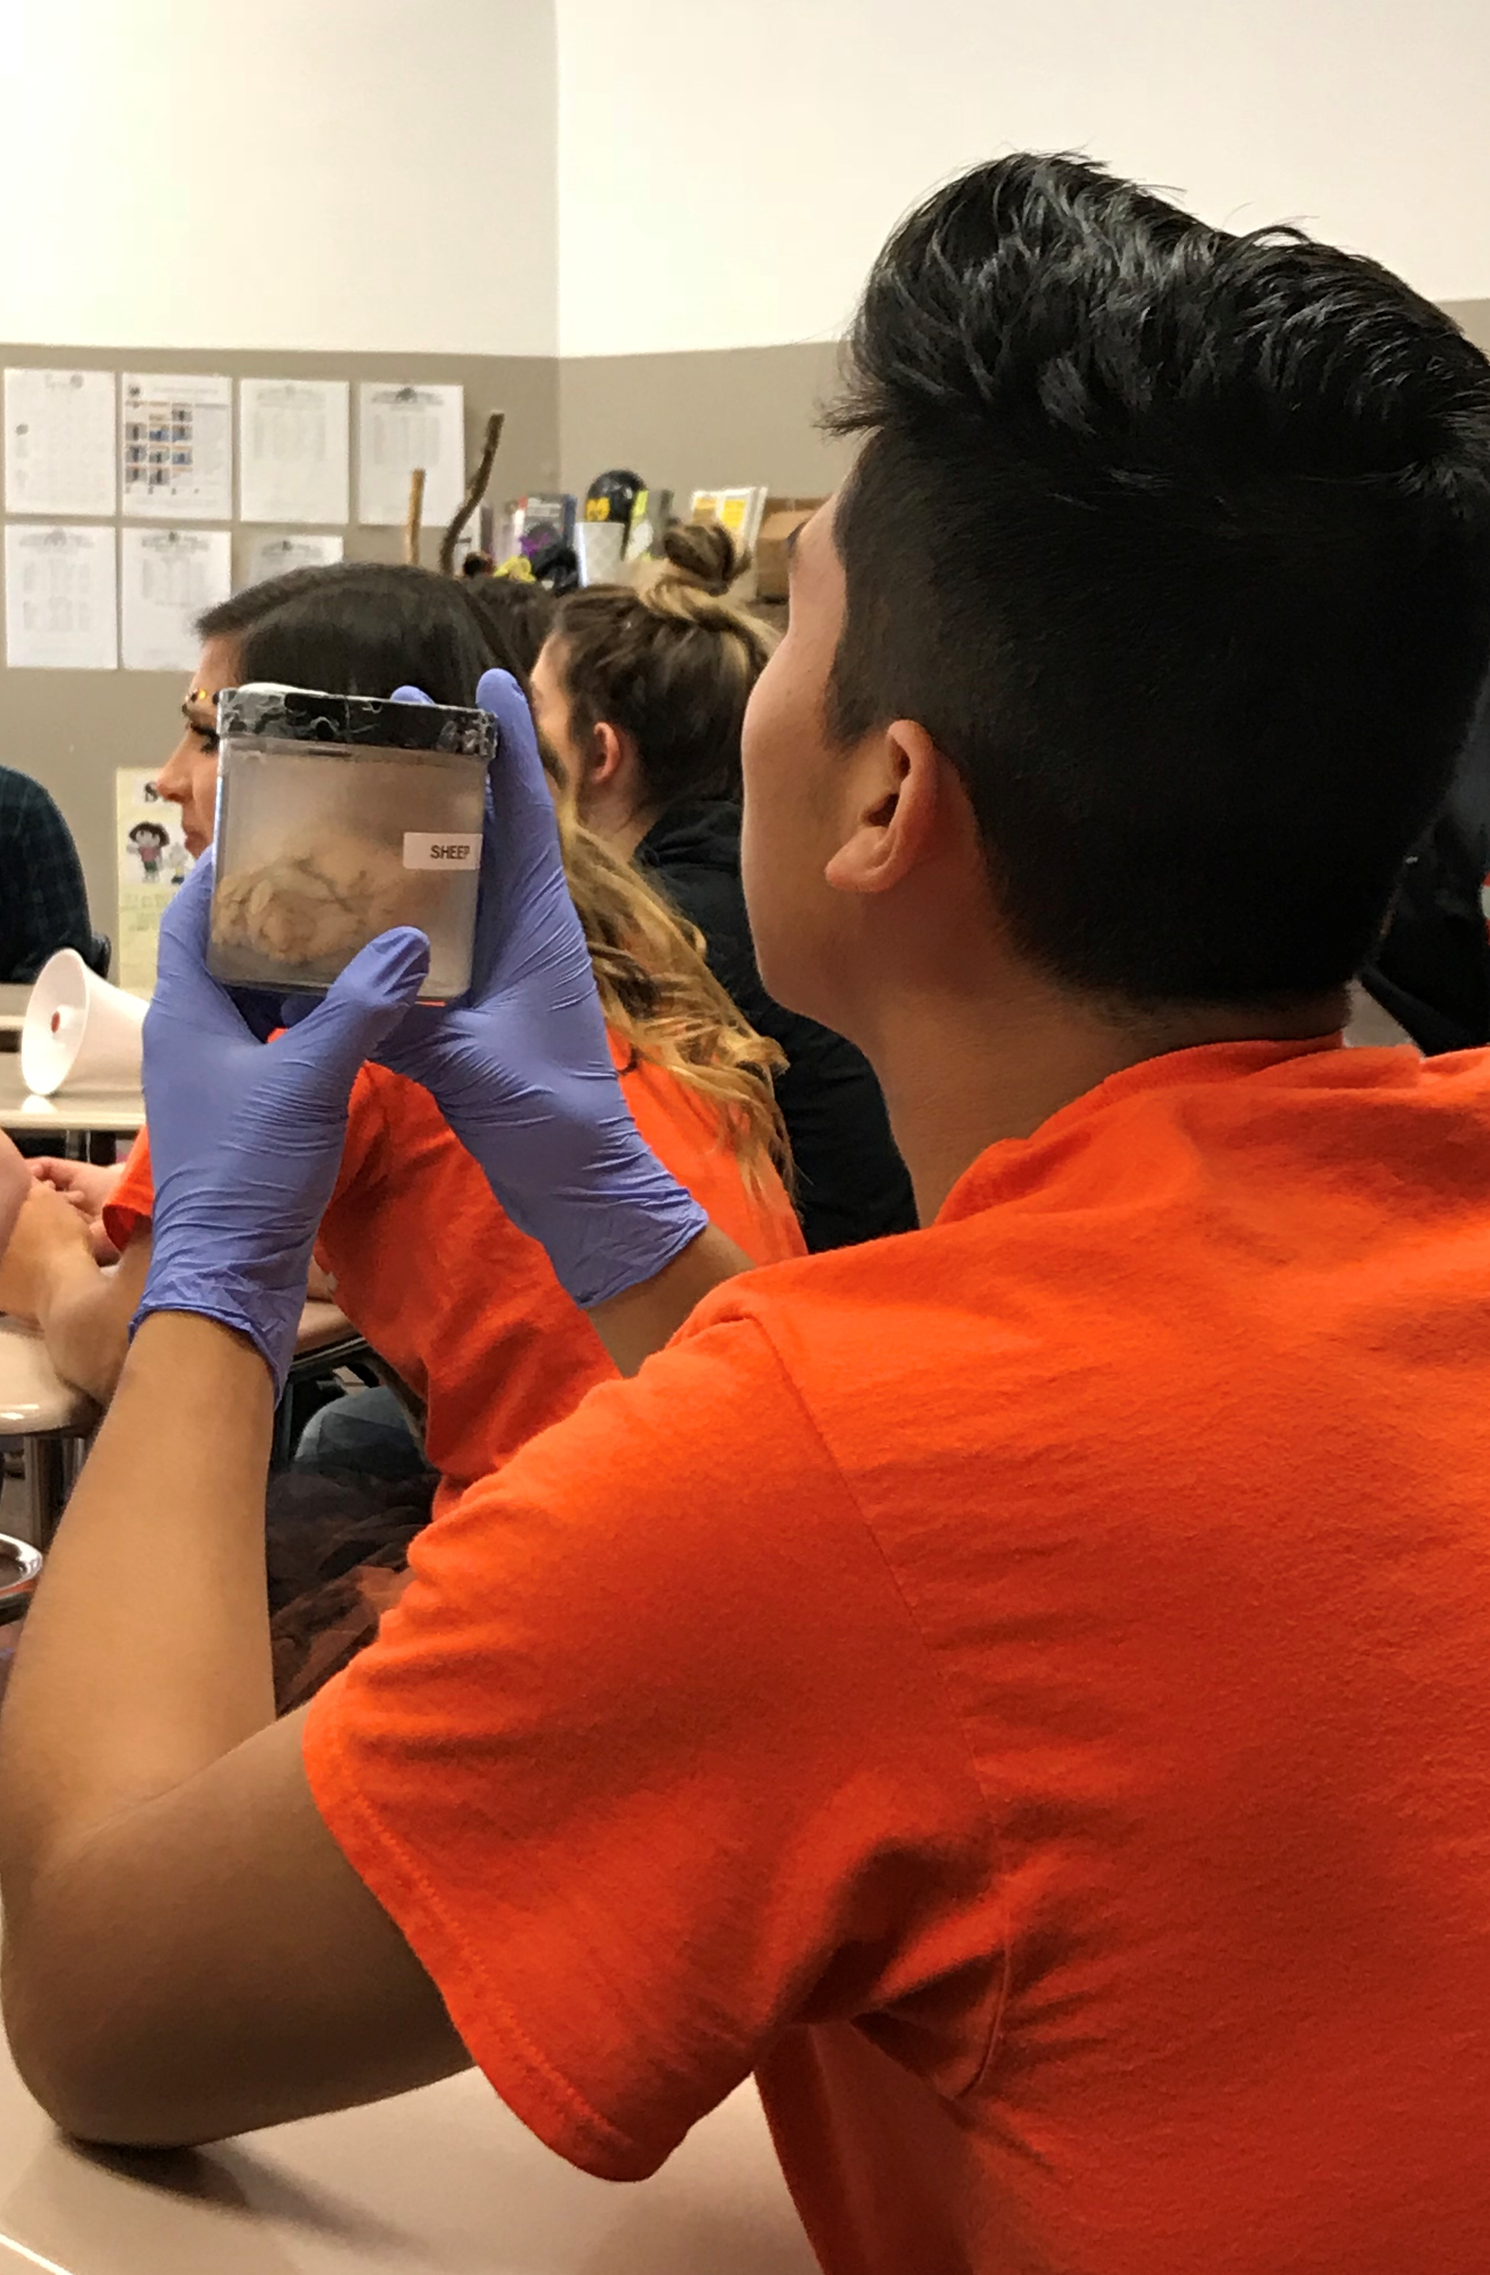
INVESTIGATE & PLAN FOR SUMMER ENRICHMENT OPPORTUNITIES
CAMPS
CLASSES/ENRICHMENT PROGRAMS
VOLUNTEERING
Notes:
In the Spring of your freshman year start looking into summer opportunities, such as camps, classes and enrichment programs and volunteering to help you prepare for college. Use the summer break to further your goals and planning for the future.

Slide 14
Use your summer wisely & HAVE FUN!
This Photo by Unknown Author is licensed under CC BY-NC

Slide 15
Oregon pacific area health education center
Please take this post
presentation survey
https://docs.google.com/forms/d/e/1FAIpQLSfon72xhPX10PnyMmqHf7YVsCEKBlElM_CfXxakT_PXmMp9nA/viewform?usp=sf_link
This presentation was supported by the Health Resources and Services Administration (HRSA) of the U.S. Department of Health and Human Services (HHS) as part of a subaward totaling $101,995 (33%) financed with Federal funding and $210,226 (67%) financed with non-Federal sources. The contents are those of the author(s) and do not necessary represent the official views of, nor an endorsement, by HRSA, HHS or the U.S. Government.

Slide 16
If you have any questions or comments, please feel free to email:
Shellene Dougherty, Executive Director
shdougherty@samhealth.org
Julia Labahn, Education Coordinator
Jlabahn@samhealth.org
Petra Gutierrez, Education Coordinator
pgutierrez@samhealth.org
Carmen Boone, Education Coordinator/Office Specialist
carmenb!@samhealth.org
www.opahec.org

