Slide 1
CAREERS IN OPTICAL HEALTH
This Photo by Unknown Author is licensed under CC BY
By Julia Labahn BS, Health Education Coordinator

Slide 2
OBJECTIVES:
Gain knowledge of the field of Optical Health
Learn about Optical Health careers
Discover educational pathways and colleges in Oregon for careers in Optical Health
Learn about the eye anatomy
Gain an understanding about a variety of optical related illness and disease
Understand basic skills and competencies for success

Slide 3
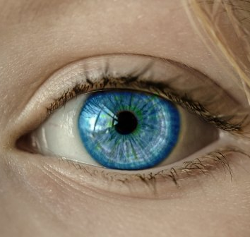
Eye Health
They say the eyes are the windows to the soul. We don't know if that's true, but what we do know that having perfectly healthy eyes—excellent vision and clear eyes, free of pain or other symptoms—are crucial to your health and well-being.
This Photo by Unknown Author is licensed under CC BY-NC-ND

Slide 4
Careers studying the eye!
OPHTHAMOLOGIST
Specializes in the medical and surgical care of the eyes and the prevention of eye disease.
They diagnose and treat patients and they are licensed to practice medicine and surgery, as well as deliver routine eye care.
Notes:
Ophthalmologist's are highly important health care professionals. Keeping our eyes healthy prolongs the quality of our lives. With the expertise of an Ophthalmologists people who are developing or have delivered some age related eye disorders have the option to have treatment.
The typical educational path to become an Ophthalmologist is completing a 4 year Bachelor’s degree, completing 4 years of medical school, completing a 1 year internship, completing 3 years of residency and become licensed.
Many ophthalmologists are certified by the American Board of Ophthalmology. The ABOP oversees the initial certification requirements for ophthalmologists and continuing education requirements for these specialized physicians to maintain their certification.
There are two medical schools in the State of Oregon which are Oregon Health & Science University in Portland and Western University and Health Sciences (COMP-NW) in Lebanon.
The median annual salary for a self-employed Ophthalmologist is approximately $398,000 and an employed Ophthalmologist is approximately $329,000.

Slide 5
Careers studying the eye!
OPTOMETRIST
Specializes in function and disorders of the eye, detection of eye disease, and eye disease management.
Conduct eye exams, prescribes corrective contact lenses and glasses, and diagnoses and treats eye diseases and disorders.
Notes:
An Optometrist is a health care professional who are trained to examine the eyes for visual defects and provide correction. They can manage eye injuries and provide services to rehabilitate some eye conditions through low vision rehabilitation and vision therapy.
The typical educational path to become an Optometrist is to complete a 4 year Bachelor’s degree, complete 4 years of Optometry school and become licensed with the State Optometry Board under the National Board of Examiners in Optometry.
There is currently one school of Optometry in Oregon which is Pacific University College of Optometry in Forest Grove. Optometrists are not required to attend medical school.
The median annual salary for an Optometrist is approximately $111,990.

Slide 6
Careers studying the eye!
OPTICIANS
Opticians work on the front line of vision care.
Educational path: 1-2 year certification program, a 6 month apprenticeship or on the job training.
Median annual salary is $39,930
Notes:
Opticians are one of the most important members of the eye care team because of the amount of direct interaction with customers. Customer loyalty is often won or lost based on how well the frame selection and eye wear fitting process goes.
Opticians keep track of orders and inventory, interpret prescriptions, collect eye measurements including corneal width and thickness, help clients with the selection of eye glasses and contact lens treatments. They create work orders to ensure proper fir and repairing broken frames and educate clients on proper eyeglass and contact lens care.
Essentially, Opticians are the customer care of optical health.
Although Oregon does not have certification and licensing requirements for opticians, it is best to seek industry-standard certifications. The American Board of Opticianry (ABO) and the National Contact Lens Examiners (NCLE) offer nationally recognized certifications for opticians seeking to validate their knowledge and competencies.
There are community college certification programs an individual can complete to master the skills needed to obtain an entry level job as an Optician. Knowledge about eye anatomy and physiology has a 30% hire rate. Schools in Oregon that provide certification as an Optician are Linn-Benton Community College in Albany, Lane Community College in Eugene, and Portland Community College that has a 2 year Associate’s degree program in ophthalmic medical terminology.

Slide 7
Careers studying the eye!
ORTHOPTIST
An Orthoptist is someone who focuses on problems that affect both eyes.
Educational path: Complete an undergraduate 4 year Bachelor’s degree and as well as 2 years of certified training (an Accredited Fellowship) from the American Orthoptist Council.
Median annual salary is $74,710
Notes:
Orthoptist’s deal with the science of eye movement.
Orthoptist’s focus on affliction's that include binocular vision, double vision, and depth perception. They treat people with crossed-eyes and have been referred by an Ophthalmologist or Optimists.
Orthoptist’s can also assist in surgeries done by Ophthalmologists.
Oregon Health & Science University’s Casey Eye Institute is Oregon’s only Orthoptist Fellowship Program.

Slide 8
Optometrist
WHAT’S IN AN EYE?
EDUCATION
Bachelors degree (4 years)- most common biological science/natural science
Take optometry exam
Start optometry school (~ 4years)
Notes:
Please take the time to watch this fascinating video about eye anatomy. As you can see there are many delicate parts of the eye that all contribute to it’s function.

Slide 9
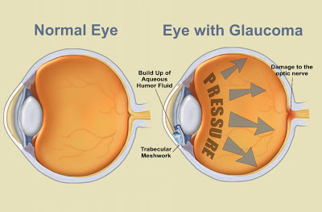
Optometrist
EDUCATION
GLAUCOMA
The leading cause of blindness although can be detected it in its early stages.
Caused by pressure that can destroy the optical nerve.
Our eye’s drainage system becomes blocked or narrowed.
Normally caused by aging.
Bachelors degree (4 years)- most common biological science/natural science
Take optometry exam
Start optometry school (~ 4years)
Notes:
The pressure from the eye’s own aqueous humor builds up in the eye, which can destroy the optical nerve and lead to blindness.
A healthy eye can drain the aqueous humor, but the drains can shrink with age and become clogged by deposits.
This is called chronic open-angle Glaucoma.
Glaucoma can also be congenital in the person is born with an impaired drainage system. The drainage system can also be blocked by the iris, or it can be damaged by hemorrhaging, tumors or inflammation.

Slide 10
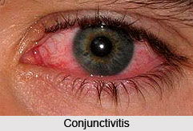
Optometrist
EDUCATION
CONJUNCTIVITIS
Very common, approx. 3 million U.S. cases per year.
Inflammation of the lining and membrane of the eyelids.
Eyelids itch and burn, or feel dry and heavy.
Easy to treat and easily detectable.
Bachelors degree (4 years)- most common biological science/natural science
Take optometry exam
Start optometry school (~ 4years)
This Photo by Unknown Author is licensed under CC BY-NC-ND
Notes:
Conjunctivitis is highly contagious and patients should make sure that they wash their hands, towels, doorknobs or anything that they handle that can be washed. Today, we know how important hand washing is to reduce the chance of contamination of bacteria. Allergic conjunctivitis can be treated with antihistamines. Bacterial conjunctivitis can be treated with antibiotic eye drops.
Pink eye (conjunctivitis) is an inflammation or infection of the transparent membrane (conjunctiva) that lines your eyelid and covers the white part of your eyeball. When small blood vessels in the conjunctiva become inflamed, they're more visible. This is what causes the whites of your eyes to appear reddish or pink.
If you are diagnosed with Conjunctivitis please make sure you do not wipe your eyes with your bare hands. Anything you touch can be a carrier to someone else.
Warm or cool compresses places on the eye can relieve symptoms. Also, avoid wearing contact lenses and eye makeup.

Slide 11
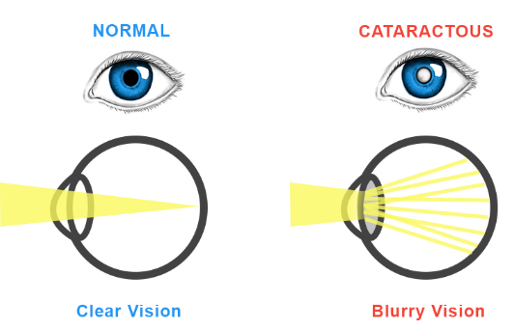
Optometrist
EDUCATION
CATARACTS
Clouding of the lens of the eye, which is supposed to be clear.
Painless, but causes vision to be blurred.
Consequence of aging.
Cataracts are easily removed through surgery.
Bachelors degree (4 years)- most common biological science/natural science
Take optometry exam
Start optometry school (~ 4years)
This Photo by Unknown Author is licensed under CC BY
Notes:
Cataracts can also be caused by eye injuries and diseases. If you start observing blurred vision it’s best to make an appointment to have your eyes checked.

Slide 12
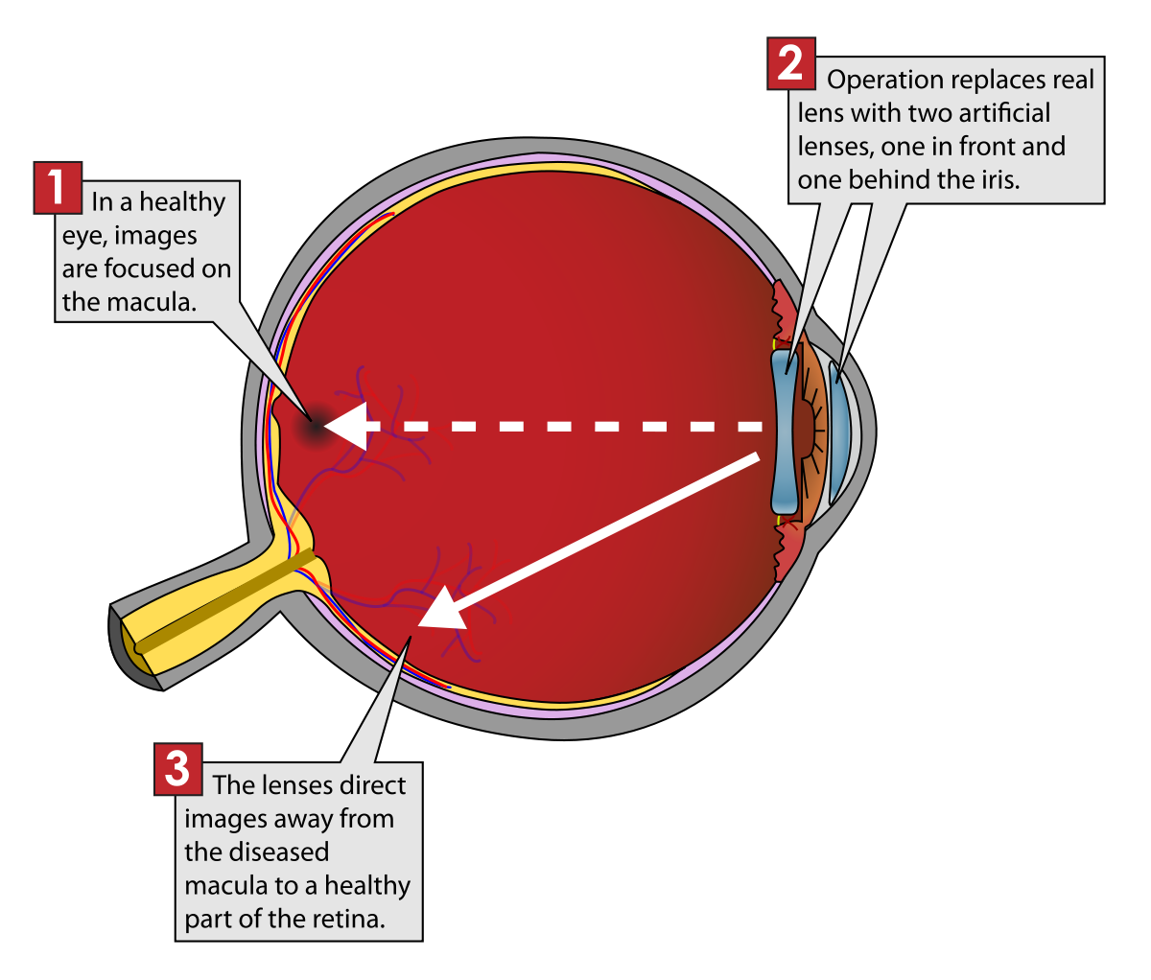
Optometrist
EDUCATION
MACULAR DEGENERATION
Is a consequence of aging or can be genetic.
If the macula is damaged, images can become blurry exactly in the center.
Macular degeneration happens when the blood vessels in the back of the eye break, leak and cause scar tissue.
Bachelors degree (4 years)- most common biological science/natural science
Take optometry exam
Start optometry school (~ 4years)
This Photo by Unknown Author is licensed under CC BY-SA
Notes:
Individuals can have a predisposition where the macula breaks down or thins out. The macula is a part of the retina, in the back of the eye near your optical nerve. The retina
receives light that the lens has focused, convert the light into neural signals, and sends the signals to the brain for visual recognition.
Macular Degeneration is considered irreversible. Although, the newest treatment for Macular Degeneration involves eye injections.

Slide 13
Optometrist
EDUCATION
SKILLS & COMPETENCIES
An interest in health and a desire to improve people’s quality of life
Excellent communication skills
Attention to detail
Have good manual dexterity and be able to work with precision
Have the ability to concentrate while doing repetitive tasks
Provide patient-centered care
Bachelors degree (4 years)- most common biological science/natural science
Take optometry exam
Start optometry school (~ 4years)
Notes:
A successful Optical health professional needs to have a genuine interest in health and a desire to improve patient’s quality of life.
Excellent communication skills are required and being a people person this provides patient’s with a sense of comfort whenproviding exams and treatment.
Attention to detail is important in all health care professions. In Optical healthcare a minute incorrect calculation or misspelling can mean a patient does not receive quality care.
Because the human eye and it’s related areas are so small, having good manual dexterity and being able to work with precision is mandatory. Also, having the ability to concentrate while doing repetitive tasks is necessary.
Finally, an Optical health professional must provide the best patient-centered care possible. This includes listening to, informing and involving patients of their care. This provides individual patients respect and value in all clinical decisions.

Slide 14
Optometrist
EDUCATION
Thank you for watching our presentation about Careers in Optical health!
Please feel free to contact Oregon Pacific Area Health Education Center with any questions you may have.
www.OPAHEC.org
Bachelors degree (4 years)- most common biological science/natural science
Take optometry exam
Start optometry school (~ 4years)

