Slide 1
Orthopedics Working with the framework of our body
By Julia Labahn, BS Health Education Coordinator

Slide 2
Overview:
Gain knowledge of the field of Orthopedics
Learn about Orthopedic careers
Discover educational pathways and colleges in Oregon for careers in Orthopedics
Be informed about the history of Orthopedic Nursing
Understand basic Skills and Competencies for success
Notes:
This presentation will teach a basic overview of the medical field of Orthopedics, Orthopedic educational pathways and careers, be informed about the history of Orthopedic Nursing and basic skills and competencies for success in an Orthopedics career and a solid foundation for those who are going on to pursue advanced degrees in Orthopedics.

Slide 3
Objectives: BY THE END OF THIS PRESENTATION STUDENTS WILL BE ABLE TO:
List 5 part of the body that Orthopedics helps
Describe the educational pathway to becoming an Orthopedic Surgeon
List 3 Specialty careers in Orthopedics
Have the ability to write a short paragraph about the history of Orthopedic Nursing
Describe 3 Skills & Competencies
Notes:
This presentation will teach a basic overview of the medical field of Orthopedics, Orthopedic educational pathways and careers, be informed about the history of Orthopedic Nursing and basic skills and competencies for success in an Orthopedics career and a solid foundation for those who are going on to pursue advanced degrees in Orthopedics.

Slide 4
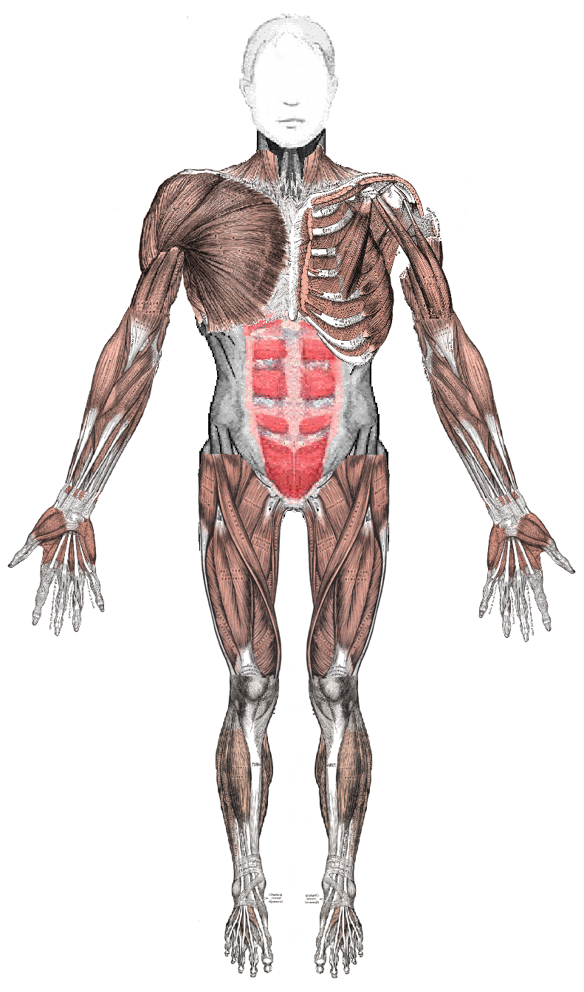
Orthopedics is the medical specialty devoted to the diagnosis, care and treatment of musculoskeletal disorders.
Bones
Joints
Muscles
Tendons
Ligaments
Nerves
This Photo by Unknown Author is licensed under CC BY-SA
Notes:
This includes taking care of the bones, joints, muscles, tendons, ligaments, and nerves that make the framework of our bodies that allow you to move, work and be active.
The human foot has 26 bones, 33 joints and more than 100 muscles, tendons and ligaments.
The human hand is made up of 27 distinct bones.
The human spine I comprised of 33 vertebrae.
The field of Orthopedics treats them all.
Once an injury or condition develops, it can be difficult to fix.
While a lot of musculoskeletal issues can be cured or controlled, there are a lot of health conditions that can last for several years or last a lifetime. If we learn to prevent injuries, we can save time, energy, money and most importantly the ability to physically do the things we love.

Slide 5
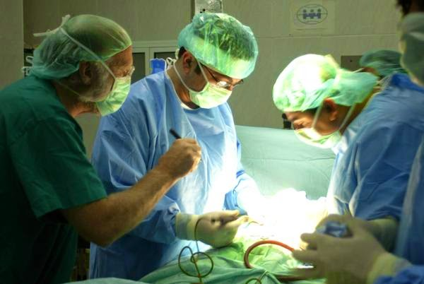
SURGEON
Orthopedic Surgeon’s spend about half of their time in the Operating Room. They also use medical, physical, and rehabilitative methods in addition to surgery.
This Photo by Unknown Author is licensed under CC BY
Notes:
Orthopedic Surgeon’s treat fractures, dislocations, torn ligaments, tendon injuries, back pain, congenital deformities and arthritis.
Research shows that there will be a shortage of Orthopedic Surgeons in the near future. Approximately 15% of Orthopedic Physicians are under 40 years old and approximately 1/3 are over 60 years old. There is a call for pre-med, medical students and physicians to enter this field to accommodate the needs of our country.
The number one reason for seeing an Orthopedic Surgeon in the U.S. is knee pain.
90% of knee replacement patients experience a significant reduction in pain. 85% of artificial knees still function 20 years after surgery.
Approximately 500,000 knee replacements and more than 175,000 hip replacements are performed annually in the U.S. and those numbers are on the rise.

Slide 6
Orthopedic Surgeon Education
4 year Bachelor’s Degree
4 years of Medical School
Approx. 5 years of residency or post-graduate education
Specialty Orthopedic Surgeons are required to complete a Fellowship
The Median annual salary is $482,000 in 2019
Notes:
Orthopedic Surgeon’s must be licensed to practice and most are board certified.
There are two medical schools in the state of Oregon which are Oregon Health & Science University (MD) in Portland and Western University Comp-NW (DO) in Lebanon.
Some programs require the physician to spend several years in general surgery before moving to the practice of Orthopedic surgery.

Slide 7
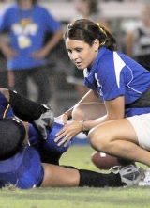
Orthopedic specialities
Some of these specialties may include:
Pediatric orthopedics
Sports medicine
Hand surgery
Joint replacement
Foot and ankle surgery
Orthopedic Oncology
Spine surgery
Physical Therapists
Orthopedic trauma
This Photo by Unknown Author is licensed under CC BY-NC-ND
Notes:
After completing a residency to become an Orthopedic Physician, one must complete a Fellowship to become a Specialist in their chosen field. A Fellowship is the period of medical training that a physician may undertake which is usually one year. During that time, the Physician is called a Fellow.
Some important Orthopedic Specialities include Pediatric Orthopedics which is mastering the special needs of growing children, Orthopedic Oncology which is a physician and surgeon who specializes in the diagnoses and treatment of primary benign and malignant tumors of the bones, and Physical Therapists who diagnose and treat individuals who have medical problems or other health related conditions that limit their abilities to move and perform functional activities in their daily lives.
Each Specialty plays an integral part in the role of Orthopedic medical needs of individuals around the world.

Slide 8
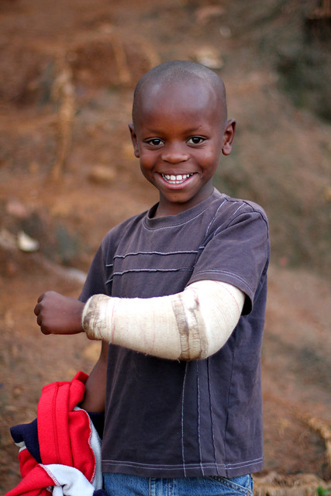
Orthopedic Nurses
Serve orthopedic patients
Assist physicians with procedures
Assist patients with post-op recovery
This Photo by Unknown Author is licensed under CC BY-NC-ND
Notes:
Orthopedic Nursing is a Specialty.
Obtaining mastery in the knowledge of equipment such as braces, prosthetics, and other orthopedic equipment are imperative in providing quality care.
Orthopedic Nurses may work in dedicated orthopedic units or in general units that serve orthopedic patients such as intensive care units, pediatrics and/or work in outpatient care clinics.
They assist physicians with preparation for procedures and assist patients with their post operative recovery. They play an important role during a time when patients need advocacy, encouragement and education.
They educate those with orthopedic conditions or complications and be familiar with casting, traction, mobility devices and pain management.
Orthopedic Nurses must have a degree as a Registered Nurse and licensed by passing the National Council Licensure Exam – Registered Nurse (BCLEX-RN) certification requirements.
Many Orthopedic Nurses gain voluntary professional certifications for the Orthopedic Nursing Certification Board.
An Orthopedic health care team also includes Licensed Vocational or Licensed Practical Nurses, Medical Assistants and Certified Nursing Assistants.

Slide 9
Orthopedic Nursing education
Registered Nurse (RN) Associates degree – 2 year Associate’s degree + license
Median Annual Salary is $75,510
Registered Nurse (RN) Bachelors or Masters degree – 4 – 6 years + license
Median Annual Salary $96,953
Advanced Practice Nurse – Advanced education and training
Median Annual Salary $100K +
Licensed Vocational Nurse (LVN) Licensed Practical Nurse (LPN) – 1-2 year program at a community college + license
Median Annual Salary is $53,240
Notes:
There are numerous community college Nursing Programs in the state of Oregon. Please reach out to locations you are interested to get accurate information about what pre-requisites and other information required to apply for the program.

Slide 10
Accredited University Nursing Schools in Oregon
Linfield, Portland, OR.
Northwest Christian University, Eugene, OR.
Oregon Health & Science University, Portland, OR. And Eastern OR.
University of Portland, Portland, OR.
This Photo by Unknown Author is licensed under CC BY-NC-ND

Slide 11
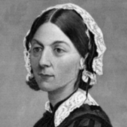
Orthopedic nursing History
Nurses are:
Trusted
Teachers
Advocates
Caregivers
Critical Thinkers
Innovators
Florence Nightingale
Notes:
History – In Victorian England c. late 1800’s the Famous Florence Nightingale led the reform of unsanitary conditions. In the United States, the Civil War was active.
She was an English Reformer, Statistician and the founder of modern Nursing.
Florence Nightingale came into prominence while serving as a Manager and Trainer of Burses during the war, in which she organized care for wounded soldiers. Casualties of war and the sick required rehabilitation and care.
Dr. James Knight founded The Hospital for the Ruptured and Crippled in his home which later became the first Orthopedic institution with exceptional nursing care.
Nurses are the most trusted healthcare professionals. They are with patients throughout the continuum of life.
Nurses are teachers, advocates, caregivers, critical thinkers and innovators.
Nursing is an honorable profession and nurses are the heart and soul of the healthcare system.

Slide 12
Orthopedic Technician Orthopedic Technicians apply and remove casts, manage patients in traction and assist the surgeon in the operating room. Median Average Salary $45,614
Notes:
Training is either on the job or training in a school approved by the National Association of Orthopedic Technologists.
Ortho Tech’s assist Ortho Surgeon’s in the practice of medicine and Ortho Nurse’s in the care of patients.

Slide 13
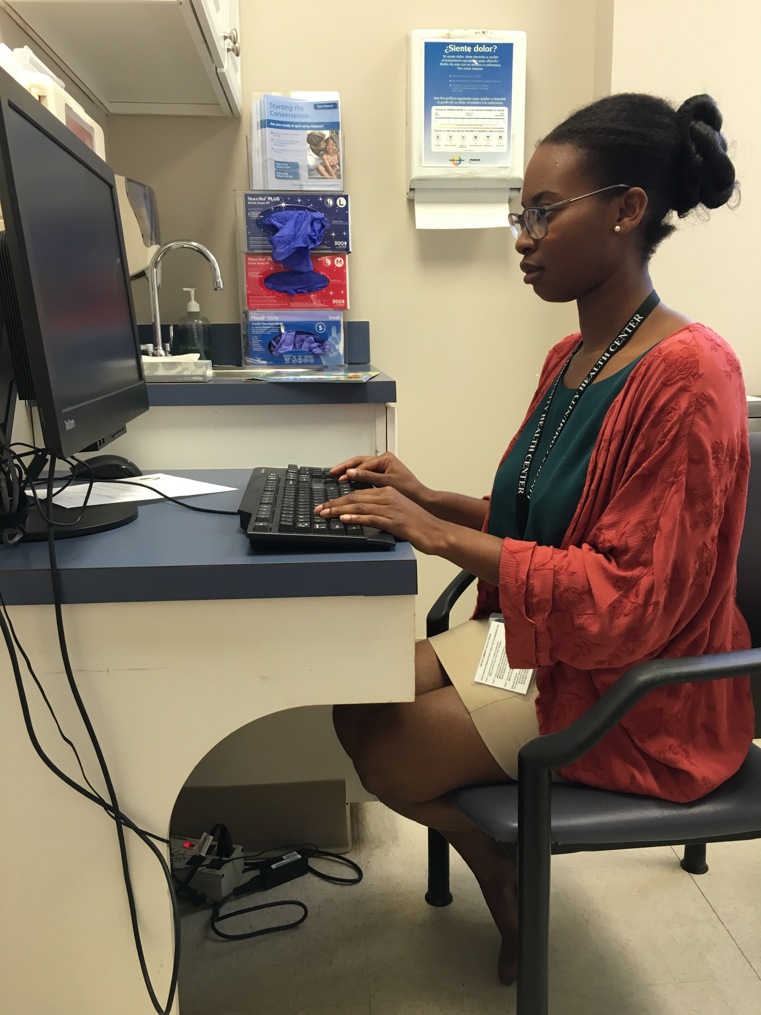
medical scribe
A Medical Scribe is a revolutionary concept in modern medicine.
Average Median Salary is $23,602.
This Photo by Unknown Author is licensed under CC BY-ND
This Photo by Unknown Author is licensed under CC BY-NC-ND
Notes:
Traditionally, a physician’s job has been focusing solely on direct patient contact and care. Physician's across the country are turning to Medical Scribe services to relieve the documentation overload. When Electronic Health Record (EHR) created an overload of documentation it slowed physicians down and pulled them away from actual patient care.
A Medical Scribe is essentially a physician’s assistant in gathering information and documentation. This career choice is an excellent opportunity for a pre-med, medical student or Physician’s Assistant to collaborate one-on-one with a physician and gain experience and exposure to real medicine in practice.
To become a Medical Scribe one needs to have a high school diploma and knowledge of medical terminology. Each physician has their own requirements when hiring a Medical Scribe. One may want an employee with some college experience and others may require training or a certificate.

Slide 14
Orthopedic Sports Medicine
Are you interested in being an orthopedic surgeon or sports medicine?
Meet James Voos, Head Team Physician for The Cleveland Browns, UH Case Medical Center. He’s also the team physician for a few area high schools.
Notes:
Any person who lives an active lifestyle and participates in an active activity such as running, swimming, or a recreational sport can use Sports Medicine.
Sports medicine is not just about rehabilitation. Preventative care and nutrition are imperative areas as well.
Rehabilitation focuses on helping the body recover from optimal functionality so it can perform the way it’s supposed to.
Preventative care focuses on teaching patients about safety and what precautions to take when exercising and being active.
Preventing an injury or illness keeps the body healthy and let’s people participate in their sport or activity longer.

Slide 15
Skills & competencies:
Detail-oriented
Practical skills such as good hand-eye coordination and manual dexterity
Active listening skills
Good organizational abilities
The ability to work on a team or alone
Provide patient-centered care
Notes:
Patient-centered care involves listening to, informing and involving patients of their care. This provides individual patients respect and value in all clinical decisions.

Slide 16
THANK YOU FOR TAKING THE TIME TO WATCH OUR PRESENTATION ABOUT ORTHOPEDIC CAREERS!
Please feel free to contact Oregon Pacific Area Health Education Center (OPAHEC) with any questions.
www.OPAHEC.org

Slide 17
Survey
Please take the Post Lesson Survey
https://docs.google.com/forms/d/e/1FAIpQLSfon72xhPX10PnyMmqHf7YVsCEKBlElM_CfXxakT_PXmMp9nA/viewform?usp=sf_link

Slide 18
References:
(n.d.). Retrieved from https://learn.org/articles/Orthopedic_Surgeon_Career_and_Salary_FAQs.html
Careers. (n.d.). Retrieved from https://www.careerexplorer.com/careers/orthopaedic-surgeon/
&na;, &na; (1992). Orthopaedic Nursing. Orthopaedic Nursing, 11(2), 10–11. doi: 10.1097/00006416-199203000-00003

