Slide 1
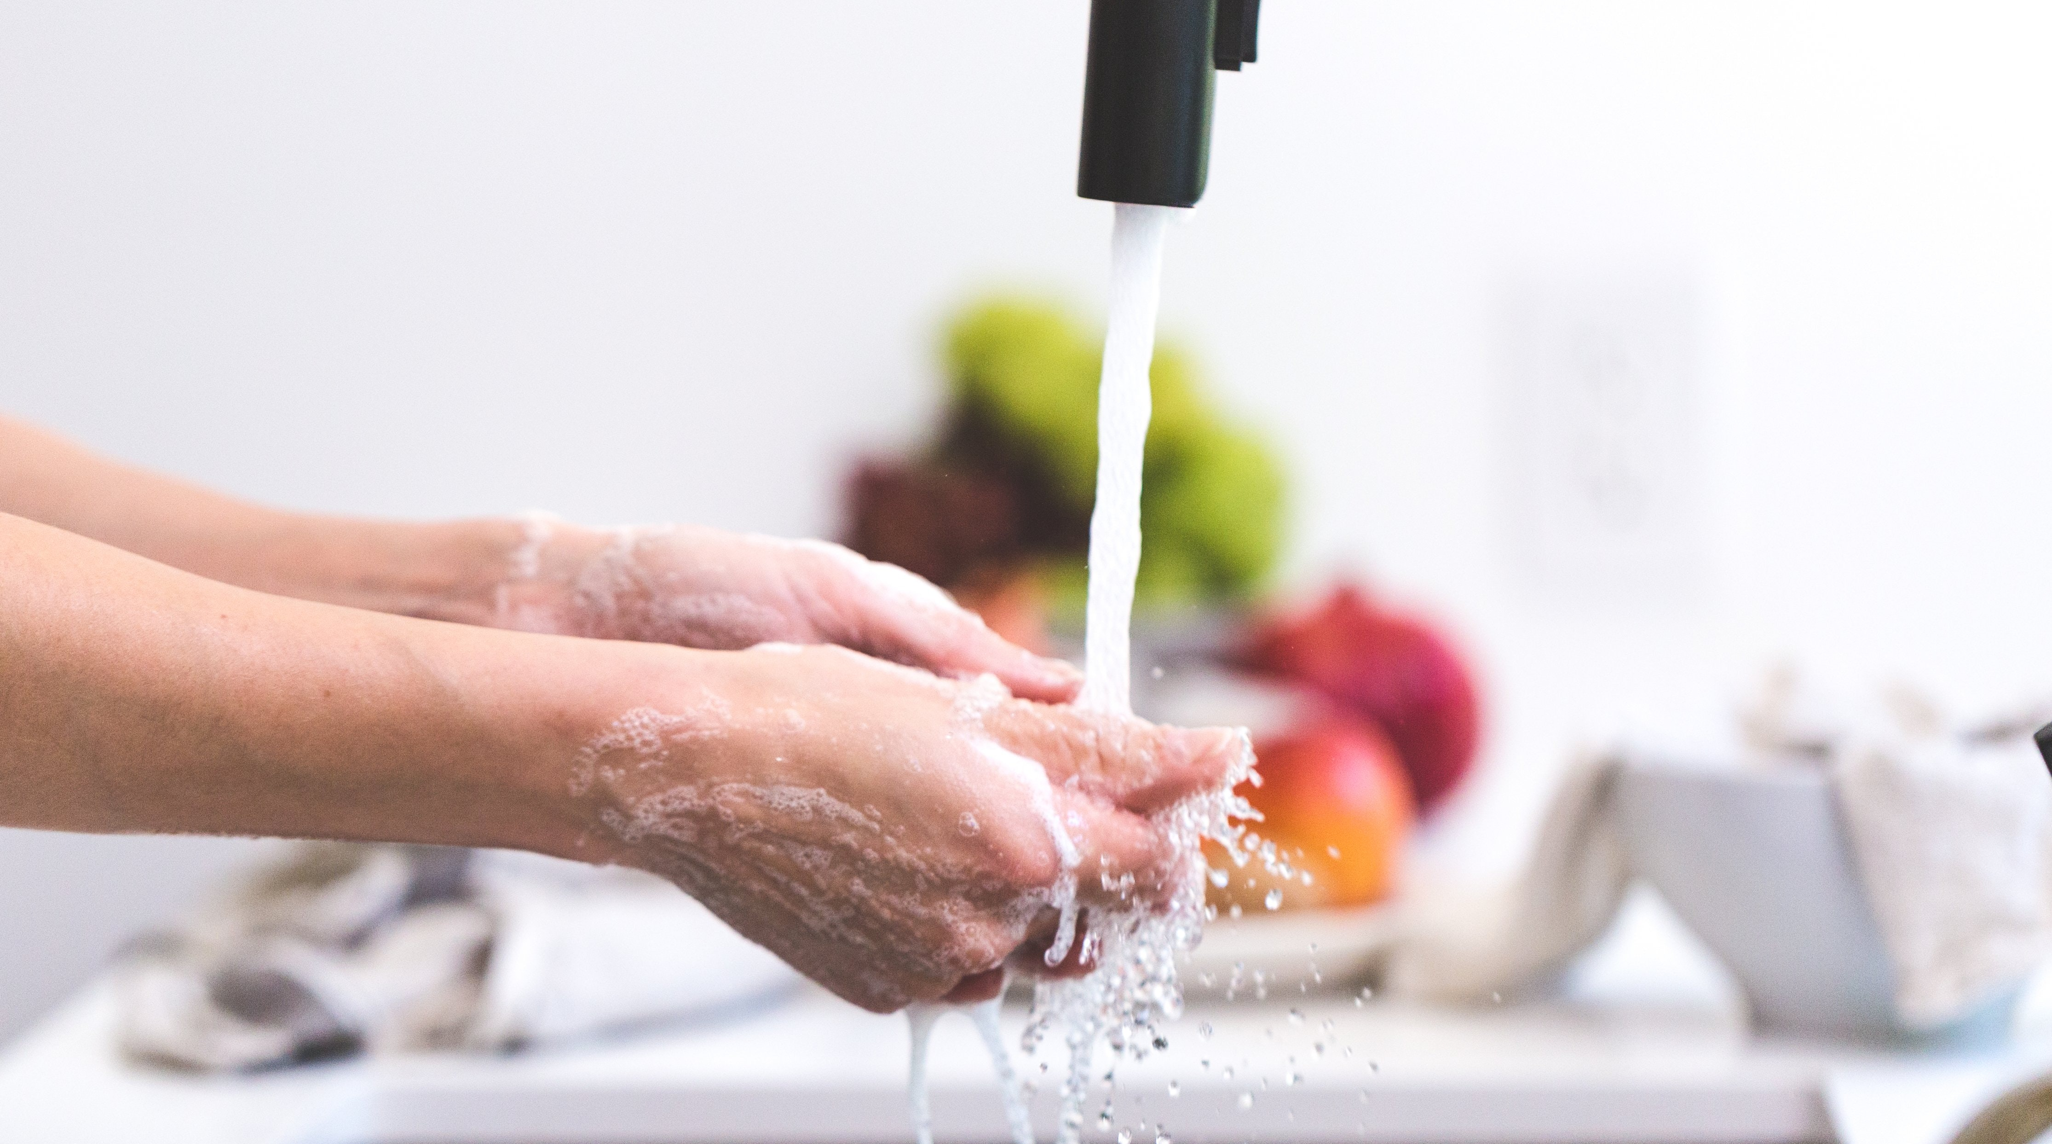
Infection Control
by Carmen Boone, MS
Infection
Microorganisms
Good
Hygiene
Practices

Slide 2
Objectives
What will you know after this lesson?

Slide 3
After viewing this presentation and completing the associated activities, students will be able to describe the following aspects of

Slide 4
Infection Control
Know types of microorganisms
Explain the chain of infection
Know methods of disinfection
Understand good hygiene practices

Slide 5
Infection Control
by Carmen Boone, MS
Infection
Good
Hygiene
Practices

Slide 6
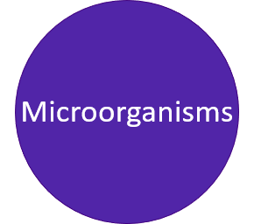
We are surrounded by microorganisms, most are harmless, some are beneficial and even necessary for our existence: non-pathogens
Others may cause sickness: pathogens

Slide 7
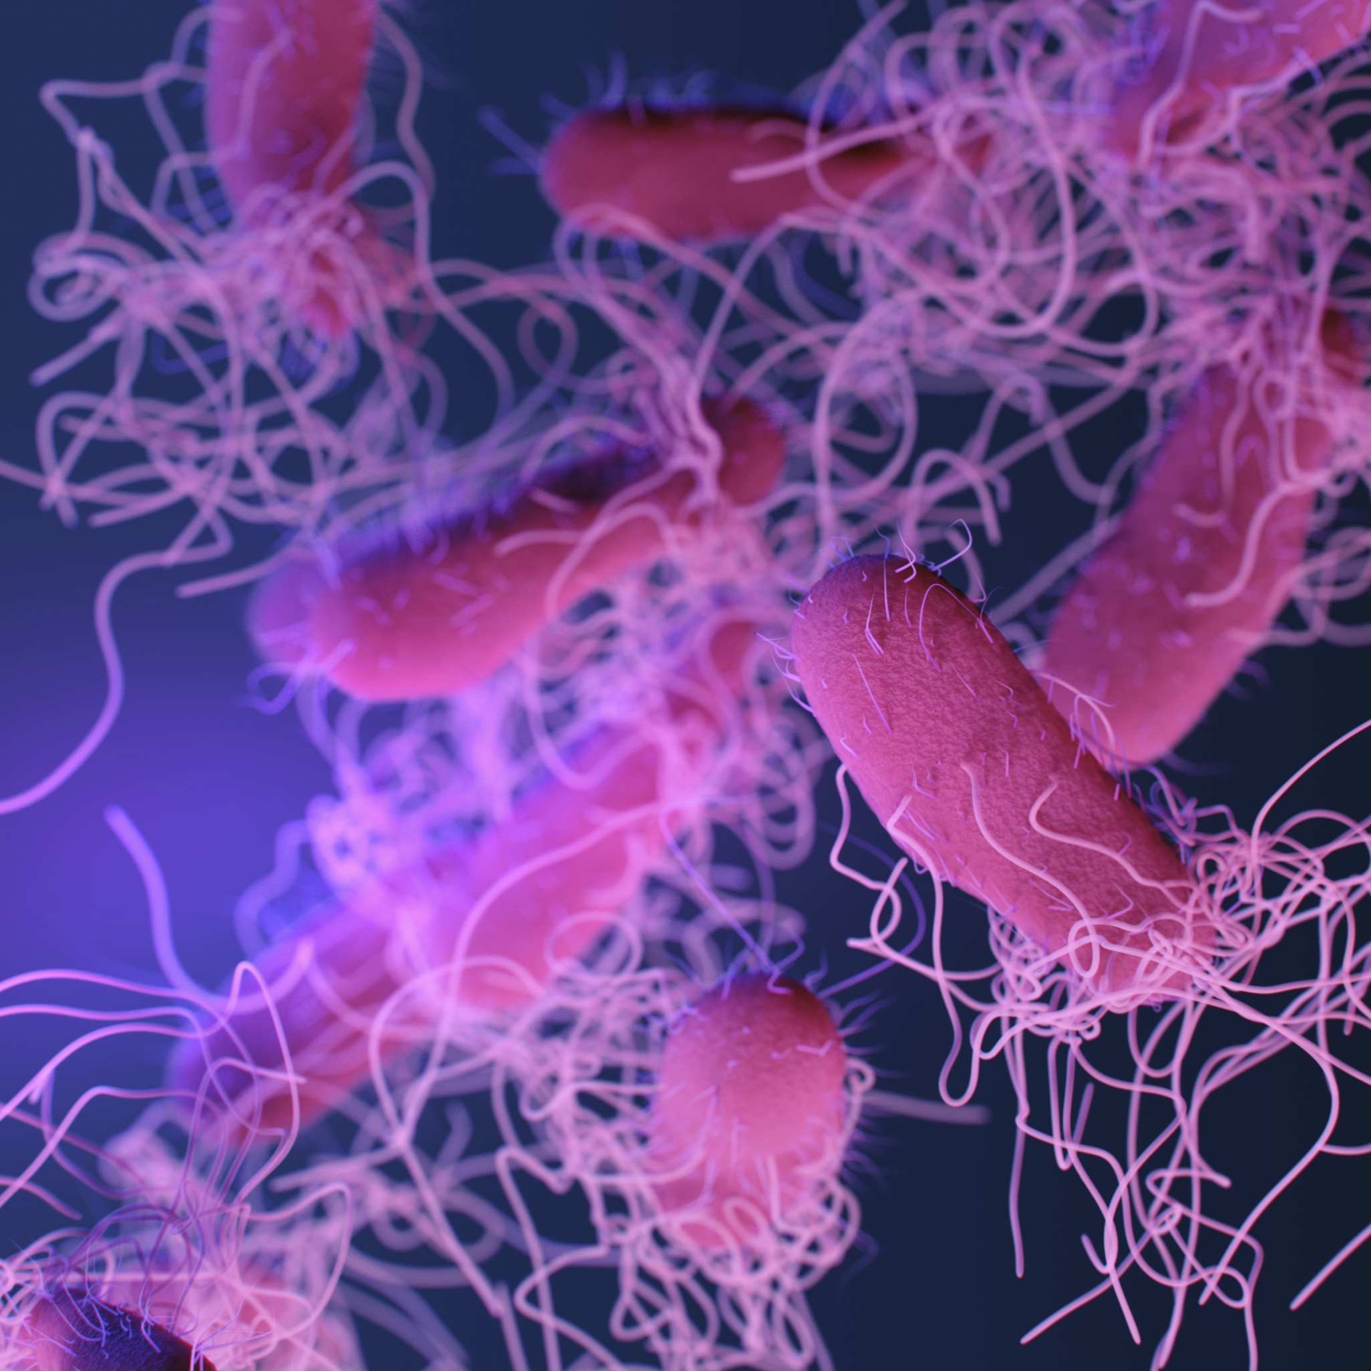
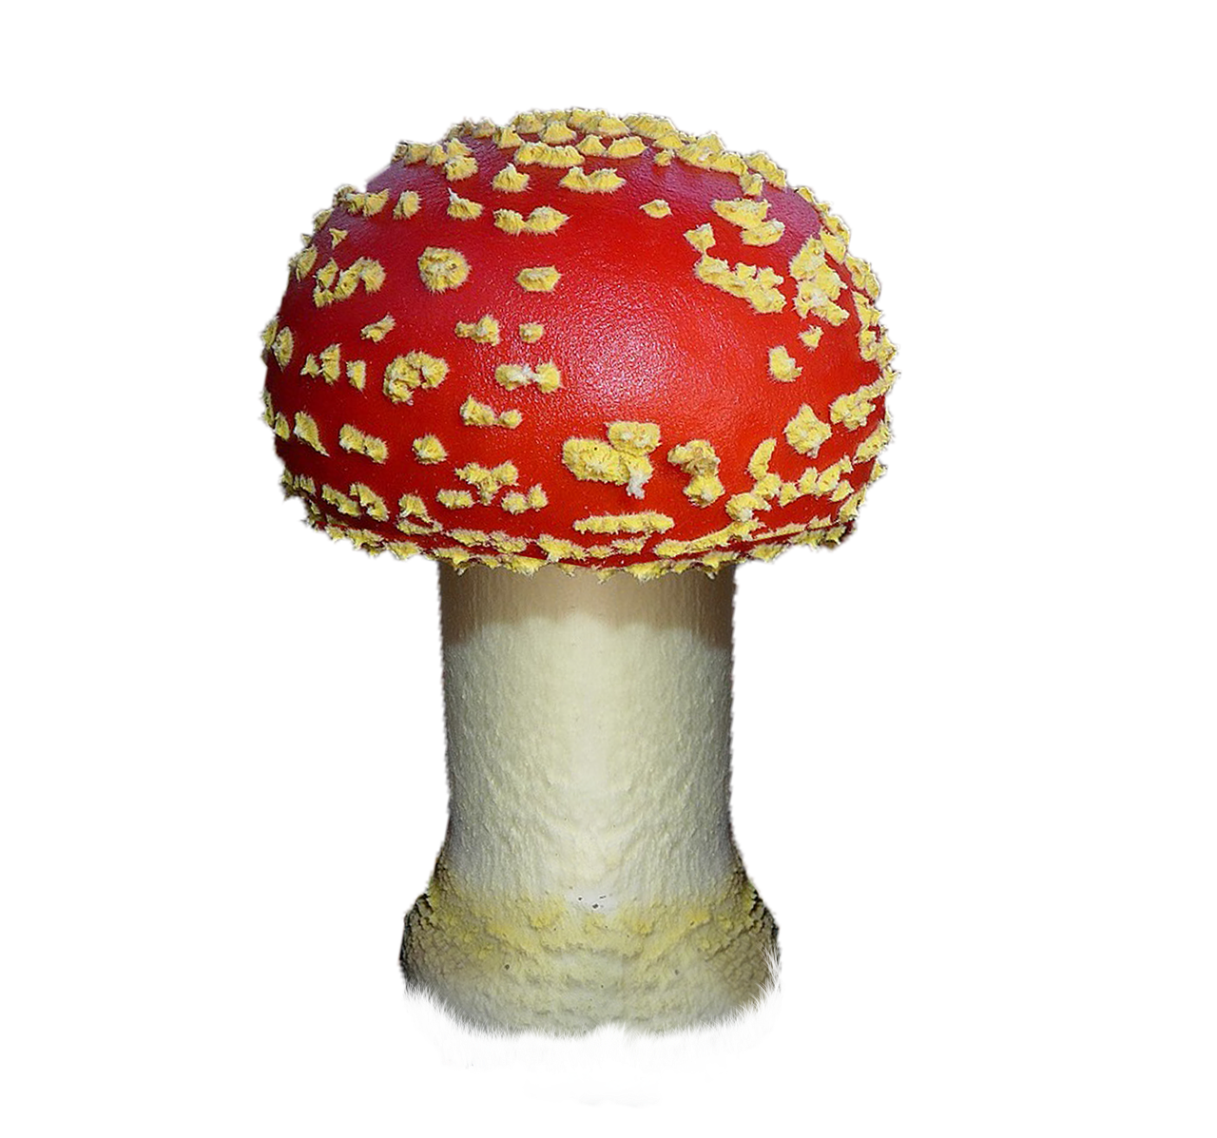
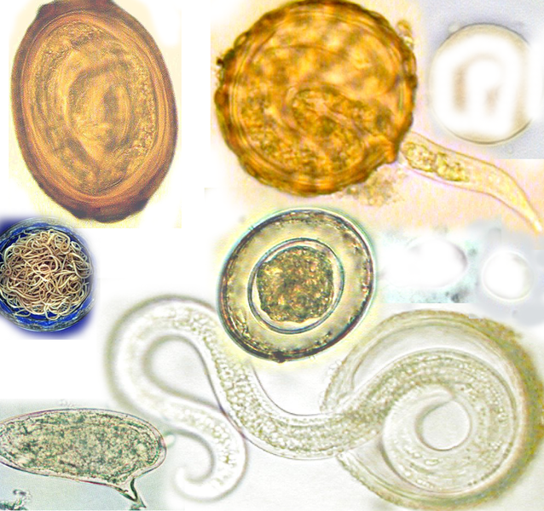
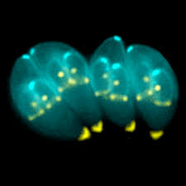
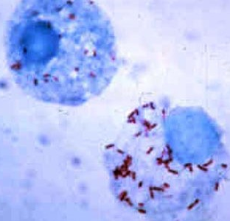
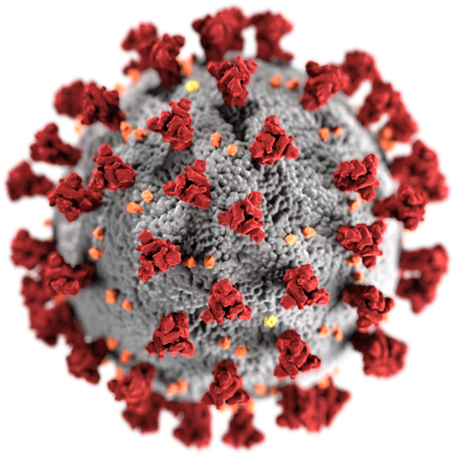
Classes of Microorganisms
Viruses
Bacteria
Fungi
Helminths
Protozoa
Rickettsiae

Slide 8
Infection Control
by Carmen Boone, MS
Good
Hygiene
Practices

Slide 9
An infection
can happen when a microorganism enters a person's body and causes harm.

Slide 10
Some produce poisons called toxins
Others attack and destroy the living cells they invade
Some cause an allergic reaction

Slide 11
How can a person get infected?
The Chain of Infection
Causative agent
Susceptible host
Reservoir
Portal of entry
Portal of exit
Mode of transmission

Slide 12
How to Stop the Chain of Infection?
Eliminate any step in the chain
Follow practices to interrupt/break the chain
Pathogens are everywhere
Continuously prevent the process

Slide 13
Breaking the Chain
ASEPTIC: Absence if disease-producing microorganisms, or pathogens
STERILE: Free from all organisms, pathogenic and nonpathogenic
Antiseptics prevent or inhibit growth of pathogens, but do not affect spores or viruses. On skin: alcohol
Disinfectants destroy or kill pathogens, not always spores or viruses. On objects: bleach
Sterilizers destroy all microorganisms, both pathogenic and nonpathogenic, spores and viruses. On objects: steam, radiation, autoclave

Slide 14
Infection Control
by Carmen Boone, MS
Infection
Microorganisms

Slide 15
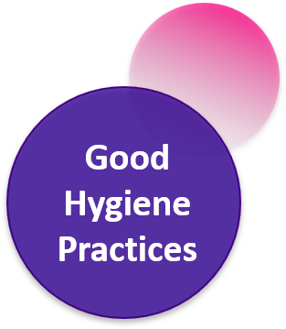
Handwashing
Most important and simple way of infection control
Prevents and controls spread of pathogens

Slide 16
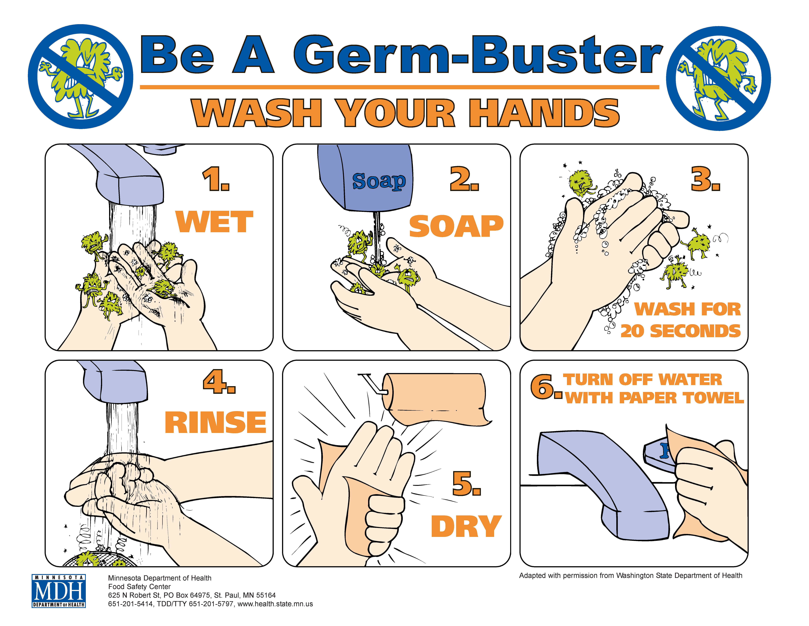

Slide 17
Waterless Hand Cleaning
Alcohol-based gel, lotion, or foam
Used if hands are not contaminated with blood or body fluids
Apply cleaner to palm of hand
Rub hands together vigorously for at least 15 seconds
After six to ten cleanings hands need to be washed with soap and water

Slide 18
Thank you!
References:
Simmers, L., Simmers-Nartker, K., & Simmers-Kobelak, S. (2009). Diversified health occupations. Clifton Park, NY: Delmar Cengage Learning.
Mitchell, J. & Haroun, L. (2006). Introduction to Health Care. Clifton Park, NY: Delmar Cengage Learning.
Teacher post lesson evaluation:
https://docs.google.com/forms/d/e/1FAIpQLScm7bY40s5NeCkKOae37psyrt4kuhGB7ssErRHKDb3mJemD8g/viewform?usp=sf_link
Student post lesson evaluation: https://docs.google.com/forms/d/e/1FAIpQLSfon72xhPX10PnyMmqHf7YVsCEKBlElM_CfXxakT_PXmMp9nA/viewform
This presentation was supported by the Health Resources and Services Administration (HRSA) of the U.S. Department of Health and Human Services (HHS) as part of a subaward totaling $101,995 (33%) financed with Federal funding and $210,226 (67%) financed with non-Federal sources. The contents are those of the author(s) and do not necessary represent the official views of, nor an endorsement, by HRSA, HHS or the U.S. Government.

