Slide 1
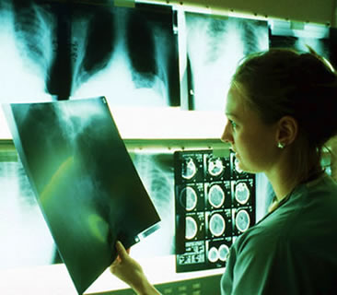
Medical Imaging
This Photo by Unknown Author is licensed under CC BY-NC-ND
By Julia Labahn, BS Health Education Coordinator

Slide 2
Objectives:
Gain knowledge of the field of Medical Imaging
Learn about Medical Imaging careers
Discover educational pathways and colleges in Oregon for careers in Medical Imaging
Understand basic skills and competencies for success
Notes:
This presentation will teach a basic overview of the field of Medical Imaging, a variety of careers and educational pathways, discover colleges in the state of Oregon that have various Medical Imaging programs, the basic skills and competencies for success in an Medical Imaging career and a solid foundation for those who are going on to pursue advanced degrees in Medical Imaging.

Slide 3
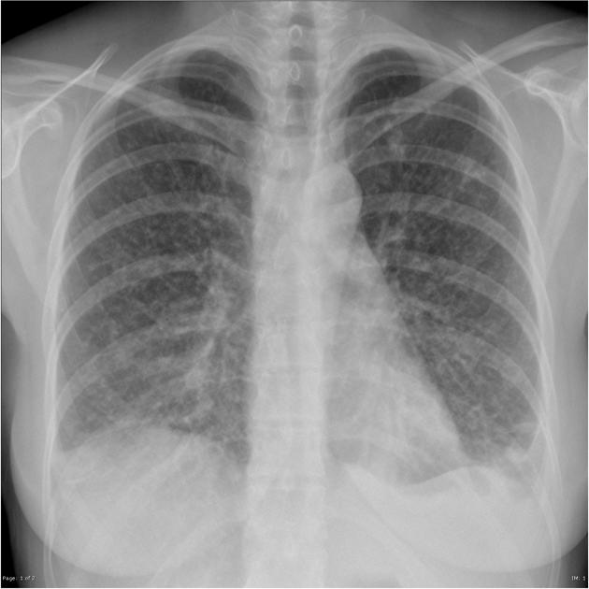
What is Medical Imaging?
Medical Imaging is the study and practice of using radiological equipment to diagnose and treat disease and ailments.
This Photo by Unknown Author is licensed under CC BY-SA-NC
Notes:
In order to pursue a career in radiology, you must complete an associates, bachelor’s, master’s or and/or a medical degree depending on the type radiology profession you wish to practice. There are 4 colleges and Universities with Radiologic Technology degree program in the State of Oregon.
There are many health care professional careers in Medical Imaging. Included are Radiologic Technologists (X-ray techs), Diagnostic Sonographer Technologists (Ultrasounds Techs), Nuclear Medical Technologists, Radiation Therapists, and Radiologists.
When you look at the x-ray image on the slide, what do you assume that this particular area of the body can tell us? Actually a variety of things. This image is of the chest cavity so it may show disease and/or illness of the lungs, a fractured rib, and many more things. Medical Imaging is an important tool for health care professionals to be able to take a snapshot of the interior areas of our body to diagnose and treat patients.

Slide 4
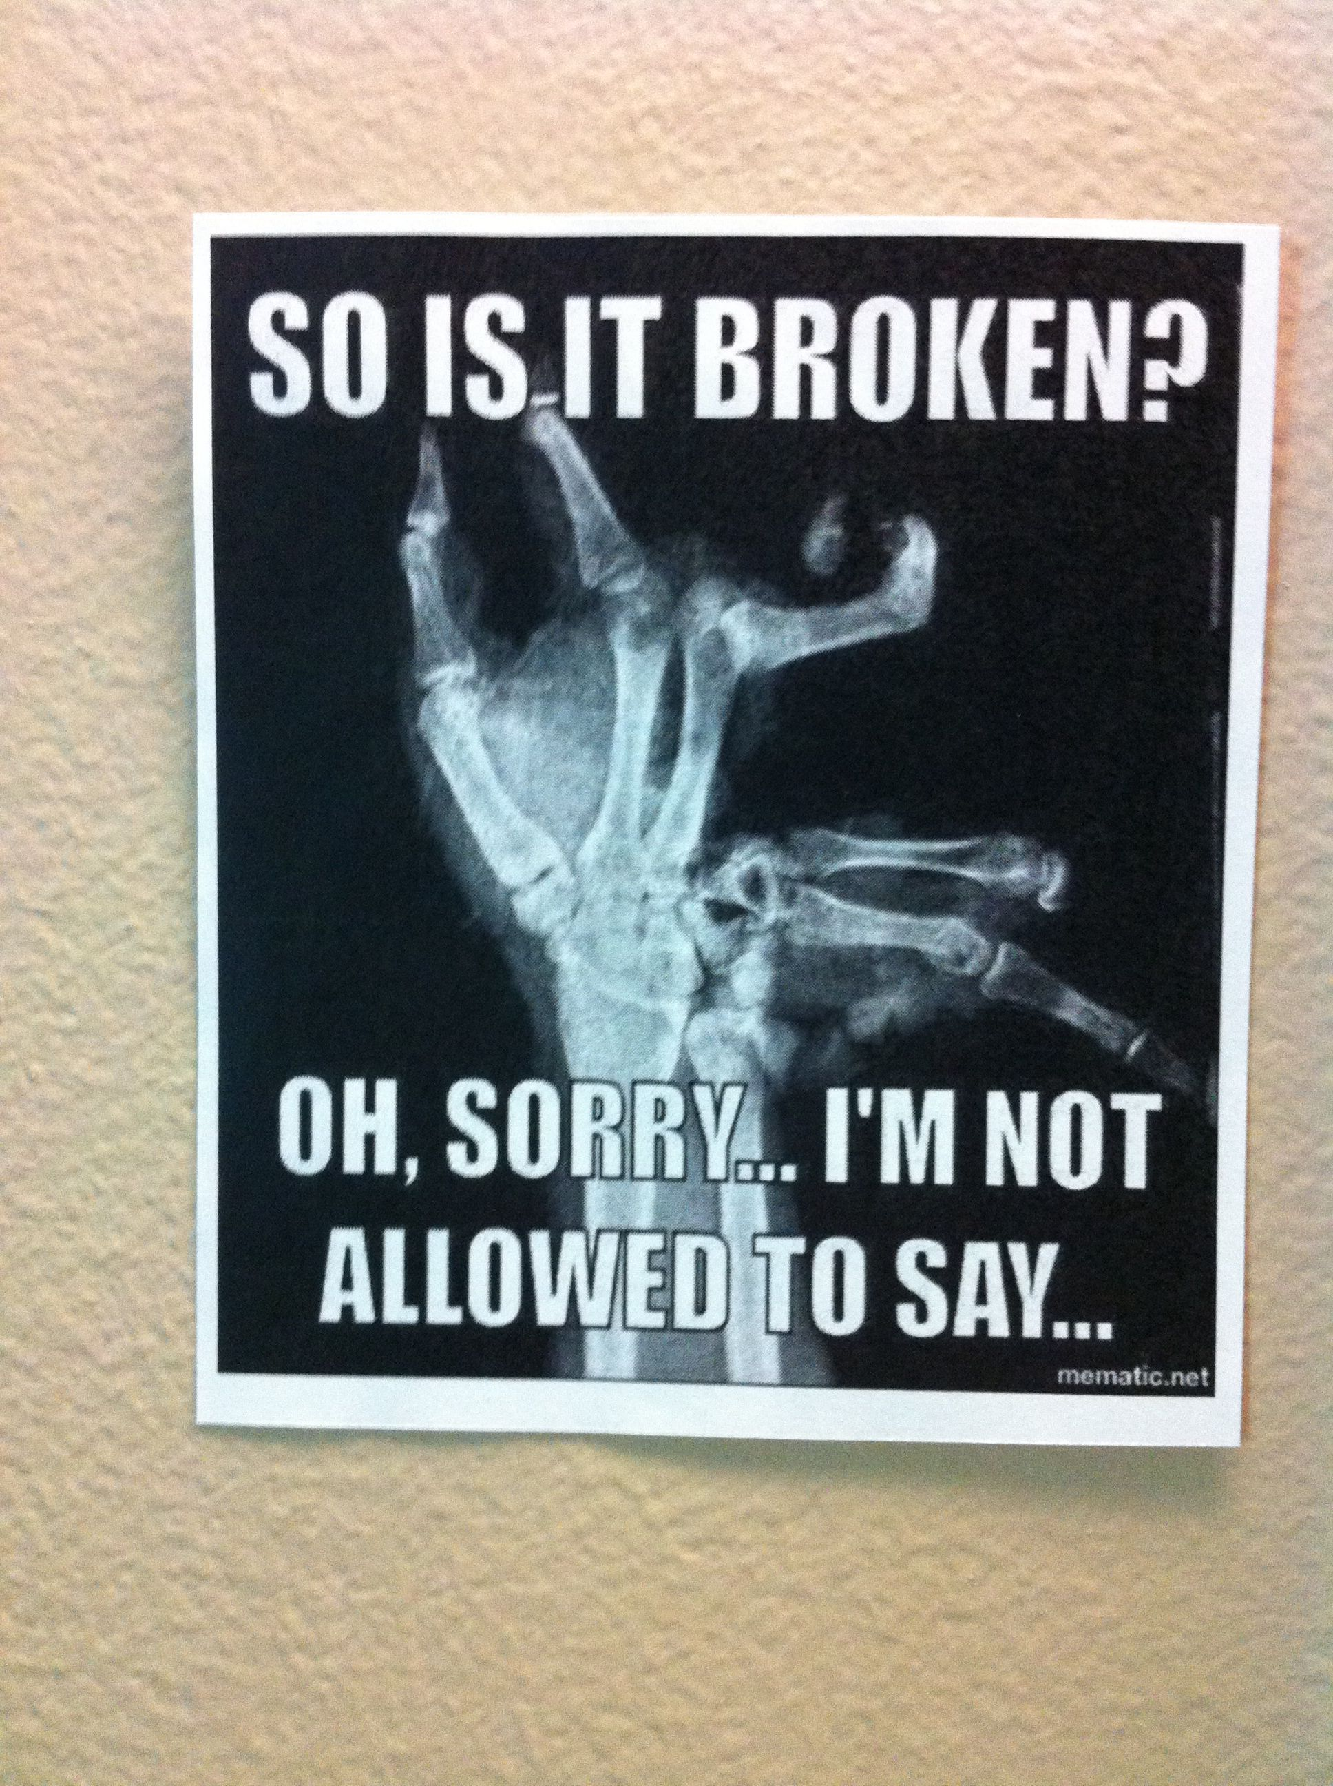
The field of Medical Imaging is growing and in high demand!
Due to an aging population that will live longer and be more active than previous generations there is a high need for the care to diagnose and treat injuries and illnesses that will guide this medical field.
Notes:
Medical Imaging careers are expected to grow much faster than the average for all occupations which currently is at a rate of 7% through the year of 2026.
Radiologic and MRI Technician jobs are expected to increase 13% while Diagnostic Sonographer jobs are expected to grow 17% through 2026.
What does all of this mean? It means that careers in Medical Imaging is in high demand.

Slide 5
Radiologic Technician (X-Ray Tech) Career An entry level health care professional career that makes the big bucks!
Job Description: | Operate medical imaging equipment and analyze test results.
Educational Requirements: | Associates Degree
Relevant Certifications: | State License, ARRT Certification
Average Salary: | $58,440
Notes:
Radiology Technicians do not diagnose but they get to see all of the interesting images! They create medical images using x-ray’s and other radiations. They may work independently or with a physician to create images of computed tomography (CT), magnetic resonance (MRI), mammography, cardiovascular intervention technology (CIT) and others.
Radiologic Technicians make a good income for the short amount of time that is required to be certified and is a rewarding career.
The career path to become a Radiologic Technician is to complete a 2 year Associates degree at a community college, pass an exam and become licensed by the state.

Slide 6
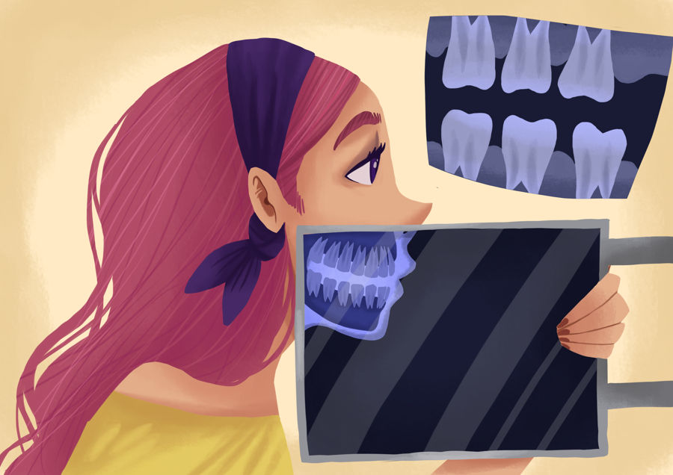
So, what does someone do in the field of Medical Imaging?
If you’ve ever been to the emergency room with a broken bone, it was probably a Radiology Technician who explained the x-ray procedure to you, made sure all of your jewelry was removed, positioned you, and then took the x-ray.
This Photo by Unknown Author is licensed under CC BY
Notes:
When you go to the Dentist, a Dental Assistant will most likely take x-ray’s of your teeth. A Dental Assistant must be trained to take x-ray’s.

Slide 7
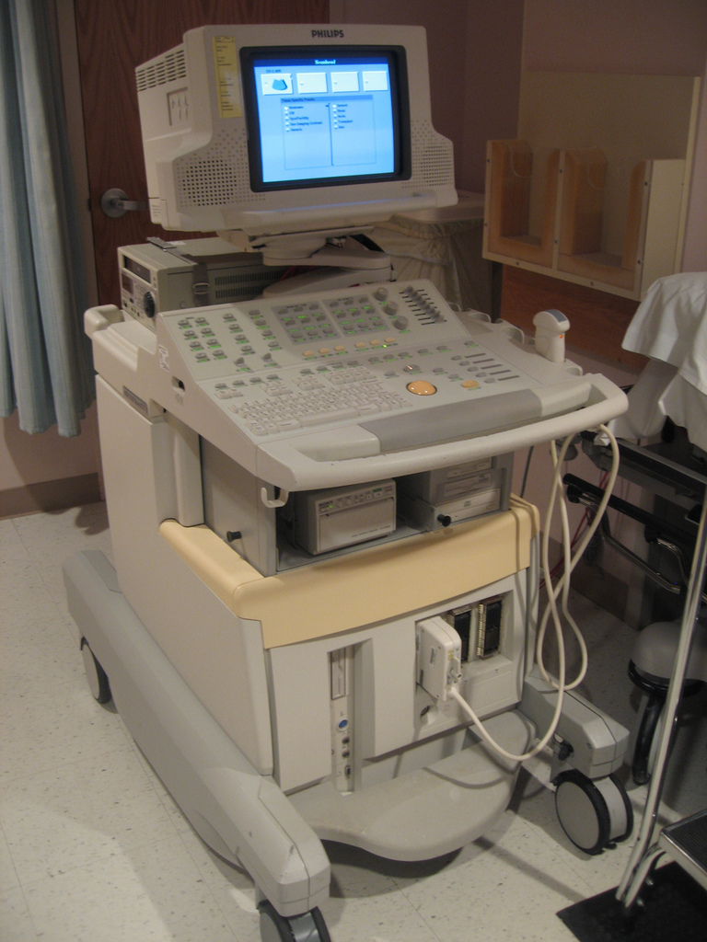
Diagnostic Medical Sonography (Ultrasound Technologists)
Job Description: | Use’s ultrasound (high-frequency sound waves to examine the developing fetus, abdomen, pelvis, brain and nervous system and blood vessels.
Educational Requirements: | Certificate, Associate’s degree or Bachelor’s degree
Relevant Licensure: | American Registry of Diagnostic Medical Sonographers (ARDMS)
Average Salary: | $65,620
This Photo by Unknown Author is licensed under CC BY-SA-NC
Notes:
Ultrasound Technologists use ultrasound sonography to generate high frequency sound waves to produce images of the body. These medical imaging procedures allow data to be gathered for interpretation and evaluation by a physician.
Sonography like all Medical Imaging has given us the ability to also catch problems before they get worse and treat patients effectively.
Sonography can be difficult to learn due to the volume of information that must be retained although the rewards are invaluable. When in a Sonography program several methods of teaching are their to assist all styles of learning. You’ll learn in classroom presentations, lab practice, on-line or virtual assignments, workbooks, audio-visual, and written assignments that are a part of the learning experience.
One of the most important skills of a Sonographer is attention to minute detail and concentration. This is critical because producing sonographic images are used in medical diagnosis and treatment. A sloppy, “that is close enough” mentality is not suited for this profession.
The educational path to become a Diagnostic Medical Sonographer is the obtain a certificate through an accredited program, obtain a 2 year Associate’s degree, obtain a 4 year Bachelors degree in Diagnostic Medical Sonography, and obtain a licensure and maintain one.

Slide 8
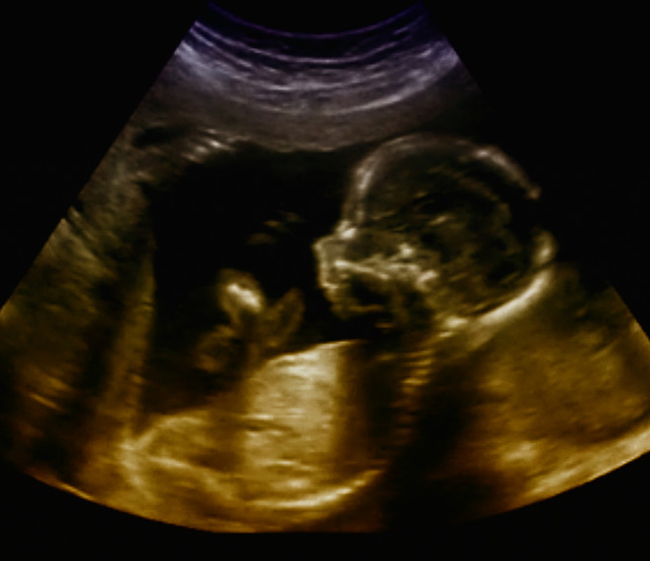
Some Radiology Technicians are generalists while others specialize in a particular type of machine or clinical area such as breast imaging or ultrasound.
This Photo by Unknown Author is licensed under CC BY-NC-ND
This Photo by Unknown Author is licensed under CC BY
Notes:
Because technology advances quickly, there is always something new to learn, and technicians continuously upgrade and enhance their skills through continuing education.
There are various different Specialties in Sonography such as abdominal sonography, neurosonography, echocardiography, obstetrical and pelvic sonography and vascular technology.
Isn’t it amazing that we can view babies in utero? Many pregnant mother’s and their unborn babies lives have been saved by ultrasound by the diagnosis of disease or congenital disorders.
Sonography like all Medical Imaging has given us the ability to also catch problems before they get worse and treat patients effectively.
In addition to operating imaging equipment, Radiology Technicians are responsible for basic maintenance and upkeep of the machines. They also keep detailed records of each procedure.

Slide 9
Nuclear Medicine Technologist
Job Description: | Administers radiopharmaceuticals to patients, positions them for images and operates the cameras and computers to produce the images and analyze data.
Educational: Requirements: | Entry-level - 2 year Associate’s degree program or 4 year Bachelor in Science degree.
Relevant Certifications: | Oregon Board of Medical Imaging (NMTCB) or American Registry of Radiologic Technicians (ARRT)
Average Salary: | $75,660
Notes:
Nuclear Medicine is another Specialty in Medical Imaging that aids physicians in making diagnoses. Nuclear Medicine Technologists perform organ imaging tests including full skeletal, cardiac blood pool, and major vascular blood pool test. Two tests utilized are a PET scan or Position Emission Tomography and a SPECT scan or Single Photon Emission Completed Tomography.
A PET scan is particularly useful in detecting cancer because most cancers use more glucose than normal tissue uses. Areas of greater intensity or “hot spots” show where large amounts of the radio-tracer have built up. PET scans create a 3-dimentional (3-D) picture of the inside of the body.
A SPECT scan is an imaging test that shows how blood flows to tissues and organs. It may be used to help diagnose seizures, stroke, stress fractures, infections, and tumors in the spine.
Nuclear Medicine Technologists must have good communication skills, be critical thinkers and have good bedside manner as patients might be in physical or emotional distress at the time you are working with them.
This career may be physically demanding although it has a low stress level, a good work life balance and solid prospects to improve and be promoted.
Nuclear Medicine Technologist must ensure a safe environment at all times and be able to explain complex examinations and procedures to patients.
Oregon Institute of Technology in Klamath Falls, Oregon has a Bachelor of Science degree program in Nuclear Medicine Technology. Many students attend a local community college and complete necessary pre-requisite courses and transfer to a University to complete this degree and get licensed through the state.

Slide 10
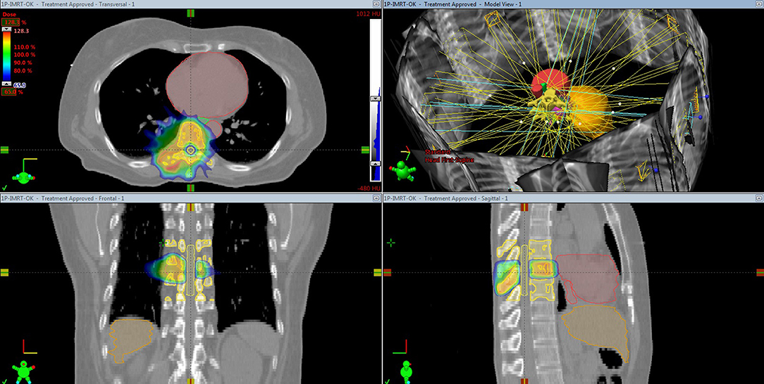
Radiation Therapist
Job Description: | Plans and administers radiation treatments to cancer patients.
Educational Requirements: | 1 year certification 2 year Associate’s degree 4 year Bachelor in Science
Relevant Certifications: | The American Registry of Radiologic Technologists
Average Salary: | $80,570
This Photo by Unknown Author is licensed under CC BY
Notes:
A Radiation Therapist is an Allied Health Professional who works in the field of radiation oncology. Oncology is the branch of medicine that deals with the prevention, diagnosis and treatment of cancer.
A Radiation Therapist works in coordination with Radiologists to implement therapeutic treatment plans for patients. They administer radiation therapy for patients under the instruction of an Oncologist’s and Radiologist’s, they locate tumors, measure the amount of radiation given and update treatment reports.
Radiation Therapists must follow regulations to protect both patients and practitioners from high doses of radiation.
Radiation therapy damages cells by destroying the genetic material that controls how cells grow and divide.
While both healthy and cancerous cells are damaged by radiation therapy, the goal of radiation therapy is to destroy as few normal, healthy cells as possible. Normal cells can often repair much of the damage caused by the radiation.
The educational path to becoming a Radiation Therapist is to attend a one year certification program, obtain a 2 year Associate’s degree program at a community college as a Radiation Therapist and/or obtain a 4 year Bachelor degree in Radiation Technology. A license to work as a Radiation Therapist is required in most states and can be obtained by the American Registry of Radiological Technologies (ARRT). This National exam can be completed after completing an accredited training program or working for two full years in the field.
A few Oregon community colleges that offer programs in Radiology are Linn-Benton Community College in Albany/Lebanon, Portland Community College in Portland, and Chemeketa Community College in Salem. There are two Universities in the State of Oregon that offer a Bachelor degree in Radiologic Technology which are Oregon Health & Sciences University in Portland and Oregon Institute of Technology (OIT) in Klamath Falls.

Slide 11
Radiologist
Job Description: | Specialty Physician who use a wide array of Medical Imaging to diagnose and, in certain cases treat patients with all types of illness.
Educational Requirements: | 4 year Bachelors degree 4 years of Medical School 4 year Residency 1-2 years of Fellowship
Relevant Certifications: | Licensing exam Board certification
Average Median Salary: | $187,200
Notes:
Radiologists are specialists in the field of Medical Imaging with the utilization of x-ray’s, sonography, Computed tomography (CT) scans, Magnetic Resonance Imaging (MRI) scans, Position Emission tomography (PET) scans, Single Photon Emission Completed tomography (SPECT) scans and radiation therapy to name a few. Radiologists help patients and their primary care doctors to arrive at the correct diagnosis in a timely fashion. They correlate patient medical histories, physical exam findings, and laboratory values with their interpretations of imaging exams.
The educational path to become a Radiologist is to complete a 4 year Bachelor degree, complete 4 years of medical school, complete 4 years of residency and many times completed 1-2 years in a specialty Fellowship. A certification by the American Board of Radiology is required a is continued education and maintenance of licensure.
There are 3 different types of specialty radiologist which are Diagnostic Radiologists, Interventional Radiologists, and Radiation Oncologists.

Slide 12
Specialty Radiology Diagnostic, Interventional & Radiation
Diagnostic Radiologists – Interpret and report on resulting images, recommends treatment and additional testing when appropriate.
Interventional Radiologists – Diagnose and treat patients using image-guided, minimally invasive techniques such as x-ray’s and MRI.
Radiation Radiologists – Prescribe and oversee each cancer patient’s progress and adjust treatment to make sure patients receive appropriate quality care.
Notes:
Radiologists are specialists in the field of Medical Imaging with the utilization of x-ray’s, sonography, CT scans, MRI scans, PET scans, SCERT scans and radiation therapy to name a few. Radiologists help patients and their primary care doctors to arrive at the correct diagnosis in a timely fashion. They correlate patient medical histories, physical exam findings, and laboratory values with their interpretations of imaging exams.
Diagnostic Radiologists work with breast imagine (mammograms), cardiovascular radiology (heart and circulatory system), chest radiology (heart and lungs), emergency radiology, gastrointestinal radiology (stomach, intestines and abdomen), head and neck radiology, musculoskeletal radiology (muscles and skeleton), neuroradiology (brain and nervous system – head, neck and spine) and pediatric radiology (imaging of children).
Interventional Radiologists carefully guide instruments through tiny incisions in the body reaching the source of a medical problem and delivering targeted treatments. These treatments are for conditions such as heart disease, stroke, cancer, and uterine fibroids. They often provide less risk, pain, and recovery time than traditional surgery.
Radiation Oncologists receive extensive training in cancer medicine, in the safe use of radiation to treat disease, and in managing ay side effects caused by the radiation.

Slide 13
Skills & Competencies:
Critical thinking skills
Good communication
Attention to detail & concentration abilities
Ability to work on a team or independently
Excellent medical & anatomical skills
Provide patient-centered care
Notes:
As a critical thinker one must be reflective of human values and balance compassion with realism. One must also be analytical, which means finding evidence in unclear and confusing situations. Being alert to the consequences of accepting a course of action and being able to defend that position are both important as well. Rushing into a plan without examining the ramifications of hastened actions can be dangerous.
A professional in the field of Medical Imaging must have good communication skills both verbally and in writing. They also must have the ability to pay close attention to detail while concentrating on their work. One small error can result in a patient receiving or not receiving quality care.
As in most healthcare professions, one must have the ability to work on a team or independently.
Medical Imaging concentrates on testing and providing results for diagnosis. A professional must have excellent medical and anatomical skills to provide the best work they are able to provide.
Finally, a Medical Imaging professional must provide the best patient-centered care possible. This includes listening to, informing and involving patients of their care. This provides individual patients respect and value in all clinical decisions.

Slide 14
Survey
Please take the Post Lesson Survey
https://docs.google.com/forms/d/e/1FAIpQLSfon72xhPX10PnyMmqHf7YVsCEKBlElM_CfXxakT_PXmMp9nA/viewform?usp=sf_link

Slide 15
Thank you watching about Careers in Medical Imaging!
Please feel free to contact Oregon Pacific Area Health Education Center with any questions.
www.OPAHEC.org

