Slide 1


Slide 2
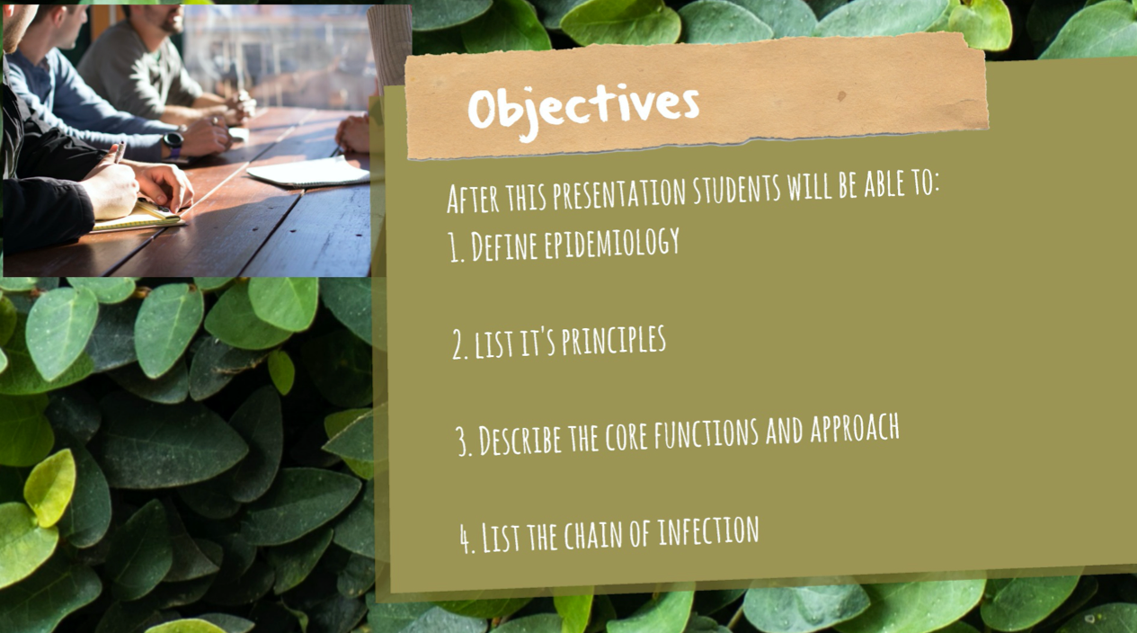

Slide 3


Slide 4


Slide 5
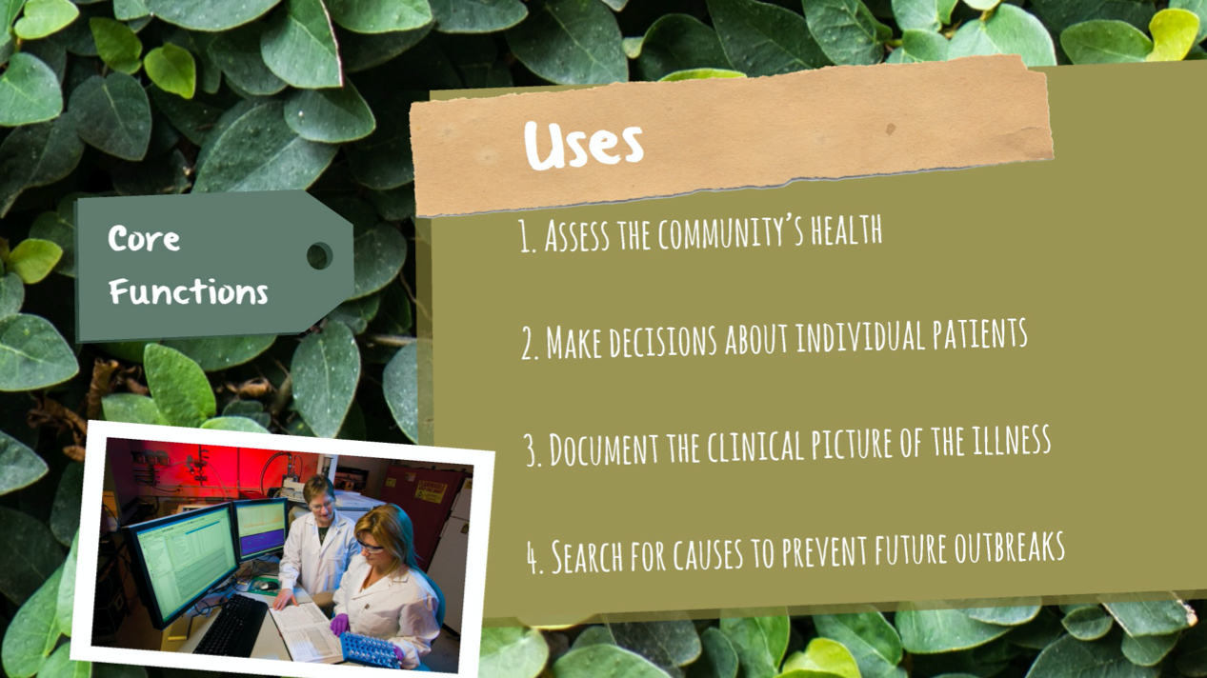

Slide 6


Slide 7
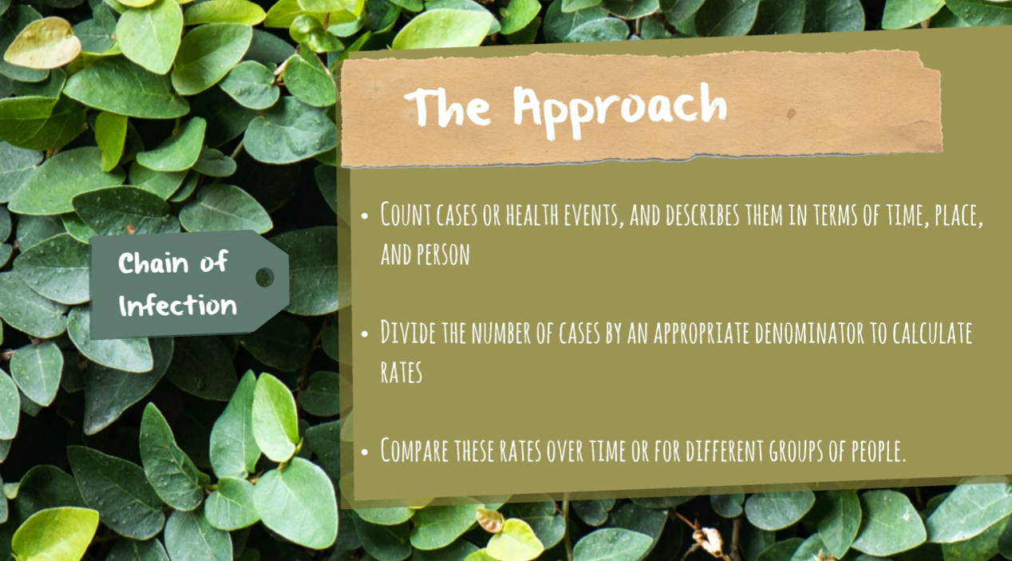

Slide 8
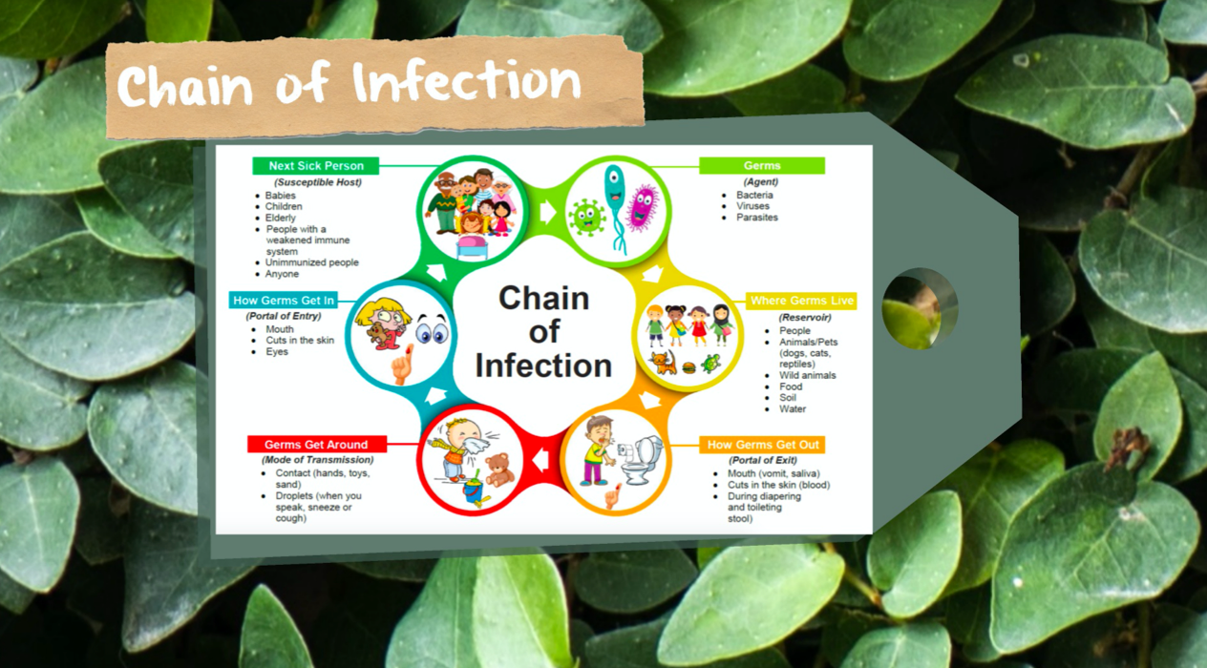

Slide 9
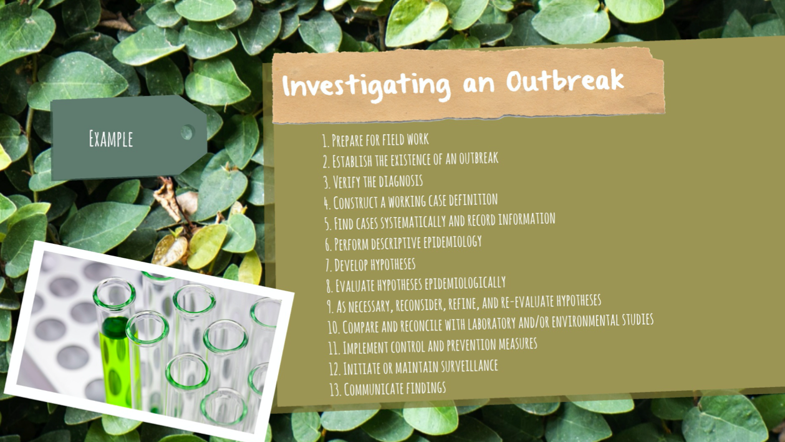

Slide 10
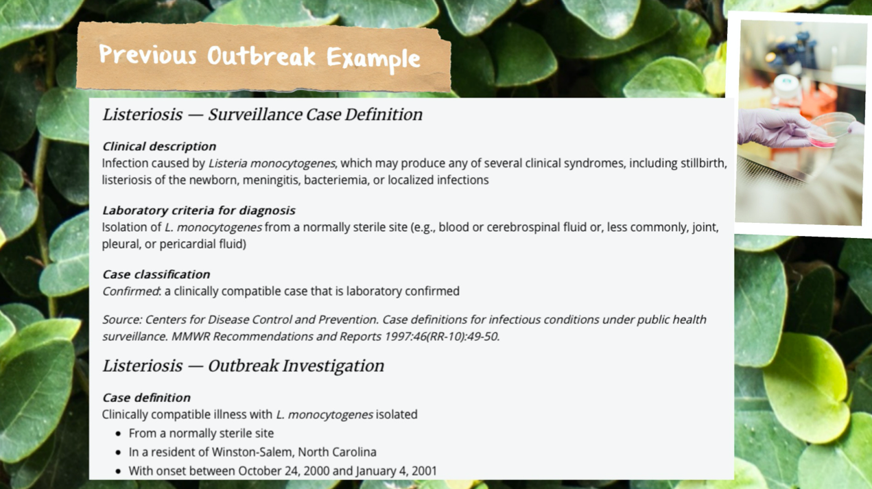

Slide 11
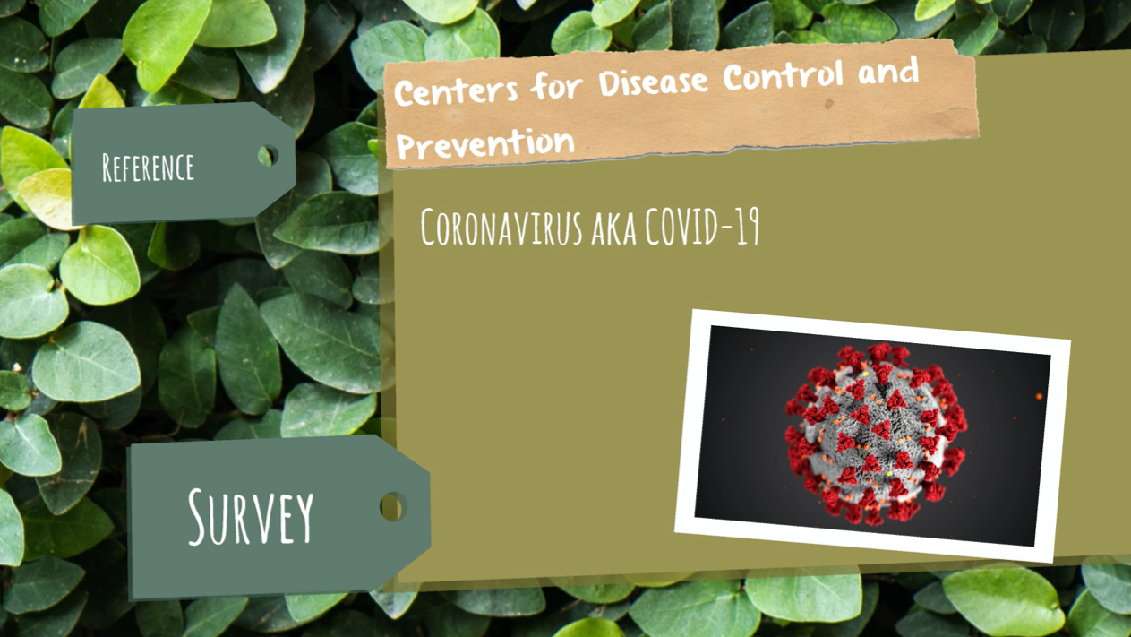

Slide 12

Notes:
https://docs.google.com/forms/d/e/1FAIpQLSfon72xhPX10PnyMmqHf7YVsCEKBlElM_CfXxakT_PXmMp9nA/viewform

Slide 13

Notes:
https://www.cdc.gov/csels/dsepd/ss1978/index.html

