Slide 1



CAREERS IN ART THERAPY
By Julia labahn
Notes:
Today we will be exploring careers in Art Therapy.

Slide 2

OVERVIEW
THERAPUTIC CONCEPTS
MODALITIES
MEDUIMS
JOB SETTINGS
TEAM APPROACH MODEL
EDUCATION & CREDENTIALING
This Photo by Unknown Author is licensed under CC BY
Notes:
In this presentation we will explore what art therapy is, the therapeutic concepts, modalities and mediums, job settings and the education and credentialing necessary to work in art therapy.

Slide 3
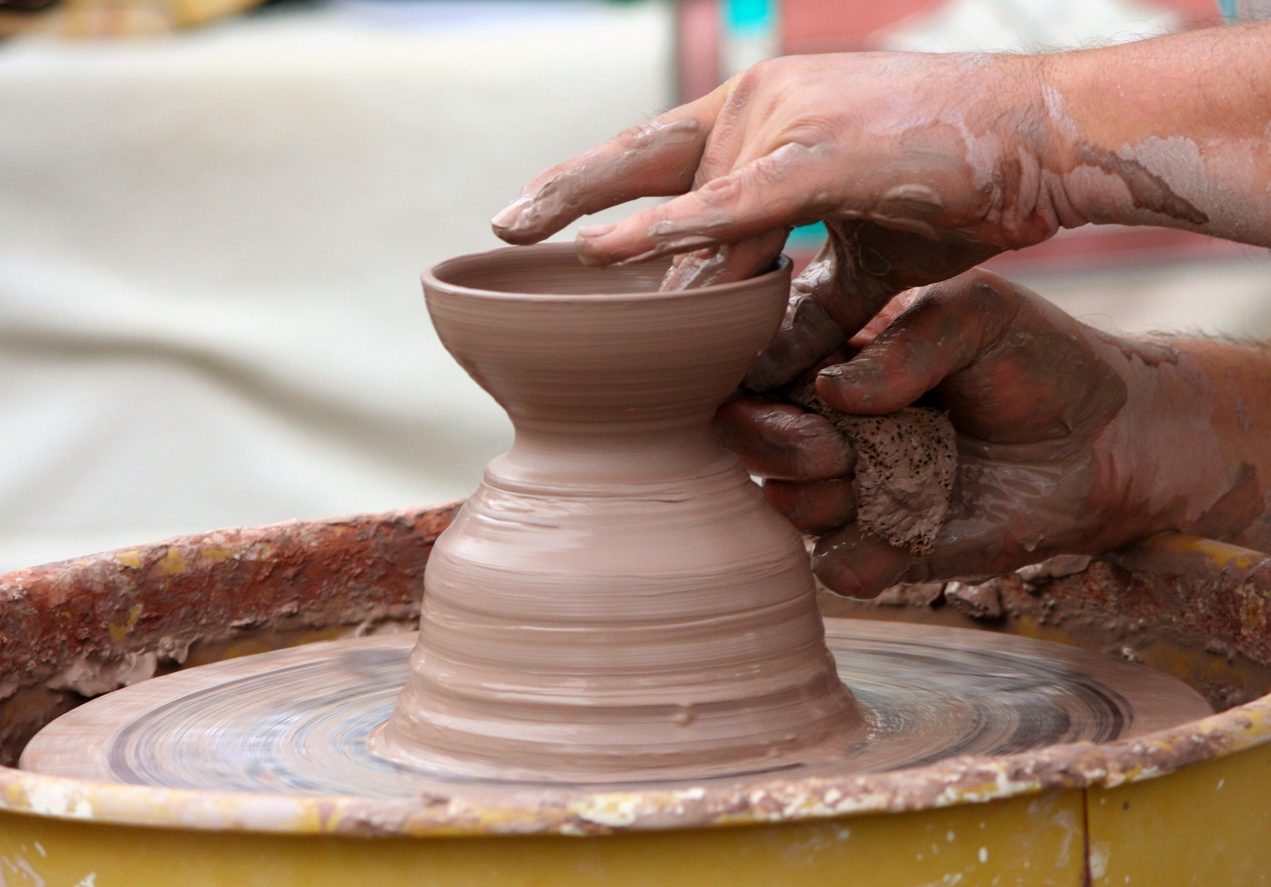
OBJECTIVES
List 3 Roles & Responsibilities
List 3 Educational Requirements
Describe 2 Mediums
List 2 Modalities
Be able to list 4 Skills & Competencies
Describe 3 Benefits to Patients
Notes:
After viewing this presentation students will be able to:
List 3 roles and responsibilities, list 3 educational requirements, describe 2 mediums and 2 modalities, be able to list 4 skills and competencies of an art therapist and finally describe 3 benefits to patients.

Slide 4
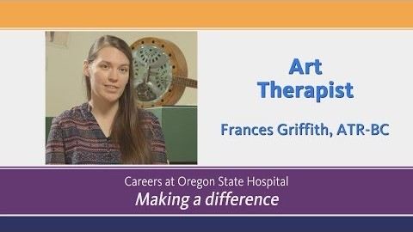
Let’s Watch a Video!

Slide 5
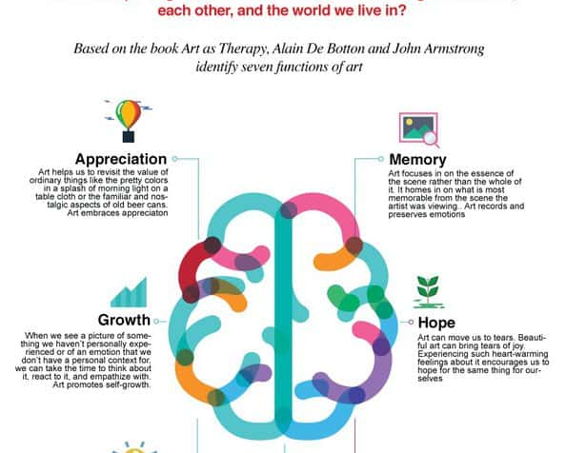
WHAT IS ART THERAPY?
This Photo by Unknown Author is licensed under CC BY-NC
This Photo by Unknown Author is licensed under CC BY
Notes:
Art therapy is an integrative mental health and human services profession that enriches the lives of individuals, families, and communities through active artmaking, creative process, applied psychological theory, and human experience within a psychotherapeutic relationship.
Art therapy, facilitated by a professional art therapist, effectively supports personal and relational treatment goals as well as community concerns. Art therapy is used to improve cognitive and sensorimotor functions, foster self-esteem and self-awareness, cultivate emotional resilience, promote insight, enhance social skills, reduce and resolve conflicts and distress, and advance societal and ecological change.

Slide 6

This Photo by Unknown Author is licensed under CC BY
WHY IS ART THERAPY IMPORTANT?
Notes:
“Art therapy has been shown to benefit people of all ages. Research indicates art therapy can improve communication and concentration and can help reduce feelings of isolation. This type of therapy has also been shown to lead to increases in self-esteem, confidence, and self-awareness.”

Slide 7

WHY IS ART THERAPY USED?
This Photo by Unknown Author is licensed under CC BY-NC-ND
Notes:
“Art therapists use the process of self-expression, and the resulting artwork to help clients understand their emotional conflicts, develop social skills, improve self-esteem, manage addictions, reduce anxiety, and restore normal function to their lives.”
“Art therapists are master’s level clinicians who work with people of all ages across a broad spectrum of practice.
Guided by ethical standards and scope of practice, their education and supervised training prepares them for culturally proficient work with diverse populations in a variety of settings.
Honoring individuals’ values and beliefs, art therapists work with people who are challenged with medical and mental health problems, as well as individuals seeking emotional, creative, and spiritual growth.”

Slide 8


CREATIVE ARTS THERAPY
ART PSYCHOTHERAPY
This Photo by Unknown Author is licensed under CC BY
Notes:
Two other Art Therapy careers are Creative Arts Therapy and Art Psychotherapy. Creative Arts Therapy uses active engagement in the arts to address mental, emotional, developmental, and behavioral disorders. A few examples would be designing a postcard you’ll never send or painting your emotions.
Art Psychotherapy is a form of treatment that uses creative modalities including art making, drama, and movement to improve and enhance physical, mental, and emotional well-being.

Slide 9

THERAPUETIC CONCEPTS OF ART THERAPY
Perception
Personal Integration
Emotional Regulation
Behavioral Modification
This Photo by Unknown Author is licensed under CC BY-SA
Notes:
Individuals use creative expression to produce various types of media, which helps them explore their innermost emotions and thoughts, reconcile conflicts, manage stress and anxiety, develop self-awareness, manage addiction and self-deprecating behaviors, and increase their sense of self-esteem.
Perception, Personal Integration, Emotional Regulation, and Behavioral Modification are all Therapeutic Concepts of Art Therapy. Let’s do a quick review of what these concepts are.

Slide 10

We all have a different perception that anyone else. We may agree on the same perception but because we all see the world around us differently someone’s perception will always be their own!
Notes:
We all have a different perception that anyone else. We may agree on the same perception but because we all see the world around us differently someone’s perception will always be their own!
Art Therapy explores someone’s understanding of what constitutes self-perception and global perception. Once art is created, it stand on it’s own for interpretation. This makes the world a magical place!
What are your individual perceptions of this picture? This is an optical illusion! One person may see two face profiles facing each other while another may see a candlestick!

Slide 11

This Photo by Unknown Author is licensed under CC BY-SA-NC
Notes:
Because art is so personalized we need to personally integrate our own emotions and experiences to be creative. Embracing yourself, your identity and self-image allows for you to create your own special form of art.

Slide 12
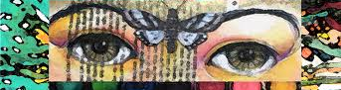
Emotional Regulation
Chanel expression through being creative
Notes:
Emotional regulation is important so we can be creative using our own personal emotions as a release. This is really important! Imagine if artwork did not have emotion behind the creation?

Slide 13
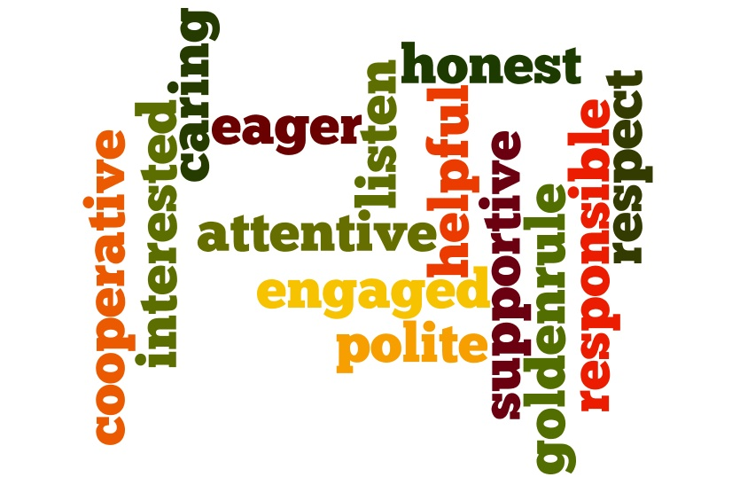
Behavioral Modification
- Helps you manage your behaviors
This Photo by Unknown Author is licensed under CC BY
Notes:
The creation of art helps a person manage their behaviors. It can help with stress, anxiety, sadness, loneliness and any other emotion that creates behaviors. It can also help us feel connected.

Slide 14
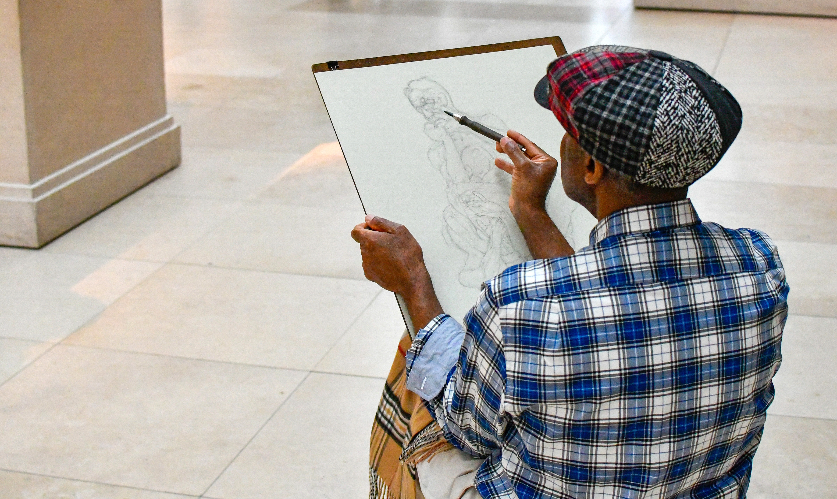
Who do Art Therapists
work with?
Individuals who are encountering mental or emotional challenges.
Notes:
Art Therapy can help anyone although most Art Therapists mainly work with people that are having mental or emotional challenges. Being creative using Art Therapy helps people explore their feelings and improve many areas of their lives.

Slide 15

Art therapy mediums
Painting
Drawing
Coloring
Sculpting
Beading
Collage
Photography
Textiles
This Photo by Unknown Author is licensed under CC BY-ND
Notes:
There are so many different modalities in creating art and one is not a better choice than another. Each person is drawn to their own personal preferences.
Painting, drawing, coloring, sculpting, beading, collage, photography and textiles are just a few mediums used in art therapy.

Slide 16

9 ways Art Therapy can help patients
Notes:
Art Therapy can help people in so many ways. Here are a few: Improving self-management, alleviate symptoms of depression, address past trauma, improve communication skills, reduce stress, improve problem-solving skills, building self-image, mitigate symptoms, and provide a positive distraction.

Slide 17
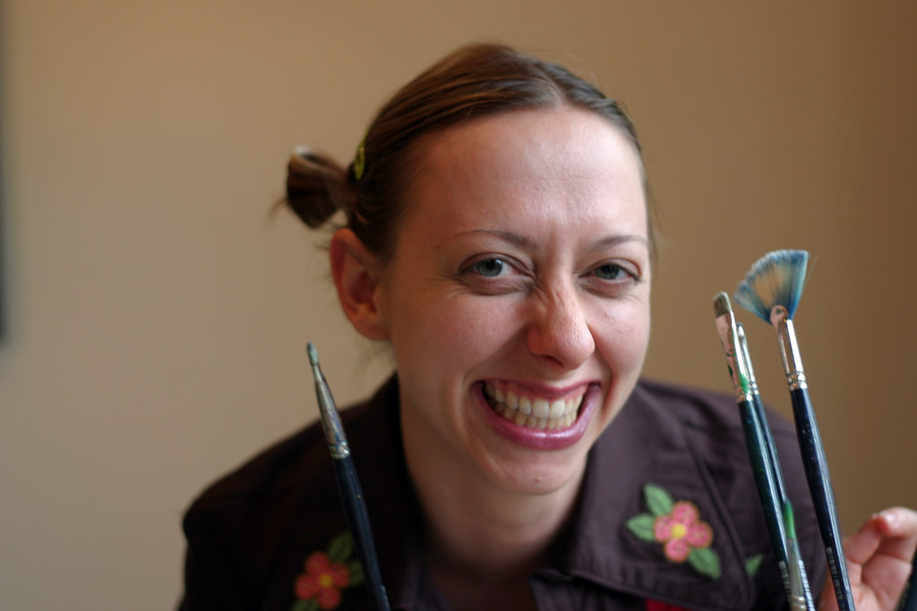
ART THERAPY IS USED TO:
IMPROVE
FOSTER
CULTIVATE
PROMOTE
ENHANCE
REDUCE & RESOLVE
This Photo by Unknown Author is licensed under CC BY
Notes:
Art Therapist’s job responsibilities is not only to provide people with the tools to create art. Art Therapists work to improve others’ cognitive and sensory-motor functions, foster self-esteem and self-awareness, cultivate emotional resilience, enhance social skills, and reduce and resolve conflicts and distress.

Slide 18
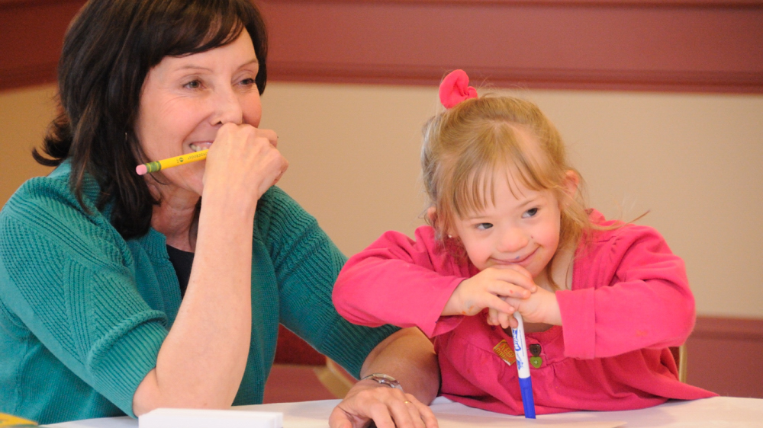
RESPONSIBILITIES –
Assess
Observe
Design & develop
treatment plans
This Photo by Unknown Author is licensed under CC BY-NC-ND
Notes:
Working as an Art Therapist one would assess needs, assess patient’s skills, observe patient behavior and design and develop treatment plans.

Slide 19

SKILLS NEEDED TO BE A SUCCESSFUL ART THERAPIST
This Photo by Unknown Author is licensed under CC BY-ND
Notes:
Here are a few skills needed to have a successful career as an Art Therapist. One must be artistic, have people skills, have knowledge of many different art mediums, be accepting of the diversity of others, do well working on a team, have empathy and be flexible, have self-advocacy and be able to read the moment.

Slide 20

JOB SETTINGS
This Photo by Unknown Author is licensed under CC BY-SA
Notes:
Art Therapists work in a variety of different places. They work in hospitals and clinics, Outpatient Mental Health Agencies, Community Agencies and Non-Profit Settings, as well as Domestic Violence and Homeless Shelters.

Slide 21

MULTIDISCIPLINARY TEAM-BASED APPROACH
ASSESS
ANALYZE
REPORT
This Photo by Unknown Author is licensed under CC BY-SA
Notes:
Art Therapists work with a multidisciplinary team-based approach. This means that they work on a team as a key player as part of a patients care plan. They assess a person’s experience, not the end result. They analyze, chart patient experience, report findings, and work with the team for the goal of patient improvement.

Slide 22

COURSES NEEDED TO COMPLETE TO PRACTICE ART THERAPY
Theories of art therapy, counseling & psychotherapy
Ethics and standards of practice
Assessment & evaluation
Individual, group, & family art therapy techniques
Multicultural issues
Research methods
Internship experience in clinical and/or community settings
This Photo by Unknown Author is licensed under CC BY
Notes:
During their education a person obtaining a higher education to become an Art Therapist is required to take many of the following college courses. Theories of art therapy, counseling, and psychotherapy, ethics and standards of practice, assessment and evaluation, therapy techniques, multicultural issues and research methods as well as complete and internship gaining on the job experience.

Slide 23

CERTIFICATION & LICENSING
The mission of the Art Therapy Credentials Board is to protect the public by providing the competent and ethical practice of art therapy through the credentials of art therapy professionals
  Certification from the Art Therapy Credentials Board, Inc. (ATCD)
  License issued by the American Art Therapy Association (AATA)
  License issued by Oregon Health Authority Licensing Board in the State of Oregon
This Photo by Unknown Author is licensed under CC BY-NC-ND
Notes:
Art Therapists must be certified and licensed to practice which is obtained after completing a Masters degree.

Slide 24
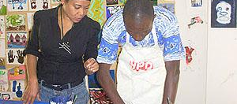
This Photo by Unknown Author is licensed under CC BY-SA
BOARD CERTIFIED ART THERAPIST (ATR-BC)
Notes:
Art Therapists can further their profession by becoming board certified as a licensed Art Therapist. This certification signifies experience and competency.

Slide 25
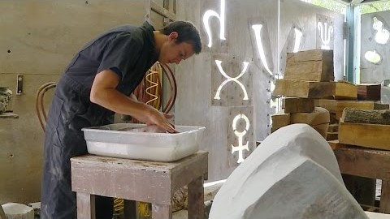
WESTERN OREGON UNIVERSITY COLLEGE OF ARTS
Notes:
Discuss with students the College of Arts program at Western Oregon University.

Slide 26

PLEASE TAKE THIS POST-PRESENTATION SURVEY
https://docs.google.com/forms/d/e/1FAIpQLSfon72xhPX10PnyMmqHf7YVsCEKBlElM_CfXxakT_PXmMp9nA/viewform?usp=sf_link
This Photo by Unknown Author is licensed under CC BY-SA
This presentation was supported by the Health Resources and Services Administration (HRSA) of the U.S. Department of Health and Human Services (HHS) as part of a subaward totaling $101,995 (33%) financed with Federal funding and $210,226 (67%) financed with non-Federal sources. The contents are those of the author(s) and do not necessary represent the official views of, nor an endorsement, by HRSA, HHS or the U.S. Government.
This Photo by Unknown Author is licensed under CC BY-SA-NC
Notes:
On behalf of Oregon Pacific Area Health Education Center we would like to ask you to take this post-presentation survey.

Slide 27
Thank you for viewing this presentation about a Career as an Art Therapist!
Please feel free to contact OPAHEC with any questions or comments.
Shellene Dougherty, Executive Director
shdougherty@samhealth.org
Julia Labahn, Education Coordinator
Jlabahn@samhealth.org
Petra Gutierrez, Education Coordinator
pgutierrez@samhealth.org
Carmen Boone, Education Coordinator
carmenb@samhealth.org
www.opahec.org
Notes:
Thank you for viewing this presentation about a career as an Art Therapist. Please feel free to contact us with any questions or comments. You can also visit us at www.opahec.org.

Slide 28
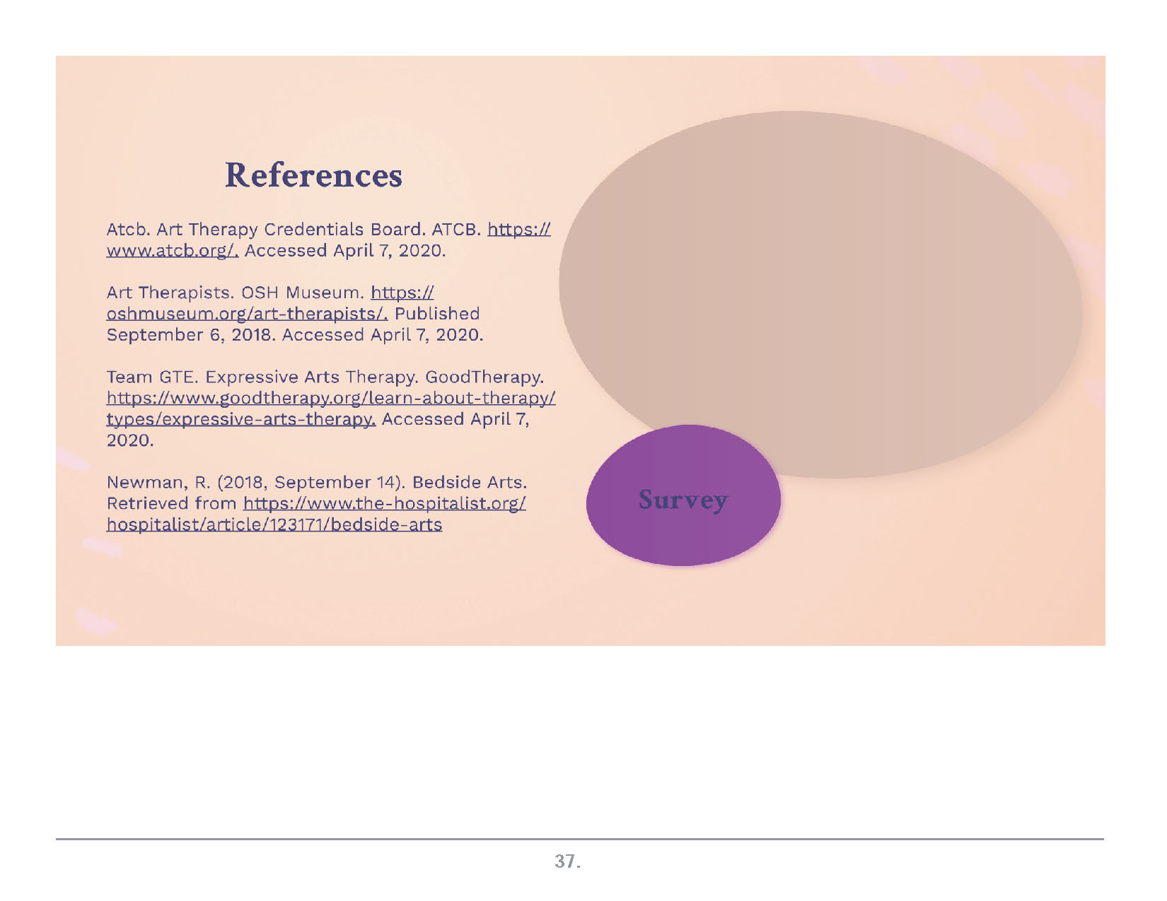
The 24 Character Strengths. (n.d.). Retrieved from https://www.viacharacter.org/character-strengths
Knowledge vs Wisdom. (n.d.). Retrieved from https://www.diffen.com/difference/Knowledge_vs_Wisdom
Www.facebook.com/profc. (2018, March 9). Courage . . . Find Some: Our Virtue of the Week. Retrieved from https://ethics.blog/virtues-courage/
humanity - Dictionary Definition. (n.d.). Retrieved from https://www.vocabulary.com/dictionary/humanity
History. (n.d.). Retrieved from https://japanesegarden.org/history/

