Slide 1
CAREERS IN
EMERGENCY MEDICAL SERVICE
By Julia Labahn
Notes:
Introduce presentation to students:
This presentation is about careers in Emergency Medical Service. We will explore a variety of careers and locations that these professionals work in.
Many people think that EMS/Paramedics just work driving an ambulance to help people when they are in need, but there are many other options.
EMS/Paramedics also work in the forests, deserts, on the sea, and on the ice like in Alaska!

Slide 2
OVERVIEW
What is EMS?
History of EMS
Careers in EMS
Job Responsibilities
Skills & Competencies
Education Requirements & Programs in Oregon
Notes:
This is an overview of this presentation which includes what EMS does, the history of EMS, careers in EMS, job responsibilities, skills and competencies, and the educational requirements and programs in Oregon.

Slide 3
OBJECTIVES After viewing this presentation students will be able to:
Discuss
Discuss information about the general field of EMS
List
List 3 careers in EMS
Discuss
Discuss the educational pathways & programs in Oregon
Describe
Describe 3 job responsibilities in EMS
List
List 4 basic skills & competencies in EMS
Notes:
After viewing this presentation students will be able to:
Discuss information about the field of EMS
List 3 careers in EMS and what they do
Discuss the educational pathways and programs in Oregon
Describe 3 job responsibilities in EMS
And finally
List 4 basic skills and competencies in EMS

Slide 4
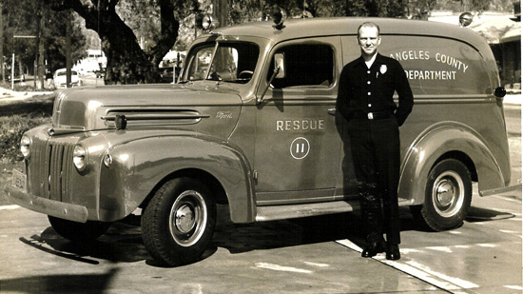
HISTORY The birth of modern EMS
“The White Paper” made recommendations for prevention and management of accidental injuries.
Notes:
In 1966, United States President Lyndon B. Johnson received the report: Accidental Death & Disability: The Neglected Disease of Modern Society, which identified accidental injuries as the “leading cause of death in the first half of life’s span”.
The report revealed that in 1965 alone, vehicle accidents killed more Americans than were lost in the Korean war.
This report was known as “the White Paper” and made recommendations for prevention and management of accidental injuries including the standardization of emergency training for “rescue squad personnel, policemen, firemen and ambulance attendants”.
This standardization led to the first nationally recognized curriculum for EMS.

Slide 5
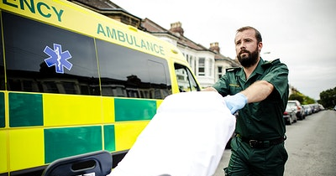
WHAT DO EMS/PARAMEDICS DO?
Respond to 911 calls Provide first aid Assess Transport Transfer Report Inventory
Clean
Notes:
WHAT DO EMS/PARAMEDICS DO? Respond to 911 calls for emergency medical assistance, such as cardiopulmonary resuscitation (CPR) or bandaging a wound. Assess a patient’s condition & determine a course of treatment. Provide first-aid treatment or life support care to sick or injured patients. Transport patients safely in an ambulance. Transfer patients to emergency departments, hospitals or other healthcare facilities. Report their observations & treatment to physicians, nurses, or other healthcare facility staff. Document medical care given to patients. Inventory, replace, and clean supplies & equipment after use.

Slide 6
THE BEST REASONS TO WORK IN EMS
Every day is different
In demand job
Growth potential
Work in diverse opportunities
Help people
Build solid life skills
Notes:
Emergency Medical Service professionals work in health care helping sick and injured in emergency medical situations. These first responders respond to medical incidents and accident scenarios where they provide care and facilitate transportation to more advanced medical facilities.
The best reasons to work in EMS are:
Every day is a different day – You won’t be bored working in EMS. They respond to all sorts of calls dealing with different situations in different locations.
EMS is an in demand job. Medical and trauma accidents happen in random places at unexpected times. EMS are constantly on call to assist people in trouble.
There is growth potential after obtaining an EMS certification. It is a great starting point in the health care field. After the EMS Basic, you can earn an EMT Intermediate or Paramedic certification or, you can use your baseline knowledge to kickstart a career in nursing or get an education in medicine.
You’ll work in diverse opportunities! Earning an EMS certificate is a great way to find work on an ambulance, as a firefighter, or on ski patrol. This professional certificate can open a lot of doors.
EMS help people who need medical care. Working in EMS is a rewarding way to make a living.
Finally, EMS training can help build a foundation of first aid knowledge that you can apply to your own life and experiences.

Slide 7
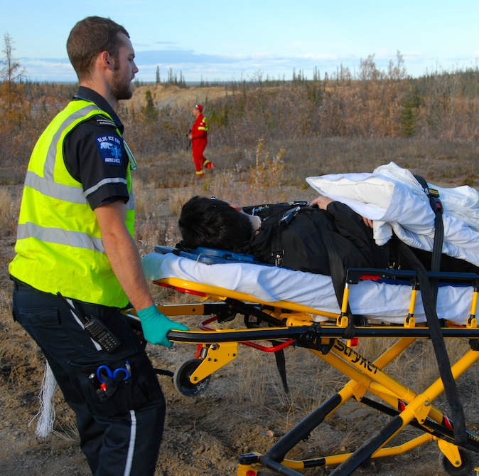
WHERE DO EMS/PARAMEDICS WORK?
Urban & rural settings
Wilderness
Private ambulance services
Fire departments
Hospitals
Other rescue services
Special operations
This Photo by Unknown Author is licensed under CC BY-NC
Notes:
EMS/Paramedics work in many different settings.
Urban & rural settings
Wilderness
Private ambulance services
Fire departments
Hospitals
Other rescue services
Special operations

Slide 8
TRANSPORTATION
This Photo by Unknown Author is licensed under CC BY-NC-ND
Notes:
When transporting a patient in an ambulance, one EMT or Paramedic may drive the ambulance while another monitors patients’ vital signs such as blood pressure, pulse, temperature and blood oxygen levels as well as gives additional care.
Some Paramedics work as part of a helicopter’s or airplane’s flight crew to transport critically ill or injured patients to a hospital.
EMT’s also transport patients from one medical facility to another. Some patients may need to be transported to a hospital that specializes in treating their particular injury or illness or to a facility that provides long-term care, such as a nursing home.

Slide 9
The National Registry of Emergency Medical Technician’s (NREMT) provides national certification of EMT’s & Paramedics at 4 levels.
The National Registry of Emergency Medical Technicians
EMR
EMT
Advanced
EMT
Paramedic
Notes:
The National Registry of Emergency Medical Technician’s (NREMT) provides national certification of EMT’s & Paramedics at 4 levels.
This organization’s mission is to provide a valid, uniform process to assess the knowledge and skills required for competent practice by EMS professionals throughout their careers, and to maintain a registry or certification status.
EMR – Emergency Medical Responder
EMT - Emergency Medical Technician
Advanced EMT
Paramedic

Slide 10
EMERGENCY MEDICAL RESPONDER (EMR)
Trained professionals
May provide immediate lifesaving interventions
Provide basic care
This Photo by Unknown Author is licensed under CC BY-SA-NC
Notes:
Trained professionals to provide basic care with minimal equipment.
May provide immediate lifesaving interventions while waiting for Emergency Medical Services (EMS) resources to arrive.
Other titles of this profession are Emergency Care Attendant or Certified First Responders.

Slide 11
EMERGENCY MEDICAL TECHNICIAN (EMT) BASIC
Care for patients at the scene of an incident & while taking patients by ambulance to a hospital.
Assess a patients condition
Manage respiratory, cardiac, and trauma emergencies.
This Photo by Unknown Author is licensed under CC BY-SA-NC
Notes:
Care for patients at the scene of an incident while taking patients by ambulance to a hospital. At this level one would typically be paired with a high-level provider in ambulances, or fire trucks, or in emergency transportation vehicles.
An EMT has the skills to assess a patients condition & to manage respiratory, cardiac, and trauma emergencies.
An EMT can perform CPR, give oxygen, administer glucose to diabetics, help people who are having asthma attacks or allergic reactions, extricate patients and prepare them for transport.
The basic requirements to begin working as an EMT Basic are:
You must be 18 years of age or older
You should have completed a state approved EMT training program
You must possess a valid CPR certification
You may be required to pass the NREMT exam
You must be in good health
Have excellent communication skills
You must be up to date on your immunizations
Certification requires at least 154 hours of classroom and practical education.

Slide 12
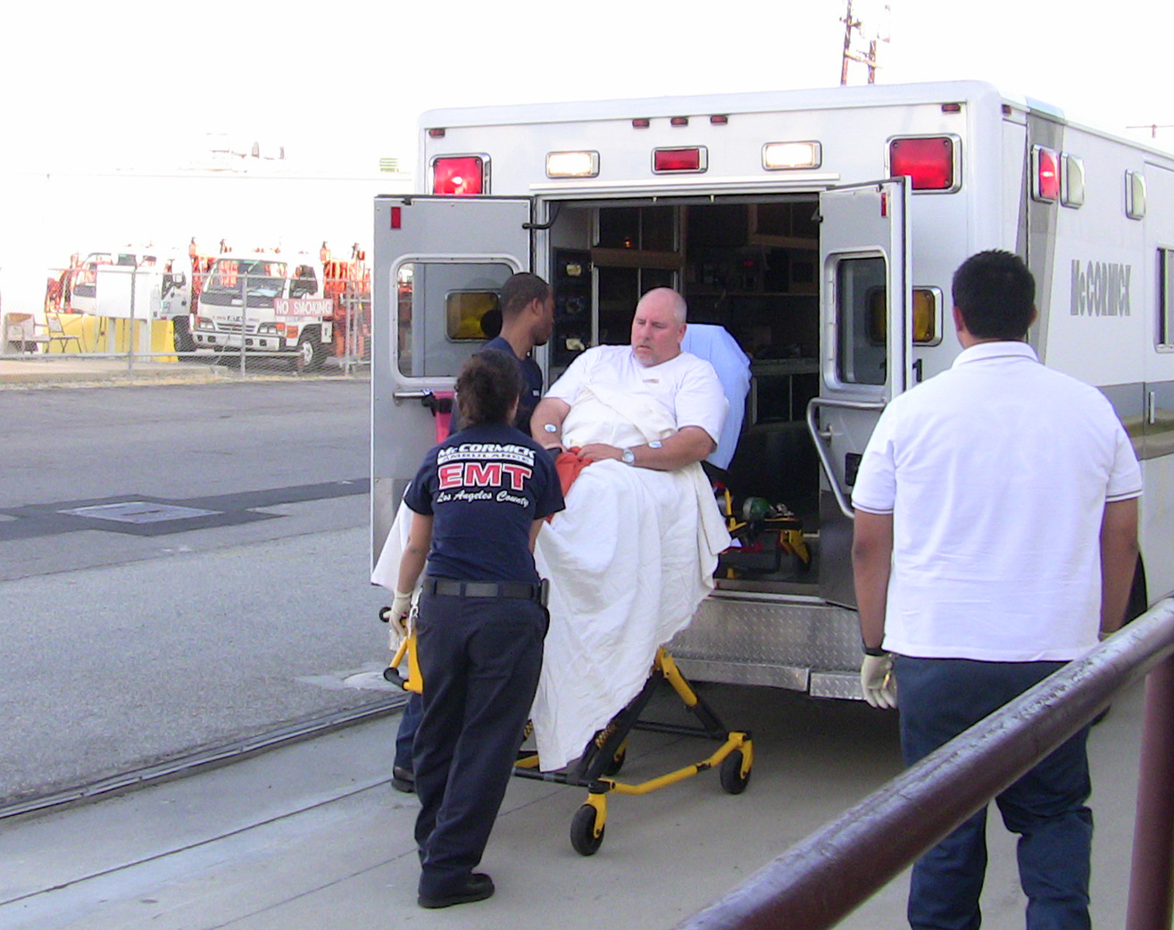
ADVANCED EMERGENCY TECHNICIAN (EMT) Also known as an EMT - Intermediate
Completed the requirements for the EMT level & course in more advanced medical procedures, such as administering intravenous fluids & some medications.
This Photo by Unknown Author is licensed under CC BY-SA
Notes:
This professional has completed the requirements for the EMT level, as well as instruction in more advanced medical procedures, such as administering intravenous fluids & some medications.
An EMT Intermediate position expands to scope of practice for an EMT Basic with more skills, responsibilities, and knowledge.

Slide 13
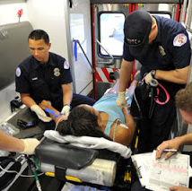
PARAMEDIC
Provides more extensive pre-hospital care than do EMT’s.
Can give medications orally & intravenously, interpret electrocardiograms (EKG’s) & other monitoring equipment.
This Photo by Unknown Author is licensed under CC BY
Notes:
Paramedics provide more extensive pre-hospital care than EMT’s do. They can administer medications orally and intravenously, interpret electrocardiograms which monitor heart functions and use other monitors & complex equipment. They can also provide advanced airway management for patients, resuscitate patients and help people who have suffer trauma.
Paramedics have broad healthcare knowledge and an advanced life-saving skill set.
This training can require a minimum of 700 hours of classroom training , as well as a significant amount of field experience, but these professionals have the ability to work in a wide variety of settings and situations.

Slide 14
FIREFIGHTER PARAMEDIC
Firefighter Paramedics work out of a firetruck, also known as a “ladder”, or a fire department ambulance.
Notes:
Firefighter Paramedics work out of a firetruck, also known as a “ladder”, or a fire department ambulance.
EMS/Paramedics work with other health care professionals including nurses and physicians, as well as firefighters and police officers.

Slide 15
FIREFIGHTER PARAMEDIC RESCUE VIDEO
Notes:
We are now going to watch a short video about a real life rescue performed by the Riverside County Fire Department. I chose this video to share because it depicts a non-trauma emergency taking place in an area that we may not consider when thinking about EMS. This is just another area of EMS that an individual can work in. One must be physically fit and have the stamina to hike into areas that may not be comfortable to come to the aid of someone in distress.

Slide 16
EMT/PARAMEDIC LARGEST EMPLOYERS
EMT’s & Paramedics largest employers are:
Ambulance Services 47%
Local government, excluding education & hospitals 27%
Hospitals, state, local & private 19%
(These %’s exclude volunteers who do not receive pay.)
Notes:
EMT’s & Paramedics largest employers are:
Ambulance Services 47%
Local government, excluding education & hospitals 27%
Hospitals, state, local & private 19%
(These %’s exclude volunteers who do not receive pay.)

Slide 17
SCHOOLS & PROGRAMS IN OREGON
CHEMEKETA CC Salem, OR – EMT, EMT-P
CLACKAMAS CC Oregon City, OR – EMT, EMT-I
OHSU/OIT Portland/Sherwood, OR – EMT-P
PORTLAND CC Portland, OR – EMT, EMT-P, EMT-I
Notes:
There are various EMS programs across the state. The public programs locally are:
Chemeketa CC, Clackamas CC, OHSU/OIT in Portland, and Portland CC in Portland.
These programs are accredited and recognized by The National Registry of Emergency Medical Technician’s (NREMT).

Slide 18
EMS/EMT/PARAMEDIC PROGRAMS IN OREGON
Notes:
We are now going to watch a short video about an EMS program at Lane CC in Eugene, Oregon. This will give you some insight about what an EMS program may look like.

Slide 19
LET’S WATCH A HEALTH & SAFETY AWARENESS VIDEO
Notes:
Now we are going to watch a fun video about health and safety awareness while on the job as an EMS. You’ll notice many different ways these professionals use PPE or personal protection equipment to reduce the risk of spreading infection and disease as well as the way they use their bodies to pick up heavy equipment and people.
Let’s see how many important ways you can find in the video to prevent injuries!
Write them down during the video when you spot one and we will have a short discussion afterwards.

Slide 20
INJURIES & ILLNESSES FACTS FOR EMT’S & PARAMEDICS
High rate of illness & injury
Perform a large amount of: kneeling, bending, and lifting while caring for and moving patients
May be exposed to contagious diseases, viruses, & toxic chemicals
Notes:
One of the highest rates of injuries & illnesses of all occupations.
Are required to do a considerable amount of kneeling, bending, and lifting while caring for and moving patients.
May be exposed to contagious diseases and viruses such hepatitis B & HIV and toxic chemicals.
These risks can be reduced by following proper safety procedures, such as waiting for police to clear an area in violent situations or wearing gloves while working with a patient.

Slide 21
INTERVIEW WITH A PROFESSIONAL
PARAMEDIC FIREFIGHTER!
Notes:
We are now going to watch a video from a professional Paramedic Firefighter that works at the Albany, Oregon firehouse!

Slide 22
GPA, VOLUNTEERING, & CLUBS
This Photo by Unknown Author is licensed under CC BY-SA-NC
This Photo by Unknown Author is licensed under CC BY-NC-ND
Notes:
If you are thinking about pursing a higher education and/or any health care career program it’s important to fully understand what school require in potential candidates.
Grades are the key piece but your #1 job is to be the best student you can be. Grades reflect your progression on knowledge. Time management skills and ability to think critically.
Other than grades it’s important to be well-rounded in your life. Having a balance of getting good grades, volunteering your time for others, being an active part of relevant clubs and having a good family and social life is important.
Most high schools and colleges have leadership and other clubs that you can join to learn from and also engage in your community.
Volunteering while in high school, taking a gap year or in college has many benefits. It only takes a few hours out of your week to help others and also has other personal benefits.
Volunteer experience improves your resume and increases college acceptance. According to researchers, students who do community service are more likely to do well in school which in turn improves grades and academic potential.
Volunteering can also create a network which is beneficial to create opportunities and it also allows you to become a better person overall.
Actively participating in clubs in high school and college are really important to keep you well-rounded, learn from and stay active in the community.
You will learn from others
You will have a ton of fun
You will meet like-minded people and make new friends
It shows that you’re proactive and enthusiastic
It improves your resume and can increase your acceptance in college or a health care program of your choice.

Slide 23
VOLUNTEER FIREFIGHTER/EMS OPPORTUNITIES
AUMSVILLE RURAL FIRE DIST
CORVALLIS FIRE DEPT
HARRISBURG FIRE DEPT
JUNCTION CITY FIRE DEPT
PHILOMATH FIRE & RESCUE
STAYTON FIRE DIST
This Photo by Unknown Author is licensed under CC BY-SA
This Photo by Unknown Author is licensed under CC BY-NC
Notes:
Volunteering gives you opportunities to:
Learn & gain hands-on experience
Build your resume
Develop a sense of pride
Serve your community

Slide 24
VOLUNTEERS & INTERNS IN EMS!
Notes:
Let’s now watch a video by the Corvallis Fire Department and learn about their volunteer and student intern opportunities.

Slide 25
NOW IS THE TIME TO ASK ANY QUESTIONS
This Photo by Unknown Author is licensed under CC BY-SA
Notes:
Now please take some time and ask any questions you may have. If I do not know the answer, I will let you know and find the information for you!

Slide 26
TEST YOUR KNOWLEDGE!
LET’S PLAY KAHOOT!
PLEASE ENTER THE PIN GIVEN TO ENTER THE GAME
WHEN PROMPTED, LET’S BEGIN TO PLAY
https://create.kahoot.it/share/healthcare-careers/c8c9e138-040b-4c19-915f-d239e7b732af
This Photo by Unknown Author is licensed under CC BY-NC-ND

Slide 27
PLEASE TAKE THIS POST-PRESENTATION SURVEY
https://docs.google.com/forms/d/e/1FAIpQLSfon72xhPX10PnyMmqHf7YVsCEKBlElM_CfXxakT_PXmMp9nA/viewform?usp=sf_link
This Photo by Unknown Author is licensed under CC BY-SA
This Photo by Unknown Author is licensed under CC BY-SA-NC

Slide 28
Thank you for viewing this presentation about EMS/Paramedic Careers!
Please feel free to contact OPAHEC with any questions or comments.
Shellene Dougherty, Executive Director
shdougherty@samhealth.org
Julia Labahn, Education Coordinator
Jlabahn@samhealth.org
Petra Gutierrez, Education Coordinator
pgutierrez@samhealth.org
Carmen Boone, Education Coordinator
carmenb@samhealth.org

Slide 29
REFERENCES:
Emergency Medical Technician. (n.d.). Retrieved June 29, 2020, from https://explorehealthcareers.org/career/allied-health-professions/emergency-medical-technician-paramedic/
CollegeGrad. (n.d.). Retrieved June 29, 2020, from https://collegegrad.com/careers/emts-and-paramedics/
Jeff. (2019, September 02). Birth of EMS: The History of the Paramedic. Retrieved June 29, 2020, from https://www.jems.com/2013/10/08/birth-ems-history-paramedic/

